Slide 1
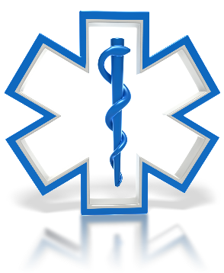
Firefighter Rehab

Slide 2
Information within this presentation was gathered from FEMA, DHS, and NFPA.

Slide 3
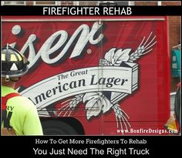

Slide 4
Forgotten Duty
As EMS providers we are prepared for the 90yo with chest pain or the 30yo having an asthma attack.
Are we ready to serve our fellow first responders?
Often times a fire stand by seems like a gravy call. To be able to stand and watch the fire do its thing is fascinating.
We forget the ones fighting the fires need to be watched too.

Slide 5
Objectives
Understand the physiologic threats to Firefighters
Recognize the dangers on a fire scene
Learn how to set up and run a rehab area
Recognize signs and symptoms of distress in Firefighters and treating their issues properly

Slide 6
Firefighter Rehab
Defined as the process of providing rest, rehydration, nourishment, and medical evaluation to those involved in an extended incident in order to help prevent injury or death of a Firefighter.

Slide 7
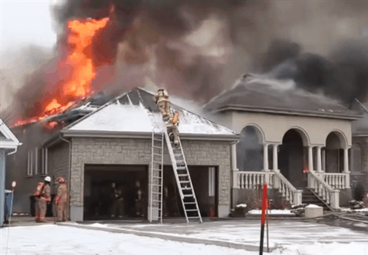
It is HOT STRENUOUS WORK

Slide 8
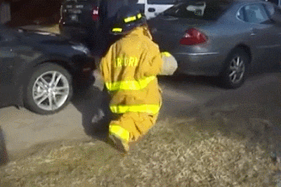
Really…It is HOT STRENUOUS WORK

Slide 9
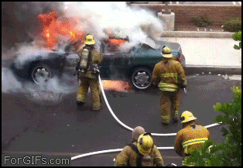
It’s not for the weak!!!

Slide 10
Why Rehab?
Decreases the likelihood of illness or injury
Ensures that physical and mental capacity of the Firefighters is maintained
Creates an atmosphere of accountability to each Firefighter & Medic on scene

Slide 11
DANGERS
Fatigue Dehydration
Strains and Sprains of muscles and joints
Nausea/ Vomiting
Carelessness from mental strain Tunnel vision
Slips, Trips, & Falls Poor decision making
Cardiac stresses Respiratory illness
Hypertension Muscle Cramps
INJURY AND DEATH

Slide 12
Poor decision making may result from exhaustion and stresses of the fire scene. A rehab plan is a must for all fire scenes.

Slide 13
Professional Firefighters are required to be physically fit and ready for action every shift.

Slide 14
Professional Firefighters are required to be physically fit and ready for action every shift.
Volunteer Firefighters typically do not have such requirements nor rigorous training.

Slide 15
Personal Dangers
Overweight/ Obesity
Diabetes
Hypertension
Poorer physical condition
Aged
Smoking
Lack of continuous training
Lack of knowledge of trends in techniques

Slide 16
The added weight of gear can be upwards of 75+ pounds added to the bodies weight = added physical stresses even before the firefighter enters the fire scene.

Slide 17
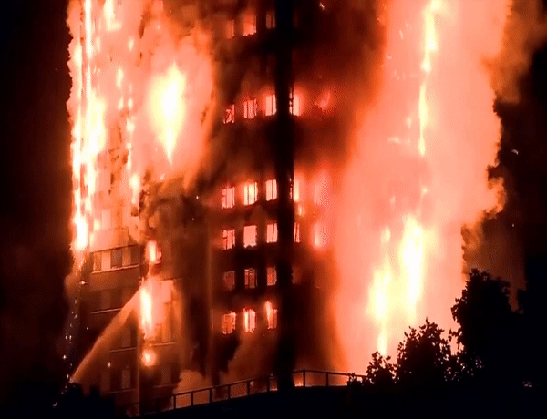
Professional Dangers

Slide 18
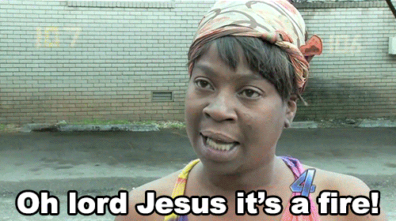

Slide 19
Factors to Consider
Extremely Hot or Cold conditions
Confined spaces
Unknown chemical or hazardous conditions
Rural environments
Lack of city water hydrants
Not enough responders
Responders that are unfamiliar with equipment
Deficiency of needed equipment
Delays in response from mutual aid departments

Slide 20
14%

Slide 21
Sudden Cardiac Arrest and Stroke are approximately 50% of all LODD for Firefighters in the US annually.
Traumatic injury accounts for less than 40% of LODD.

Slide 22
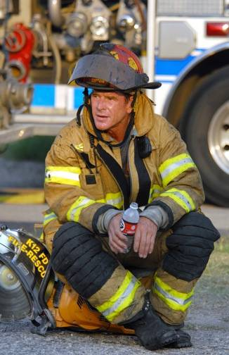
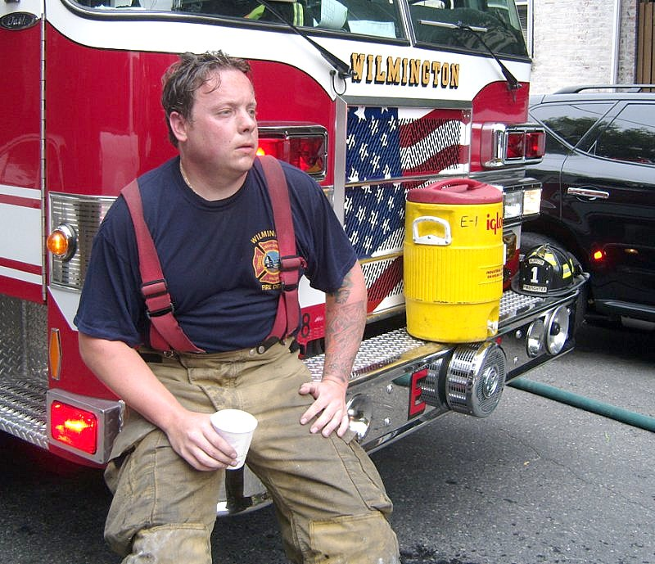

Slide 23
NFPA 1584 Guideline 1
Crew must self rehab for a minimum of 10 minutes after depletion of 30 minute SCBA cylinder or after 20 minutes of intense physical work without SCBA use.

Slide 24
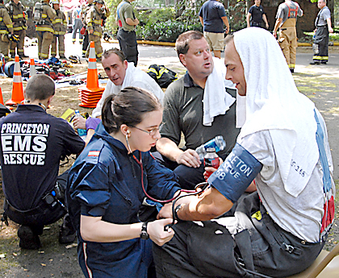
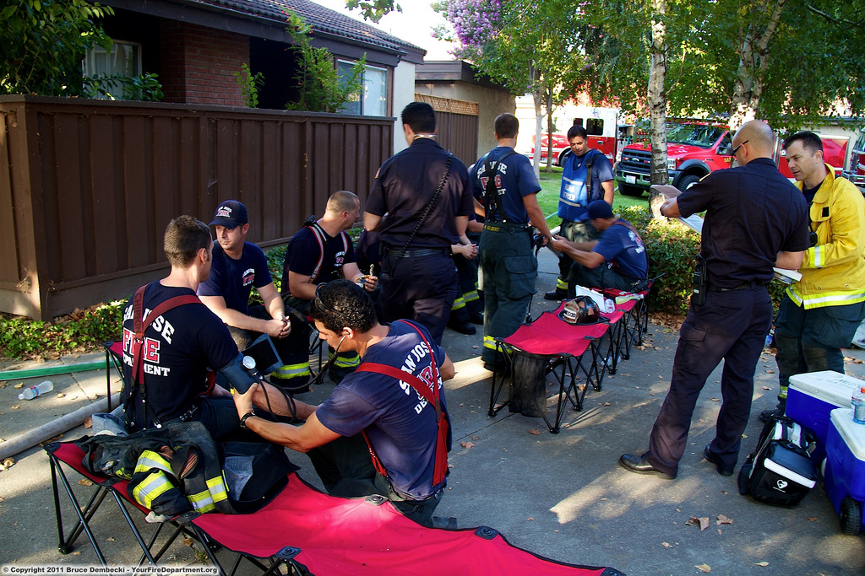
Medical evaluation, rehydration, and rest

Slide 25
NFPA 1584 Guideline 2
Formal 20 minute rehab must take place with medical evaluation after 2nd 30 minute SCBA cylinder or single 45 or 60 minute cylinder is depleted. The Firefighter must also be evaluated medically and rehab for 20 minutes after use of encapsulating chemical protective clothing and/ or following 40 minutes of intense physical work without SCBA.

Slide 26
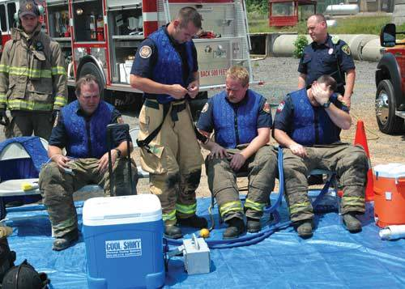
Cooling down to prevent heat exhaustion and heat stroke

Slide 27
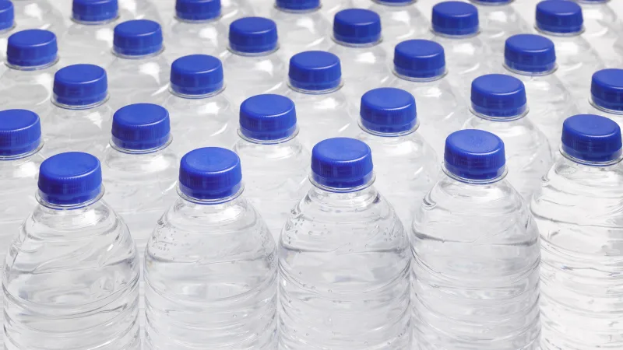
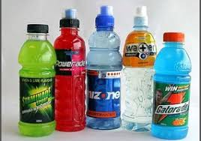
Aggressive use of water, sports drinks, and small bites to eat may prevent firefighters from heat exhaustion, low blood sugar, and overexertion.

Slide 28
Firefighters should consume as much liquids to satisfy their thirst while in rehab, and once the incident is over the firefighter should continue fluids as we typically need more fluids than we think to rehydrate.

Slide 29
Sweating depletes Sodium and exertion depletes Potassium. Both are essential electrolytes in muscle use and brain function.
The average exhausted firefighter can only consume 32oz per hour due to a slowed GI tract from the overheating.

Slide 30
Monitoring rehydration…
Loss of <5% body weight may show mild dehydration.
5%-10% loss may indicate moderate dehydration.
>10% body weight loss indicates severe dehydration.
A 200# firefighter could lose 20# of fluid weight.

Slide 31
With 5% fluid weight loss the capacity to work can be depleted by 30%
Above 5% fluid weight loss the firefighter may begin feeling nauseated, severe fatigue, and body aches.
At 10% the firefighter may exhibit muscle cramping and spasms, vision issues, and altered mental status that can quickly devolve to syncope.

Slide 32
A large amount of energy is exerted during fire scenes. This is measured in calories. Our body stores calories in Fat, Carbohydrates, and Protein. During high stress situations the body primarily uses Carbs. These calories must be replenished while rehabbing so that the body does not begin breaking down essential Proteins.

Slide 33
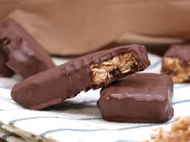
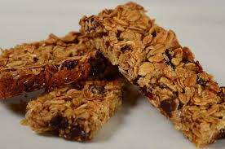
Granola, chocolate covered energy bars, and other small, quick and easy items are great sources of calories and Carbs.

Slide 34
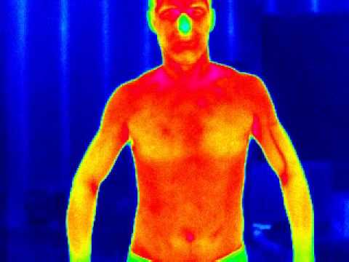
Body Heat

Slide 35
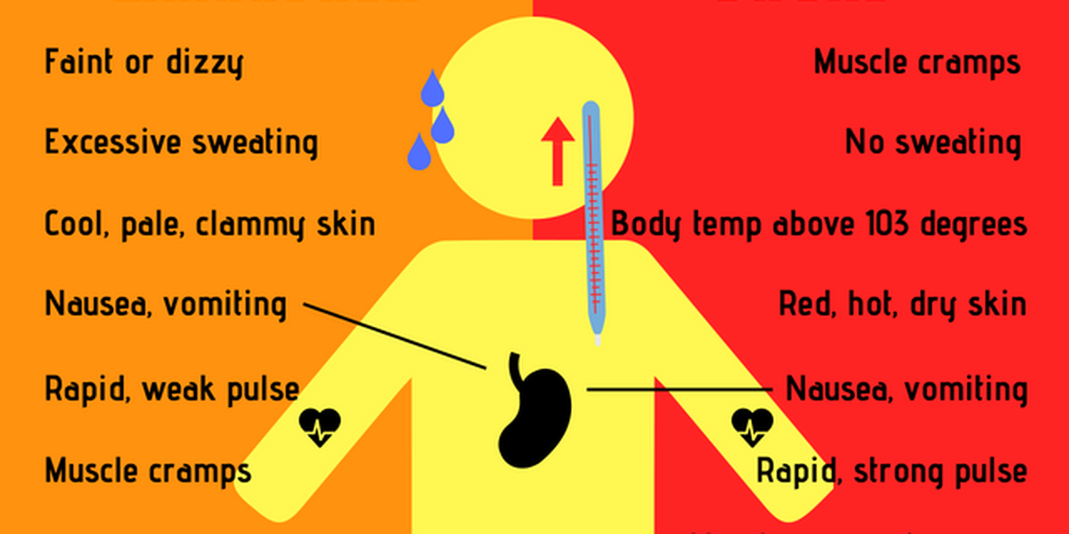
Heat exhaustion vs Heat stroke

Slide 36
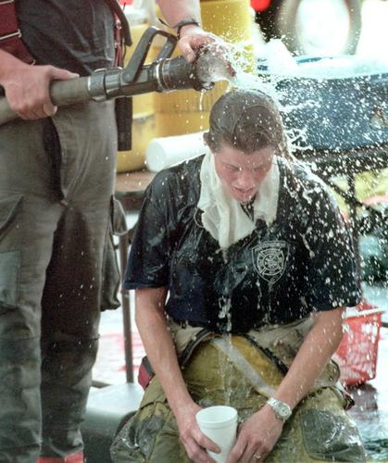
Rapid cooling is essential to prevent overheating.

Slide 37
98.6 degrees…+/- a few degrees is the relatively narrow range that humans must maintain in order to survive. Too hot or too cold creates an environment where the body and brain can not function well. Poor decision making results from poor perfusion to the brain.

Slide 38
The extreme heat of a fire scene and ambient temperatures make it difficult to maintain a consistent body temperature that is acceptable to the body & Brain. Turn out gear and protective equipment also make it difficult to regulate ones temperature.

Slide 39
Ambient air, burning fuels and structures all contribute to outside heat sources but internal sources such as metabolic activity, muscle exertion, anxiety, and even shivering all create inner heat sources that can quickly over heat a firefighter.

Slide 40
How do we cool down?
Increasing respirations to bring heated air out
Shunting blood to the skin to radiate the heat off
Sweating to evaporate heat off

Slide 41
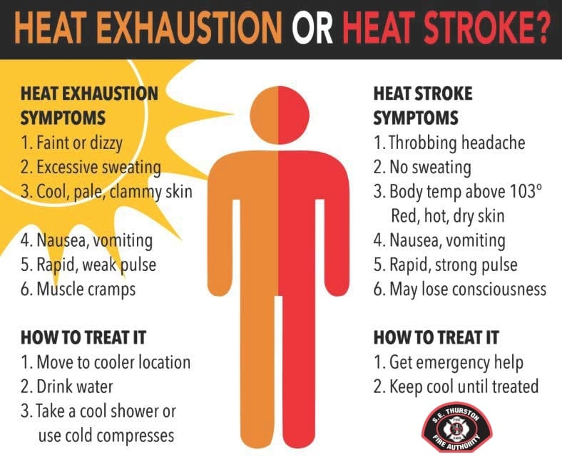

Slide 42
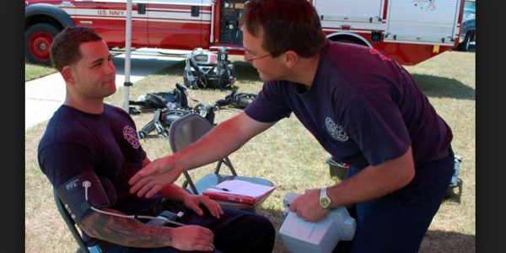
Remove them from the heat of the scene and the heat of the sun

Slide 43
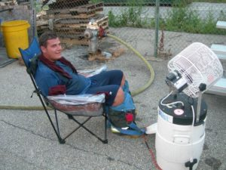
Cooling towels, misting fans, ice water immersion of the arms all will help rapidly cool the firefighter.

Slide 44
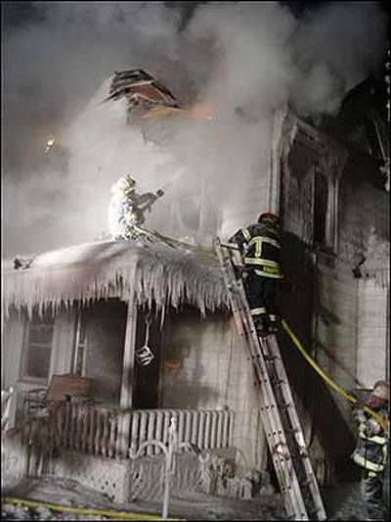
What if it’s cold?

Slide 45
Temperatures below 60 degrees combined with water and stress can create localized and systemic cold injuries such as hypothermia.
Wind and cloud cover increase these factors.

Slide 46
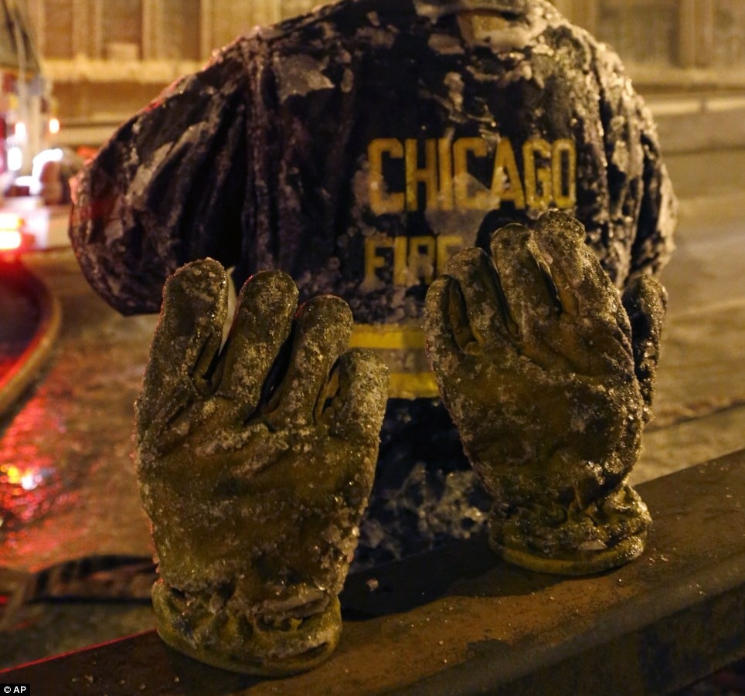
Sweat, snow, ice, and spray freezes to the gear and may not allow the firefighter to keep warm.

Slide 47
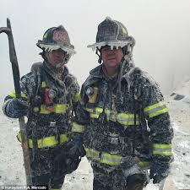
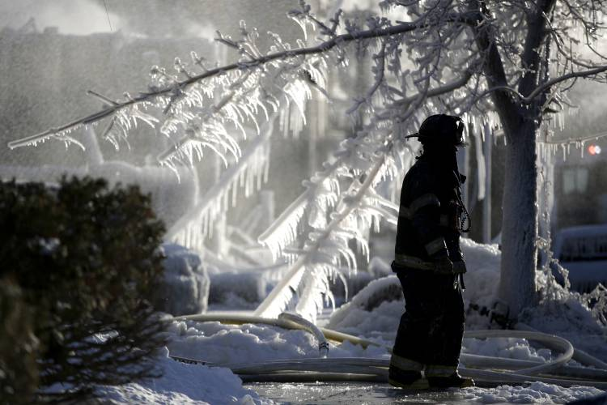

Slide 49
It is essential that the firefighter dry off prior to re entering the fire zone as wet gear or skin can quickly lower their core temperature in wintertime conditions

Slide 50
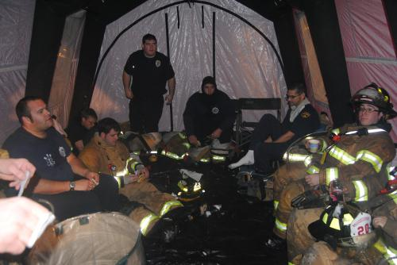
Passive Rewarming
Warming tents where the gear can dry and the firefighter can passively rewarm before re entering the fire zone.

Slide 51
Commercial rehab tents heated or cooled where the firefighter can recover.

Slide 52
Medical Monitoring

Slide 53
It is essential for medical personnel to constantly visually monitor the active firefighters for signs of possible exhaustion.

Slide 54
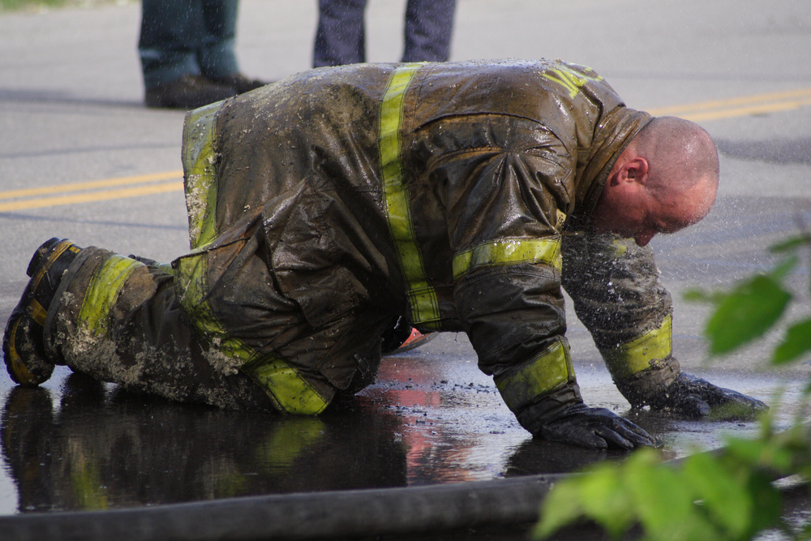
Early recognition of firefighter stress before it becomes a medical emergency is critical

Slide 55
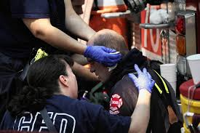
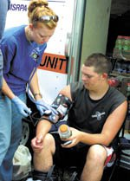
Thorough assessments, vital signs, and quick interventions!!!

Slide 56
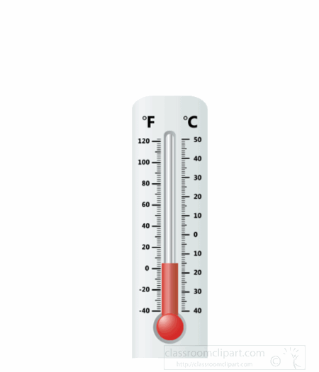
Firefighter core temperature should be acquired as soon as possible and recorded. They should not be allowed to return to the fight until their core temperature returns to normal.

Slide 57
Blood pressure, pulse oximeter, respirations, and capnography should be recorded every 5-15 minutes to monitor trending of interventions. If the interventions do not appear to be working the firefighter should be transported for hospital evaluation.

Slide 58
Acquire a blood glucose reading with the initial vitals and before the firefighter is released back into the fire scene.

Slide 59
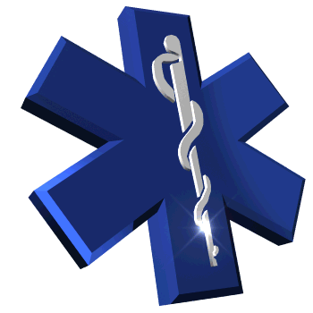
EMS Concerns
Chest Pain
Dizziness
Nausea & Vomiting
Weakness
Headache
Cramping
ALOC/ AMS
Behavioral changes
Unsteady gait
Abnormal vital signs

Slide 60
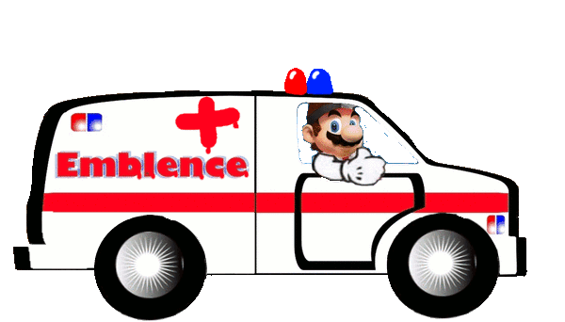
Any transports should be provided by other crews. The stand by crew should remain with the rehab team to continue monitoring the other firefighters.

Slide 61
Thorough documentation of personnel evaluated, vital signs, assessments, and interventions is a must.
Check with your local protocols and SOP’s for reporting and follow up.

Slide 62
After the Call!!!

Slide 63
The heightened awareness of the dangers should not end at the scene.
Cleaning of the hoses and equipment
Maintenance
Cleaning of PPE, Turn out gear, etc…

Slide 64
The chemicals released from combustion of todays construction materials and personal belongings attach themselves to the equipment and gear of the firefighter and can be transferred through the skin and with continued exposure cause cancer and other deadly diseases.

Slide 65
It is important to clean up after the incident.
Face and hands should be cleaned thoroughly.
Decon all masks, shields, helmets, and all other protective equipment.
The soot and build up on these things may contain carcinogens proven to cause cancer.

Slide 66
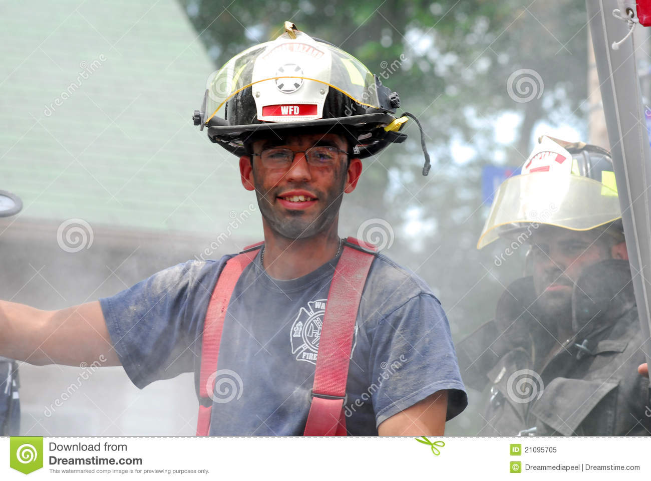

Slide 67
It used to be a badge of honor to get dirty and look like you fought a fire. Street clothes get permeated by carcinogens easier than bunker gear and the firefighter brings that home with them.

Slide 68
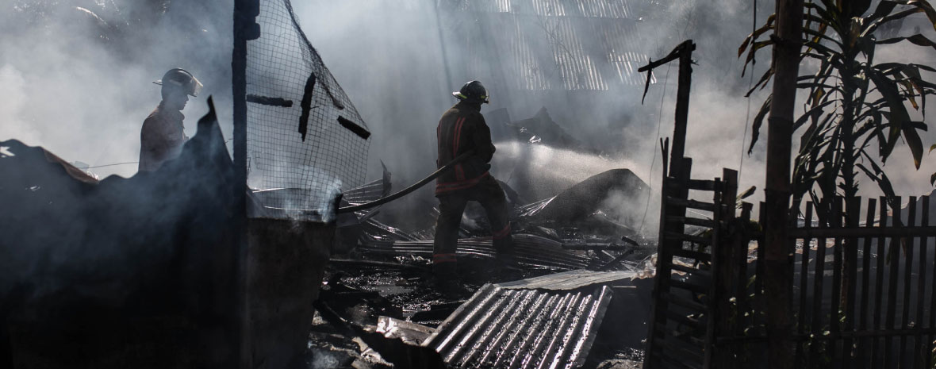

Slide 69
Proper PPE for clean up and rehab procedures, looking for hot spots, and salvage operations.

Slide 70
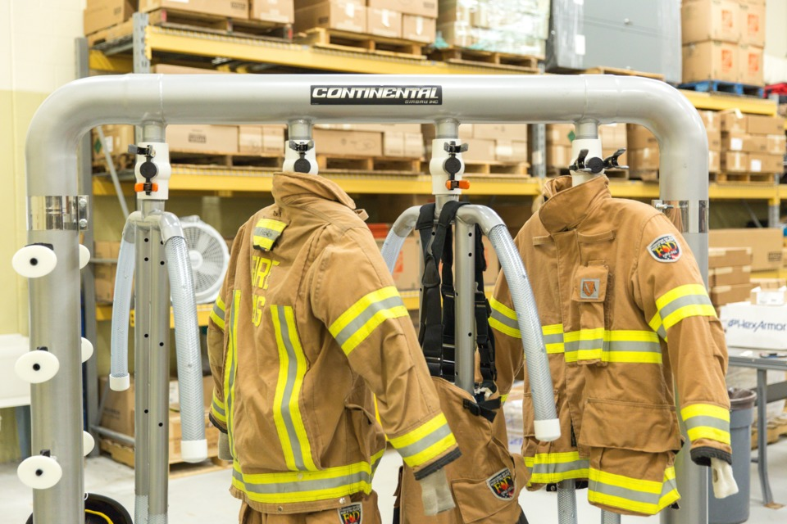
Clean gear is a must. Todays Firefighter should clean and inspect their equipment after each fire.

