Slide 1
Sports Injuries

Slide 2
Objectives
Injury Prevention
Recognition
Treatments

Slide 3
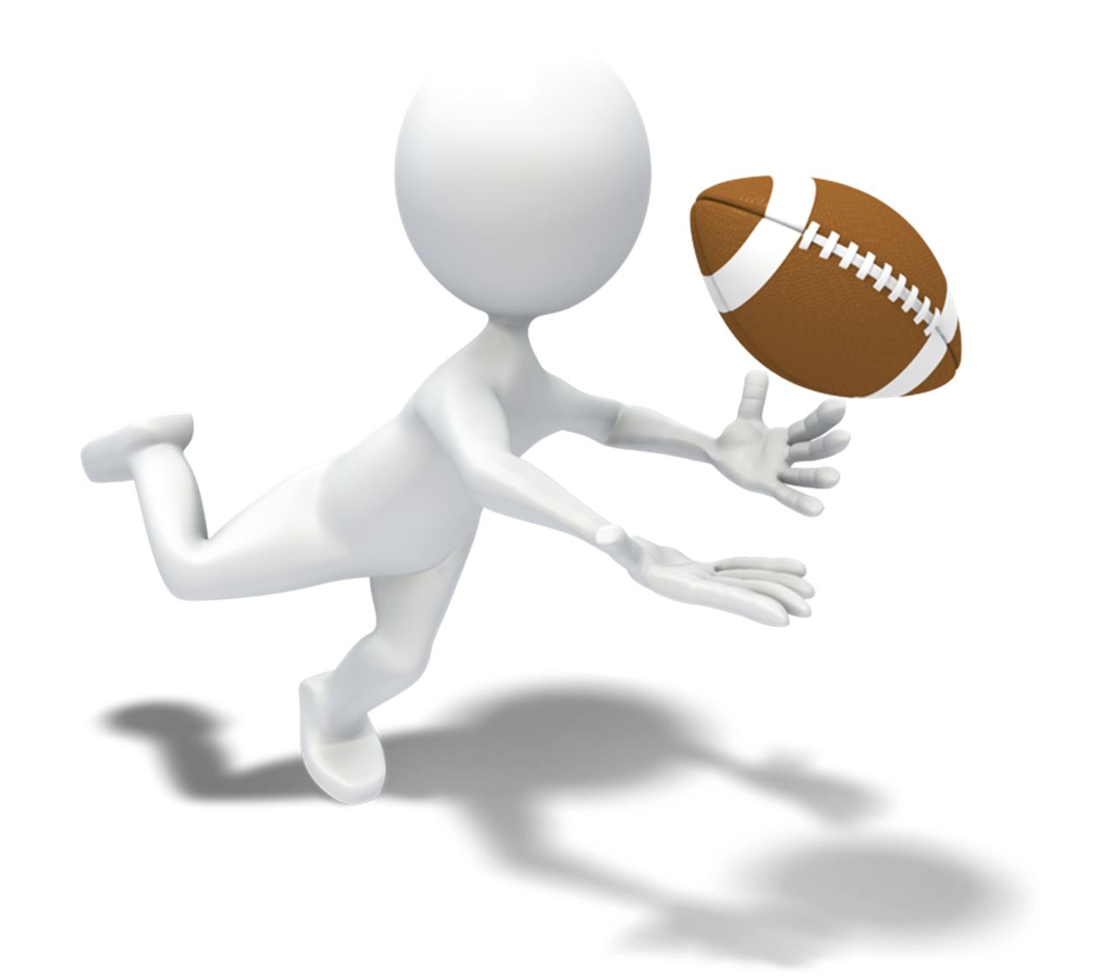
Injury Prevention

Slide 4
NCAA statistics for 2004-2009 show that football players are 7 times more likely to get injured during a game than in practice.
Ligament sprains are the most common injury >30%.
Concussions make up 7 ½% of all injuries.

Slide 5
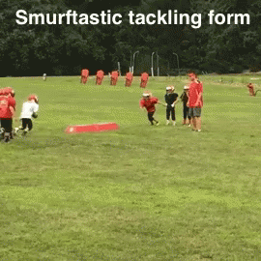

Slide 6
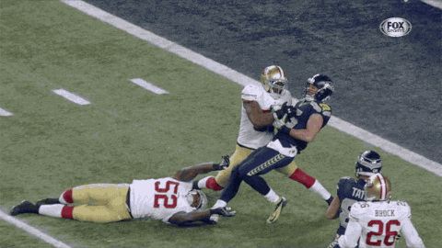
Many injuries can be prevented with proper technique. From running and cutting to tackling and falling.

Slide 7
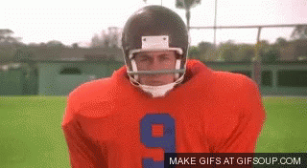
Injuries are a part of Football that can never be 100% eliminated.
Proper conditioning
Correct Stretching
Good Technique
Knowing Ones Limitations
Body Awareness
All play a key role in injury prevention.

Slide 8
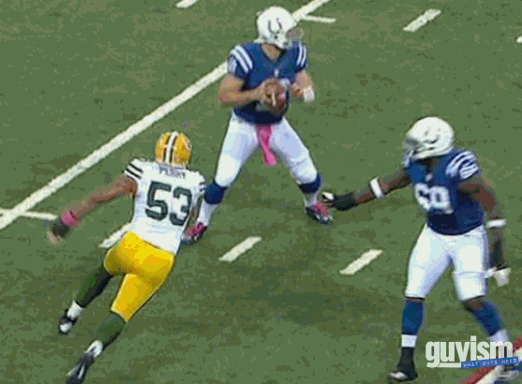

Slide 10
Proper conditioning begins days-weeks-months before the player steps onto the field. Sports medicine has become a billion dollar industry focused upon injury prevention and proper preparation to play the game.

Slide 11
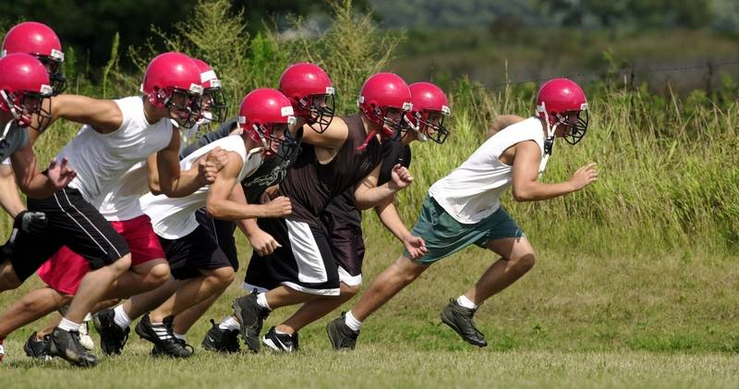

Slide 12
Todays youth coaches have been professionally trained on the methods and types of conditioning necessary to prepare the student athlete for play. Whether NFL, NCAA, IHSA, or JFL-proper conditioning is emphasized to prepare the athlete for competition.

Slide 13
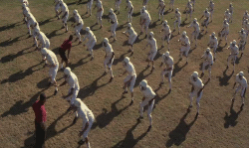
A specific ratio of cardio, strength, and flexibility training may prevent some injuries.
Concentrating on just 1 or 2 of these aspects may increase the vulnerability of the athlete to injury and disability.

Slide 14
Injury prevention begins with pre season conditioning and training months before the coin toss on that first Friday night. The heat of June, July & August comes with its limitations on the student athlete. The IHSA requires that organized training must be supervised, however, many athletes will train on their own.

Slide 15
How can the student athlete prevent injury?
Yearly pre season wellness evaluations.
Proper instruction on conditioning, stretching, and game play techniques.
Properly fitted equipment.
Being honest about pain and injury concerns with coaches and sports medicine officials.
Knowing ones own limitations.

Slide 16
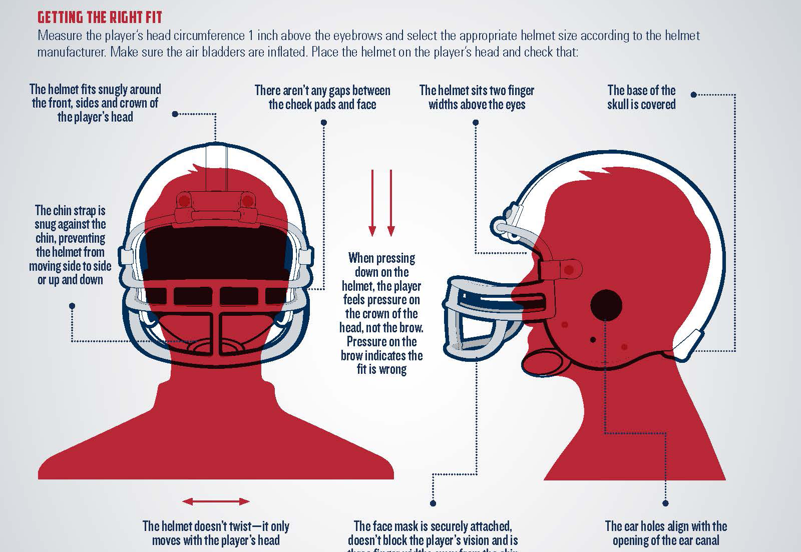

Slide 17
Exposure Injuries

Slide 18
Heat Illness
Heat illness is preventable and all involved should work diligently to educate and recognize the signs and symptoms.
Hydration prior to and during training, training in the early and late days of summer, avoiding over exertion during the heat of the day, and cooling down regularly can prevent heat stress injuries.

Slide 19
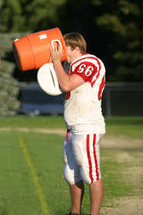

Slide 20
Heat Cramps occur when the body looses excessive amounts of water and salt. Salt is a key component of muscle use and loss of salt can make the muscles cramp. Typically the large muscles are the most effected. Quads, Glutes, Back, Triceps, and Abdominal muscles are the most effected.

Slide 21
Heat Exhaustion occurs when the body and brain begin to become weak from stresses of heat exposure. The body is actively trying to cool itself by sweating and other physical efforts. The patient may be altered and weak with fast heart rate. Dehydration is a real concern. Nausea, vomiting, cool moist skin, and fast respirations are some of the common signs.

Slide 22
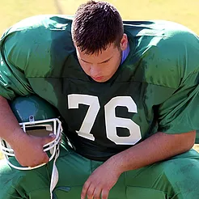

Slide 23
Heat Stroke is where the body can no longer cool itself. The patient core temperature climbs to levels above 104F. Sweating ceases and the patient may lose consciousness. They will be Red, Hot, and Dry. They need actively cooled and lost fluids need replaced ASAP.

Slide 24
Cold Exposure
Late in the season the temperatures drop and cold exposure can become a major concern. Most cold issues are localized to exposed skin of the extremities and face. These athletes are usually able to maintain core temperatures due to their conditioning and activity, but learn to recognize the signs and symptoms of hypothermia.

Slide 25
Cautions with cold exposure
Never actively rewarm cold extremities as this can cause very cold blood to return to the heart.
Never rub the extremity as ice crystals can damage skin cells.
Remove the patient from the cold and passively rewarm them slowly.

Slide 26
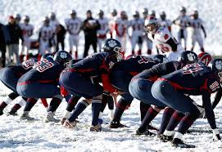

Slide 27
Other Injury Types

Slide 28
Traumatic Injuries
Traumatic injuries are by far the most common injuries in any sport. Knee, shoulder, & ankle injuries top the list for football related traumatic injuries. Concussions get all of the headlines, however, and repeated trauma to the head is extremely dangerous.

Slide 29
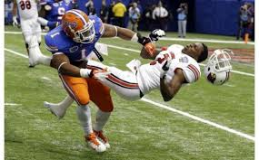

Slide 30
Overuse Injuries
Overuse injuries such as low back pain and knee pain is a very common complaint in football players due to overuse of muscle groups. Overtraining syndrome is where an athlete trains beyond his or her ability to recover easily. Proper rest, diet, and rehydration each day is critical to preventing overtraining injuries.

Slide 31
Statistics

Slide 32
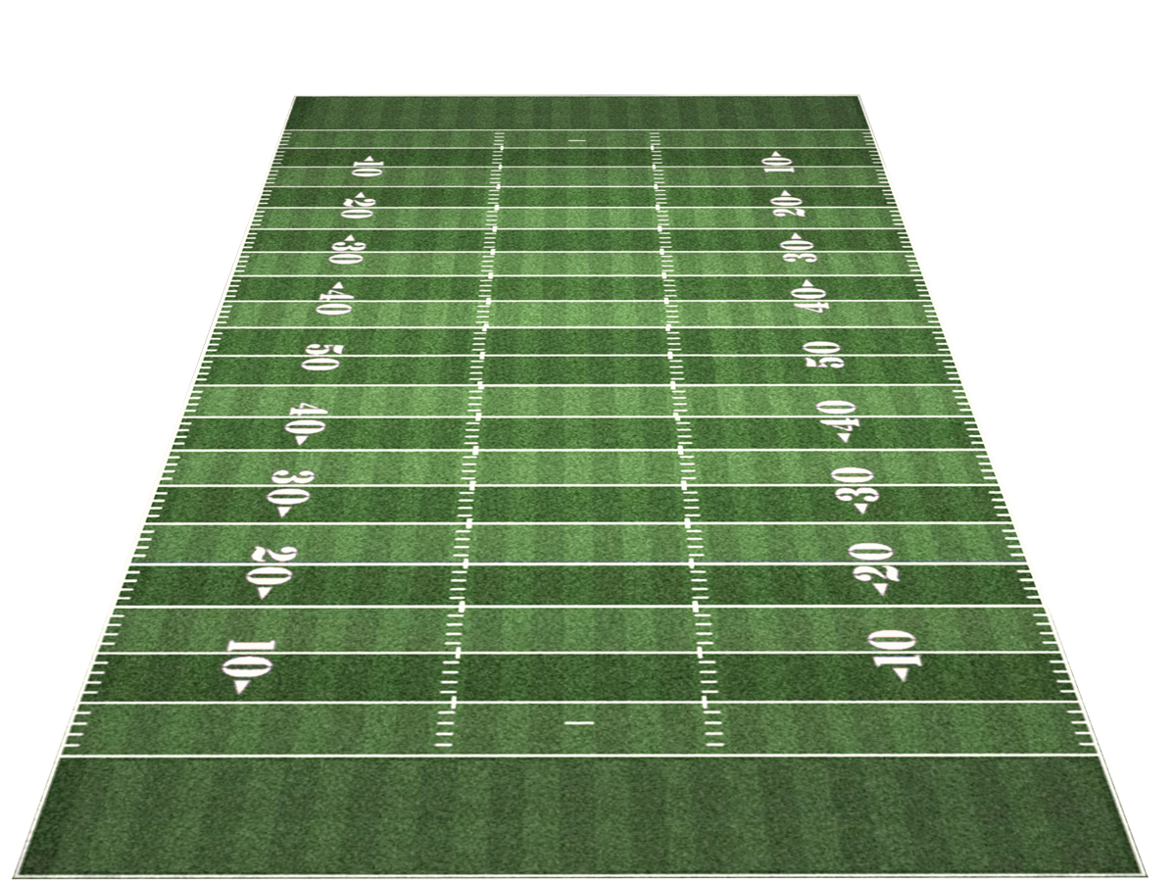
Touch Down!
Lower Limb 50%
Upper Limb 17%
Torso/ Pelvis 12%
Concussions 7.4%
Head, Neck, Face 4.3%
Injury Breakdown

Slide 33
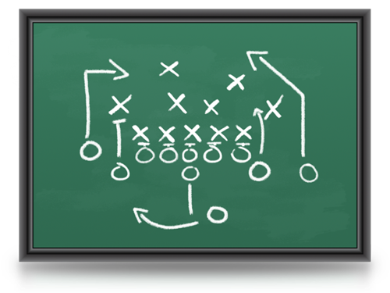
Ironically non contact incidents of injury are the most common acute injury in football. The playing surface and footwear play a large role in injury prevention.

Slide 34
Concussion

Slide 35
Concussion
Concussion is a type of brain injury. Concussions may or may not be the result of a direct blow to the head. A concussion is a change in mental state due a traumatic impact.

Slide 36
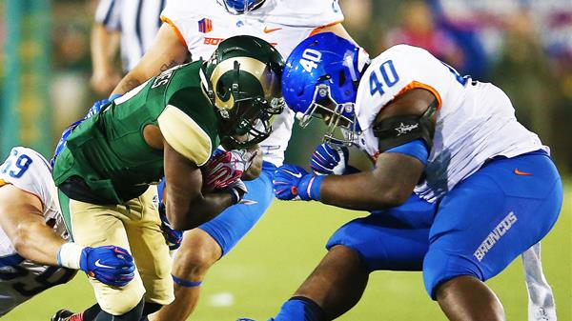

Slide 37
Concussion and injury to the brain has become more publicized over the last few years but actually accounts for a small percentage of injuries in football. <8% of injuries are concussions.

Slide 38
Improved tackling techniques, deemphasizing leading with the head, and early recognition of head injury symptoms have led to improved outcomes of student athletes.

Slide 39
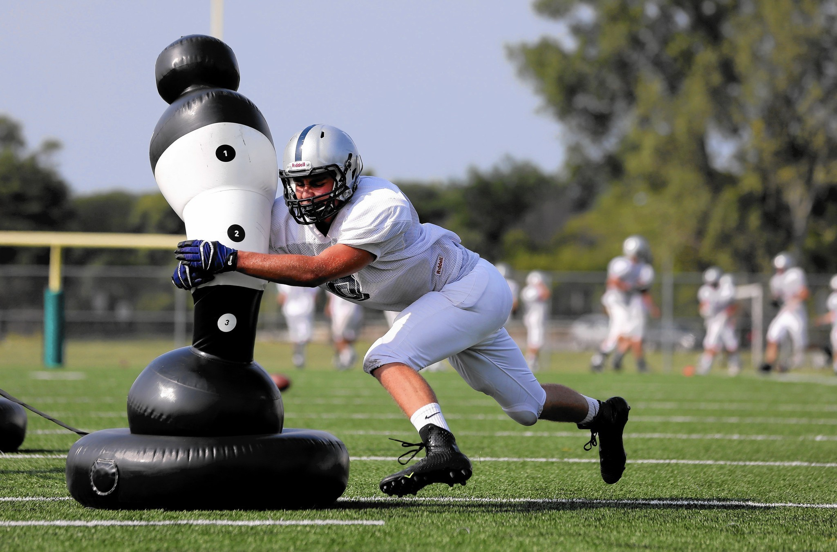

Slide 40
Signs and Symptoms of Head Injuries
Headache Unilateral Weakness
Dizziness Blurred Vision
Nausea ALOC
Lack of Coordination AMS
Anger/ Combativeness Confusion
Inability to Concentrate

Slide 41
Concussions can occur with direct blow to the head or indirect where the head is thrust in opposite directions.
Concussions may or may not have obvious signs or symptoms initially.
Early recognition of the S/S is crucial in preventing further injury and death.

Slide 42
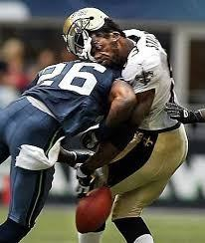

Slide 43
Concussion protocols require time to recover before reentry into practice or game play.
A common incident is SIS or Second Impact Syndrome. This is a repeated injury to brain tissue before the initial injury has healed. Players and coaches who do not recognize or fail to alert medical staff of potential brain injury expose the player to repeated injury which often can be fatal.
95% of SIS occurs in players <18yo.

Slide 44
Joint Injuries

Slide 45
Joint injuries are the most common of all sports injuries. Knee, ankle, and shoulder injuries top the list. Sprains and strains are most common joint injuries and are typically treated with RICE...

Slide 46
Rest
Ice
Compression
Elevation

Slide 47
The knee joint is the most exposed joint to injury during contact.
3 bones come together to form the knee joint (Femur, Tibia, & Patella).
4 ligaments hold the knee joint steady.
Tendons hold the many strong muscles to the joint.

Slide 48
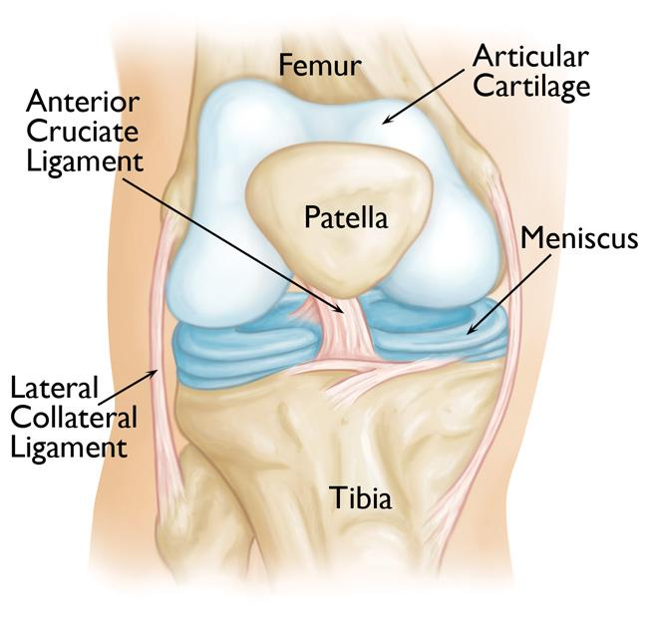

Slide 49
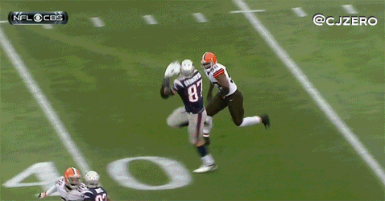
Sudden stops and directional cuts place the knee joint at risk for ligament and tendon damage. Side impact and frontal impact are the most damaging forces to the knee joint.

Slide 50
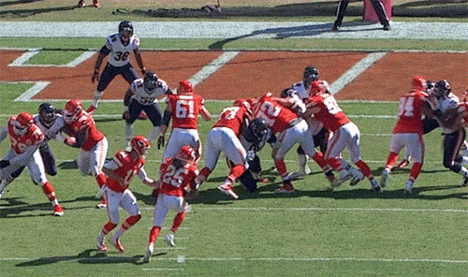

Slide 51
The ankle joint, as with the knee, is placed under tremendous stresses when movement stops and the athlete quickly moves in another direction. The playing surface, conditions, and footwear play a pivotal role in ankle injuries.

Slide 52
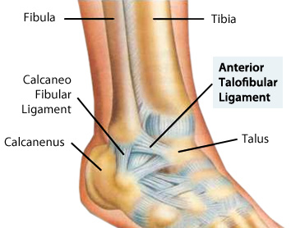

Slide 53
Multiple small bones with interwoven ligaments allows for incredible movement of the ankle joint under tremendous stresses. This also gives way to multiple areas of injury to the joint.

Slide 54
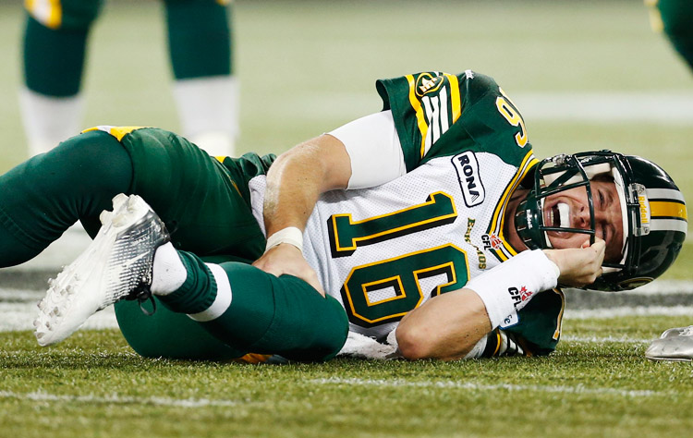

Slide 55
The shoulder joint houses the strongest and weakest bones in one package. The Scapula and Humerus attach at the Clavicle with multiple ligaments. Landing directly on the shoulder puts tremendous stresses on the joint.

Slide 56
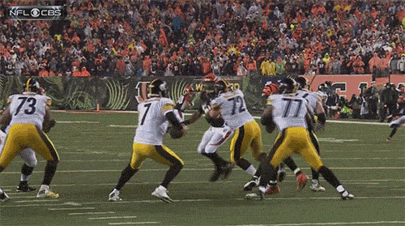

Slide 57
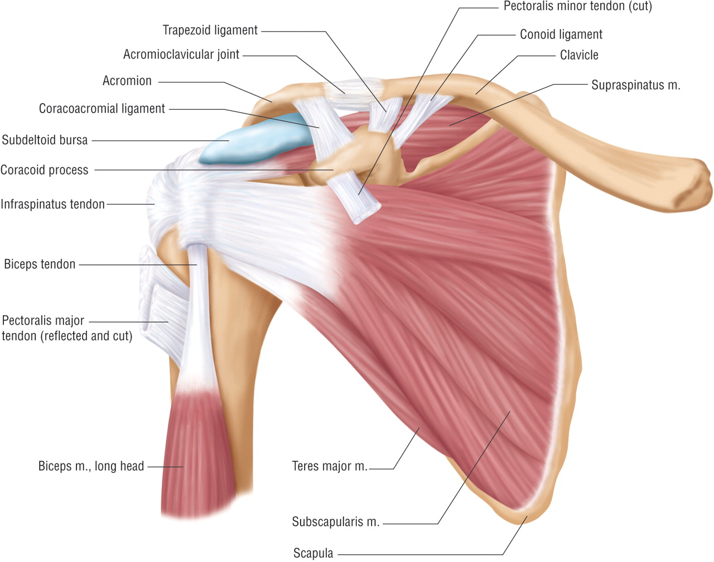

Slide 58
The Clavicle being one of our weakest bones is easily fractured when forces of impact bring the athlete down directly on the shoulder joint. Other injuries are dislocation to the joint and tears to the ligaments or tendons.

Slide 59
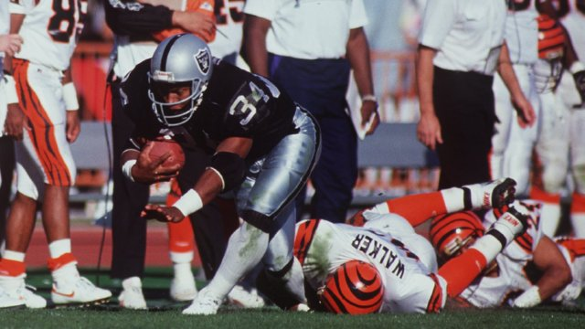

Slide 60
The hip and Pelvis are less likely to get injured in well conditioned athletes but the joint is exposed and vulnerable to heavy impact and rotational forces.

Slide 61
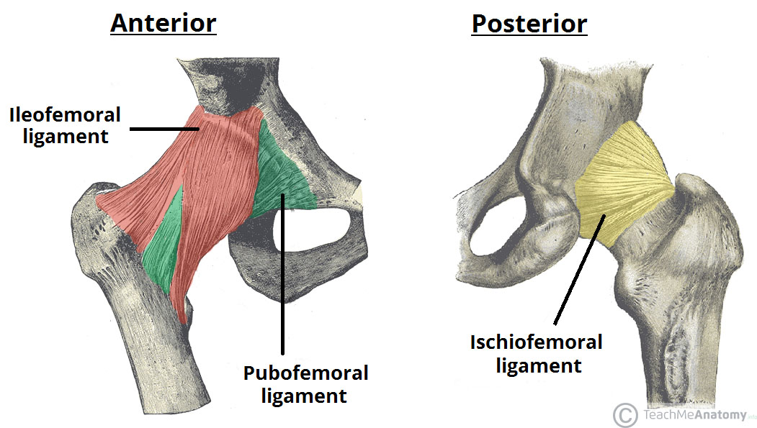

Slide 62
The wrist joint, as with the ankle, has multiple bones with interwoven ligaments.
The attachment of the Radius, Ulna, & Carpal bones is a strong but vulnerable joint.
The athletes subconscious reaction is to put the hands out to absorb impact with other objects. This leaves the wrist, hand, and fingers exposed to injury.

Slide 63
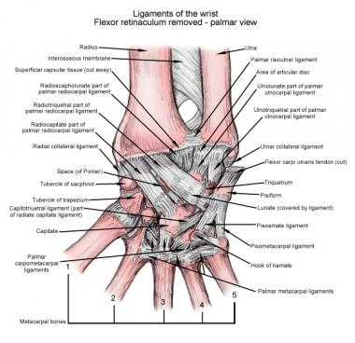

Slide 64
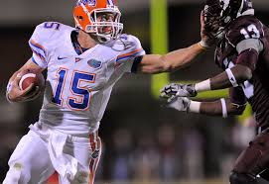

Slide 65
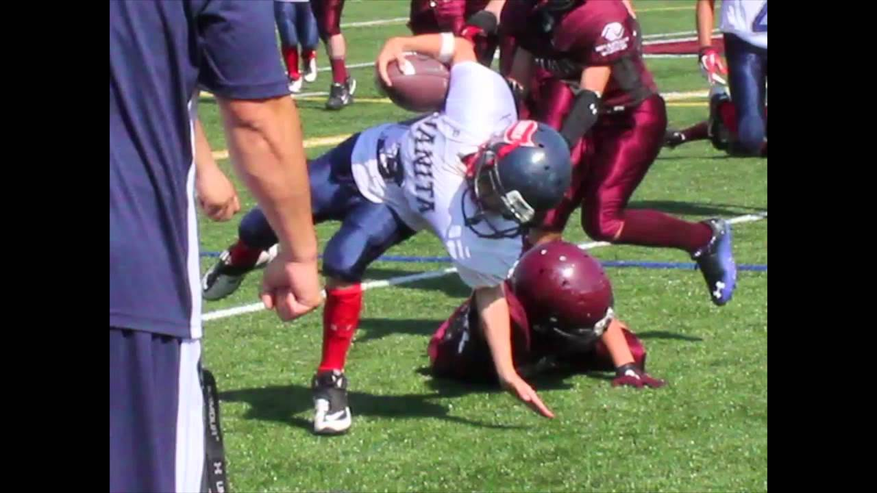

Slide 66
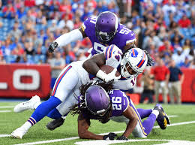

Slide 67
The Cervical Spine is one of the most vulnerable joints with multiple avenues of movement. The neck muscles are very strong and the joints are well cushioned. However, strong downward forces and hyperflexion or hyperextension can injure the Cervical Spine.

Slide 68
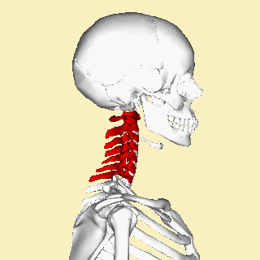

Slide 69
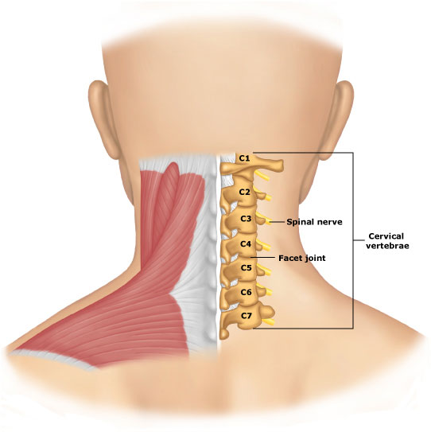

Slide 70
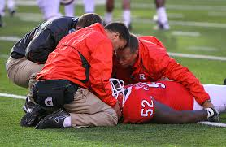

Slide 71
Performing a thorough neurologic exam when spinal injuries are suspected is critical to understand the extent of the injury and treatments needed.

Slide 72
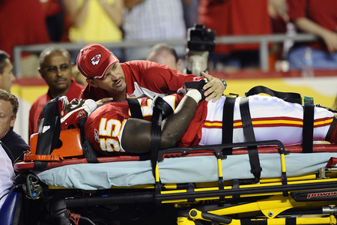

Slide 73
Miscellaneous

Slide 74
Respiratory distress is common in athletics. Heat, cold, physical activity, contact, and other stresses can exacerbate a respiratory emergency. Apply O2 ASAP and then perform a thorough assessment.

Slide 75
As with any outdoor activity lightening can be an issue. Remember lightening is an electrical discharge that can effect the Cardiovascular system. The heart can be sent into a dysrhythmia that can be fatal. Hundreds of thousands of volts from a lightening strike do not necessarily need to directly strike a person to cause injury.

Slide 76
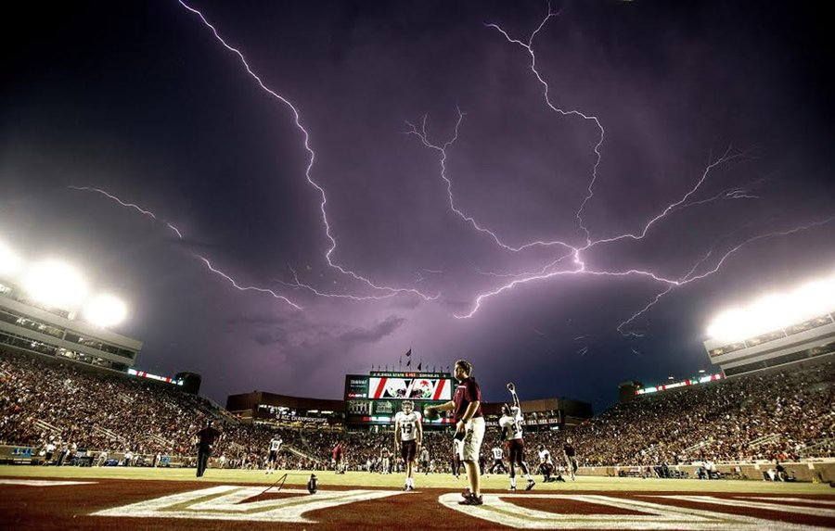

Slide 77
Treatments

Slide 78
When called upon to perform treatments for injuries in any sporting event the EMT should use good judgement as to the severity of the injury and returning to the game.
IHSA does not require that a staffed ambulance be on site for football games but does require trained personnel be present to render first aid.
Be Prepared!!!

Slide 79
In the event of a student athlete wishing to return to participation in the game…Enlist the opinions of the parents, coaches, and school officials. The student athletes welfare is the top priority. A 16-17yo does not always think of the consequences of injury vs pain.

Slide 80
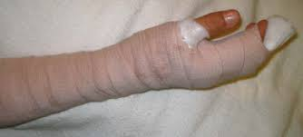
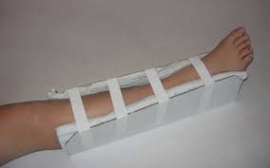
Simple splinting of joint injuries and fractures does not differ with sports injuries vs MVA’s or nursing home falls. The EMT must understand the MOI and the necessary treatments.

Slide 81
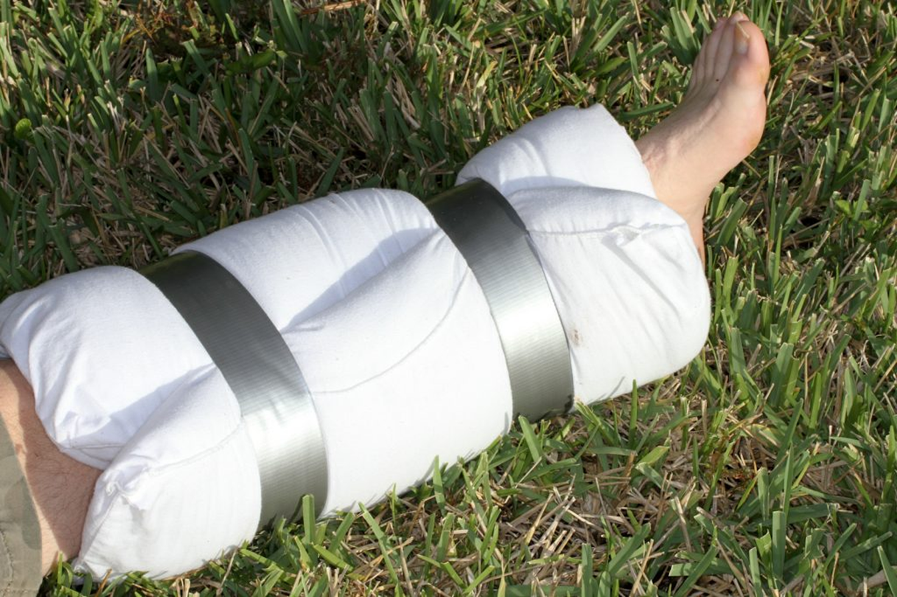

Slide 82
So much of traumatic injury splinting and treatments in the field is improvised and primitive. Remember to check PMS prior to and post splinting.
Splinting is a good method of pain control as well as preserving injured bones and tissues.

Slide 83
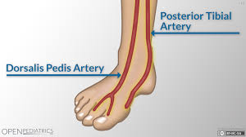

Slide 84
Video

Slide 85
Questions????????
We are here for you!!!

