Slide 1


Slide 2
You will learn how to
Write a research paper
Identify a research article
Differentiate between a research article and lit review
Know the differences between research categories and data collection methods
Define elements involved in a research study design
Determine what is Evidence Based Practice
Formulate a PICO Question

Slide 3


Slide 4
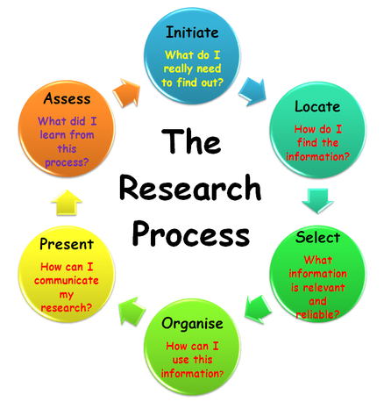
Steps in Research Process
New Mexico State University

Slide 5
Writing a Research Paper
1. Identify and develop your topic
2. Do a preliminary search for print and online resources, bibliographical information: author, title, date, page numbers
3. State your thesis statement, develop supporting argument and main
concepts
4. Develop a tentative outline: Introduction, Body and Conclusion
5. Evaluate and cite your sources
6. Make and organize your notes, verify information is factual and up-to-date, communicate thoughts and ideas, take out irrelevant information, document quotes and group notes in outline form
7. Write first draft, revise and proofread

Slide 6
Identify a Research Article
Abstract: brief summary of the article
Introduction: identifies the topics
Methods: describes how the research was conducted
Results; summarizes the data
Discussion: states conclusions and looks at practical implications
References: lists biographical sources

Slide 7
Abstract: Questions to Ask
Does the first sentence contain a statement of purpose?
Is the test population described?
Does it conclude with a statement of the experiment’s conclusions?
Why is this research important?

Slide 8
Introduction: Questions to Ask
What is the issue’s importance?
What is the main point?
Does it state the purpose of what is to follow?
What is the research question and hypothesis?

Slide 9
Methods: Questions to Ask
Is the test population stated?
Is it appropriate for the experiment?
Is the control population stated?
Are the variables controlled?
What is the study design, sample setting and procedure analysis?

Slide 10
Results: Questions to Ask
Are the experimental design results provided?
Is there supporting statistical analysis, charts and graphs?
Are the results appropriate for the situation?
Are the findings detailed enough to justify the conclusions?
Are the findings sequential with no bias or interpretation?
Do the results confirm or reject the hypothesis?

Slide 11
Discussion: Questions to Ask
Are the results discussed?
Are the conclusions based on sufficient data?
Are previous studies integrated into the discussion?
What does the statistical validity of the study imply?
How the data fit the original hypothesis?

Slide 12
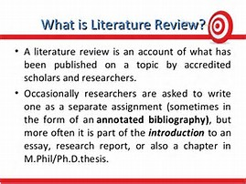
University of Wisconsin Madison Writing Center

Slide 13
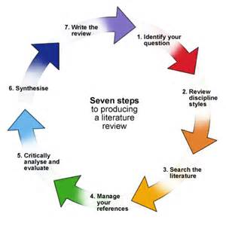
Steps to Producing a Literature Review
University of Sheffield

Slide 14
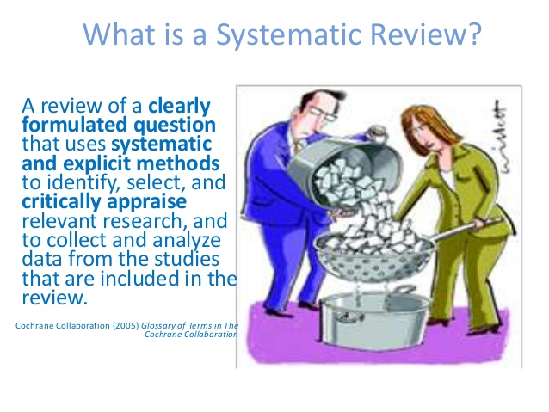
Cochrane Consumer Network

Slide 15
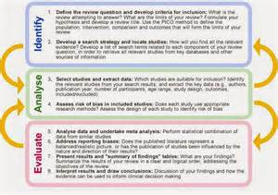
Systematic Review Process
Duke University Medical Center

Slide 16
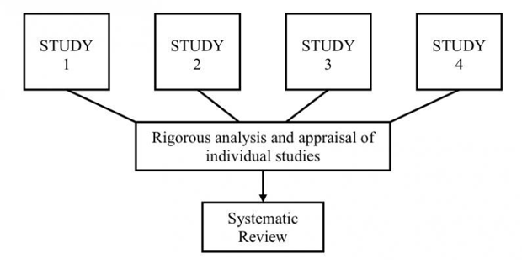
Systematic Review

Slide 17
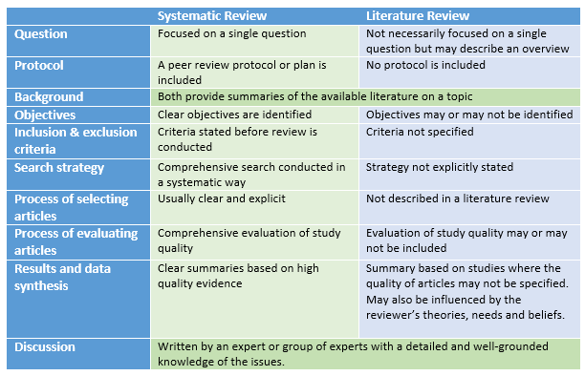
Comparison of Literature and Systematic Review
Lynn Kysh, San Jose State University

Slide 18
Integrative and Narrative Reviews
Integrative Review: A systematic review that does not have a summary statistic because sample sizes cannot be summarized in an integrative review (usually due to heterogeneous studies/samples).
Narrative Review: A review that includes published papers that support an author’s particular point of view: Serves as a general background discussion of a particular issue. How papers are found is not systematic.

Slide 19
Metadata Analysis
Meta-analysis is a systematic, objective way to combine data from studies, and arrive an estimate of treatment effectiveness and statistical significance
Combines data from case control and cohort studies
Advantages: increases sample size and allows for analysis not possible otherwise
Disadvantages: publication bias and quality of design lead to misleading results

Slide 20
Research Design and Data Collection
Research Design: plan for collecting research
Exploratory Research: define new problems or question, concept testing
Constructive Research: research based upon theories, hypotheses and case studies, used to test theories
Empirical Research : prove the theory with both direct and indirect forms of observation and analysis.
Data Collection: select after Research Design method is chosen

Slide 21
Data Collection Methods
1. Primary: critically analyze to find answers to research questions
A. Qualitative: interviews, focus groups, observation, case studies, and
games
B. Quantitative: correlation and regression
2. Secondary: data previously published in journals

Slide 22
Exploratory Study Design Questions
What do we already know about the topic?
What interventions have been successful with whom and under what circumstances?
Review existing data or information: What are their characteristics, resources and limitations? Includes demographic, educational

Slide 23
Study Design Concepts
Descriptive: observation without affecting behavior, disadvantage can be unreliable and not repeatable
A. Case reports/case series
B. Cohort studies
Evaluative: Randomized controlled clinical trials

Slide 24
Selecting a Design
Which design will provide me with the information I want?
How feasible is each option?
How valid and reliable do my findings need to be?
Are there any ethical concerns relating to choosing a specific design?

Slide 25
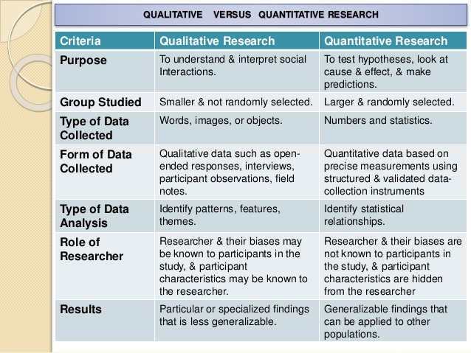
Xavier University

Slide 26
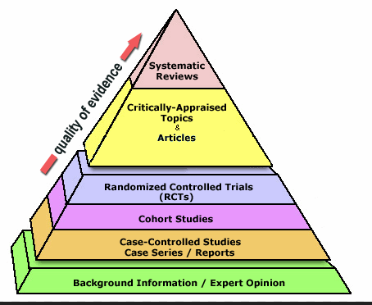
Levels of Evidence
Walden University

Slide 27
Case Series and Case Reports
Case reports: detailed description of a single case
Case series: descriptions of groups of patients with a disease
Used to illustrate an aspect of a condition, the treatment or adverse reaction to treatment
Easy to understand and can be written up in short period of time
Have no control group so they have no statistical validity

Slide 28
Case Control Studies
  In a case-control study, patients are entered into the study based on the presence or absence of the outcome (or disease) of interest. These two groups (i.e., those with the disease and those without the disease) are then compared to determine if they differ with regard to their presence of risk factors of interest. Case-Control studies are always retrospective.
www.slackbooks.com/excerpts/16771/16771.asp

Slide 29
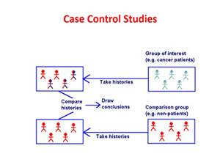
Case Control Study Design

Slide 30
Cohort Studies
  Longitudinal studies with a case defined population who have exposure and/or receive a particular treatment that is followed over time and compared with another group
  Used to establish causation of a disease of a diseases or to evaluate the outcome /impact of treatment
  Not as reliable as randomized controlled studies
  Requires a large sample size, can take no long periods of time and are inefficient for rare outcomes

Slide 31
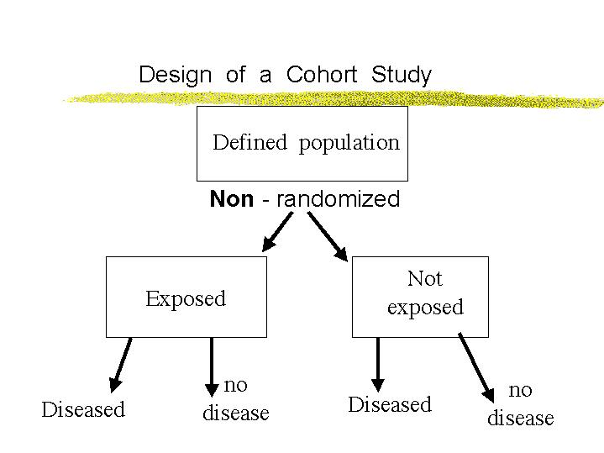
www.ttuhsc.edu/som/FamMed/lectures/epi4/sld004.htm

Slide 32
Randomized Clinical Trials
  A study in which there are two groups: treatment and control group. The treatment group receives the treatment and the control group receives either no treatment (placebo) or standard treatment. Patients are randomly assigned. Also called controlled clinical trials
  Considered the gold standard in research, best answer the question about effectiveness of different therapies and interventions
  May be double blind where neither the researcher or subject is aware of being in the study

Slide 33
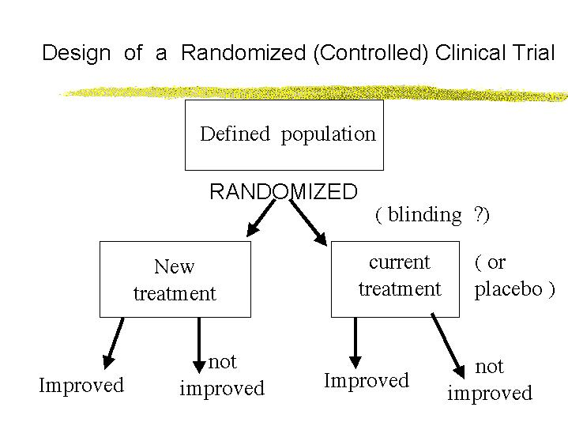
http://www.ttuhsc.edu/som/FamMed/lectures/epi4/sld016.htm

Slide 34
Double Blind Study
A double-blind study is one in which neither the participants nor the experimenters know who is receiving a particular treatment. This procedure is utilized to prevent bias in research results. Double-blind studies are particularly useful for preventing bias due to demand characteristics or the placebo effect

Slide 35
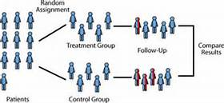
Double Bind Study

Slide 36
Type of Question | Suggested Study Type
Therapy | RCT > case control > case series
Diagnosis | Prospective, blind comparison to a gold standard
Etiology/Harm | RCT > cohort > case control > case series
Prognosis | Cohort study >case control > case series
Prevention | RCT > cohort > case control > case series
Clinical Exam | Prospective, blind comparison to a gold standard
Cost | Economic analysis

Slide 37
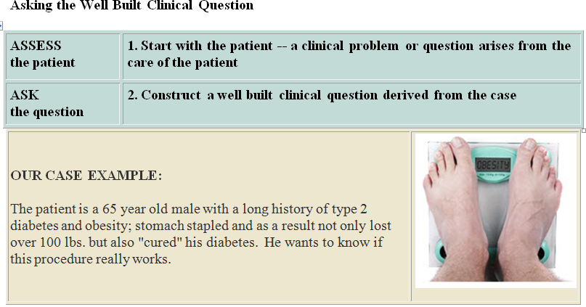

Slide 38
PICO: Components of an answerable question
Patient population/disease | The patient population or disease of interest: Age Gender Ethnicity With certain disorder (e.g., hepatitis)
Intervention | The intervention or range of interventions of interest: Exposure to disease Prognosis factor A Risk behavior (e.g., smoking)
Comparison | What you want to compare the intervention against: No disease Placebo factor B Absence of risk factor (e.g., non-smoking)
Outcome | Outcome of interest: Risk of disease Accuracy of diagnosis Rate of occurrence of adverse outcome (e.g., death)
Nollan, R., Fineout-Overholt, E., & Stephenson, P. (2005). Asking compelling clinical questions. In B.M. Melnyk, & E. Fineout-Overholt (Eds.),
Evidence-based practice in nursing & healthcare (pp. 25-37). Philadelphia: Lippincott Wilkins & Williams

Slide 39
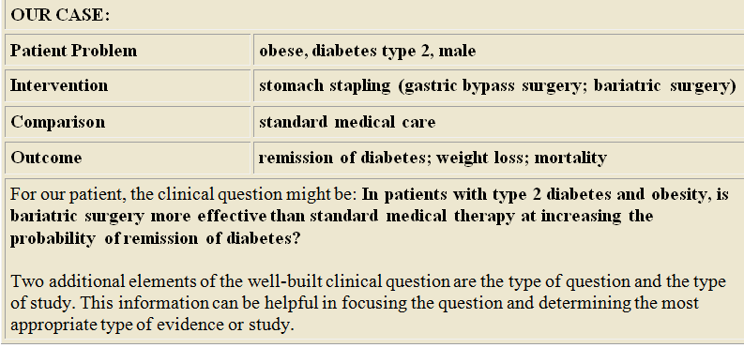

Slide 40
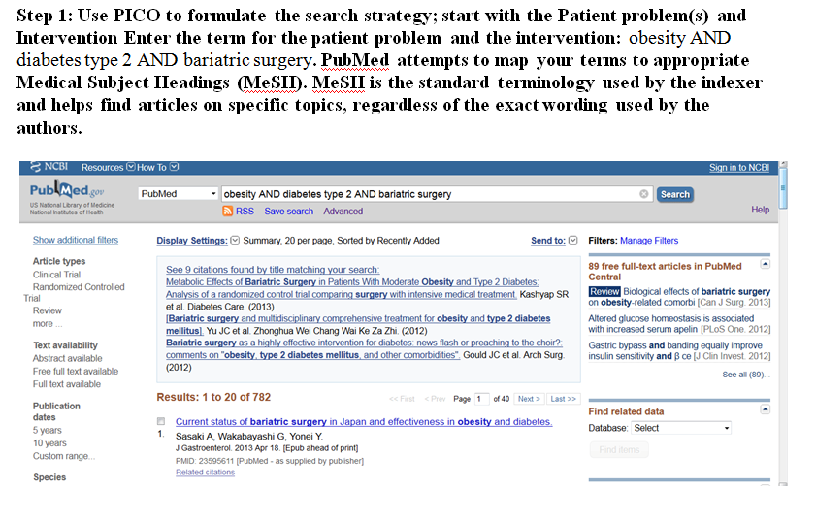

Slide 41
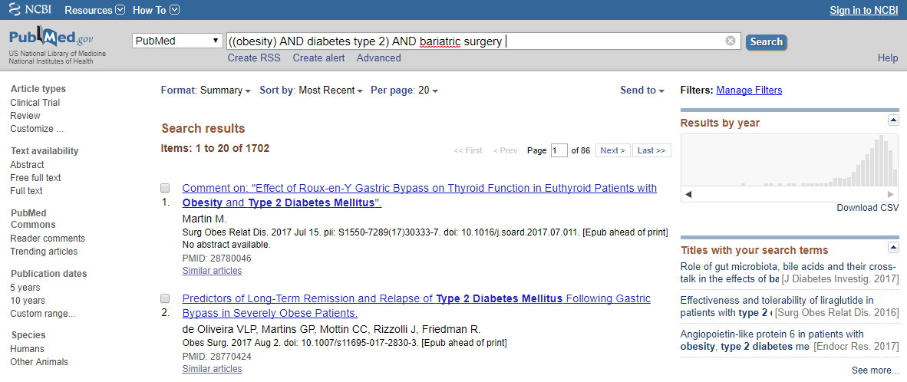
Step 1: Use PICO to formulate the search strategy : start with the Patient problem and
Intervention. Enter the term for the patient population and the Intervention: obesity AND
diabetes type 2 AND bariatric surgery PubMed attempts to map your term to the appropriate Medical Subject Headings. MeSH is the standard terminology used by the indexer and helps find the articles regardless of exact words used by the author.

Slide 42
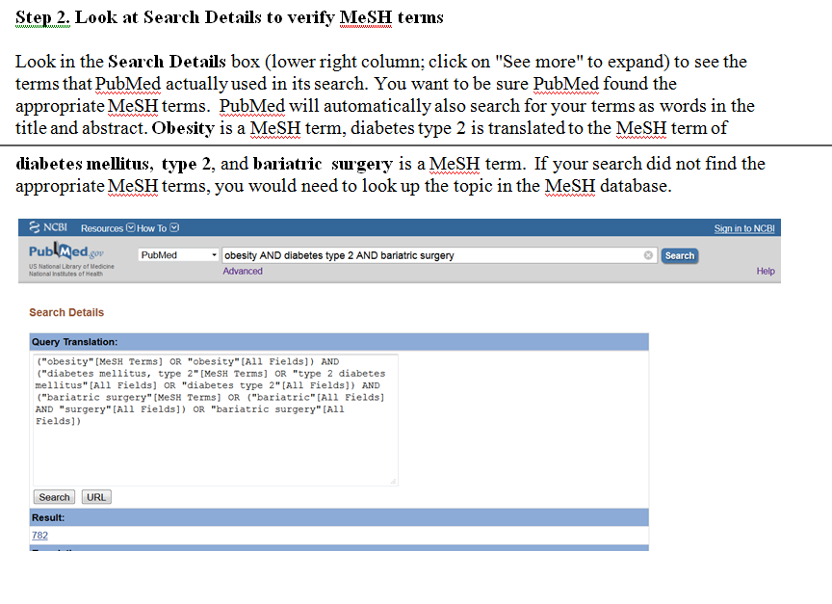

Slide 43
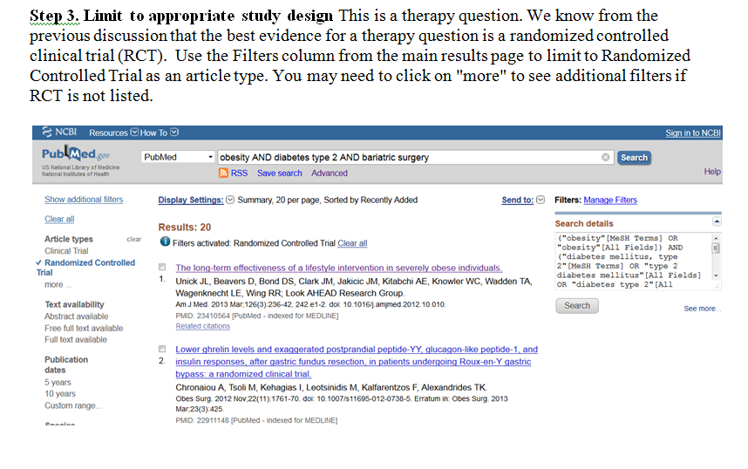

Slide 44
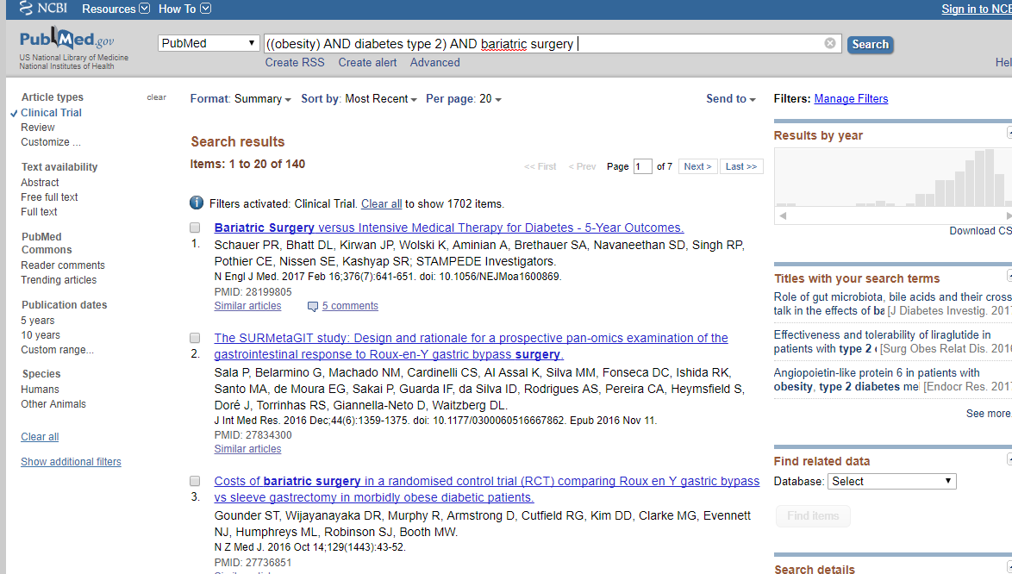
Step 3: Limit to appropriate study design. This is the therapy design. We know from the previous discussion that the best evidence for a therapy question is a randomized controlled clinical trial (RCT). Use the Filters column from the main results page to limit to Randomized Controlled Trial as an article type.

Slide 45
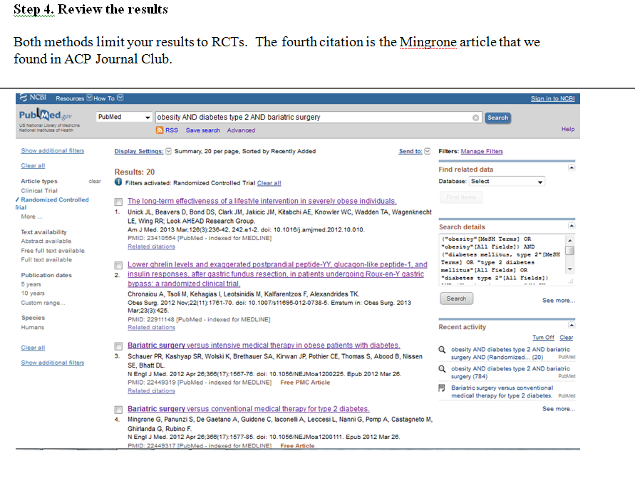

Slide 46
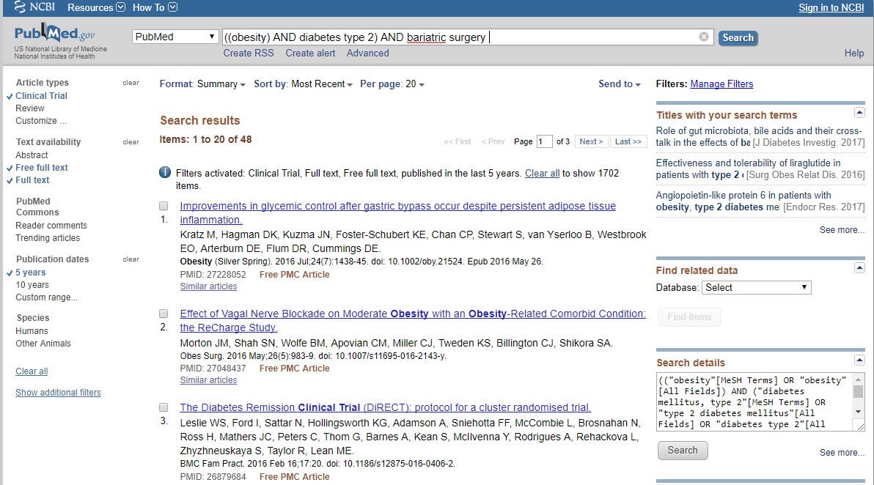
Step 4: Review Results: Both methods limit your results to RCT

Slide 47
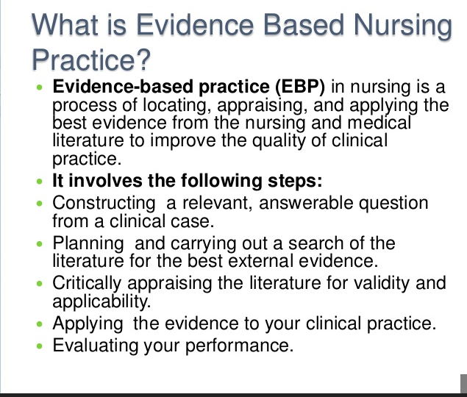

Slide 48
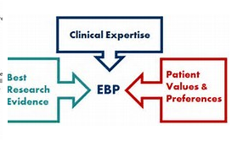

Slide 49
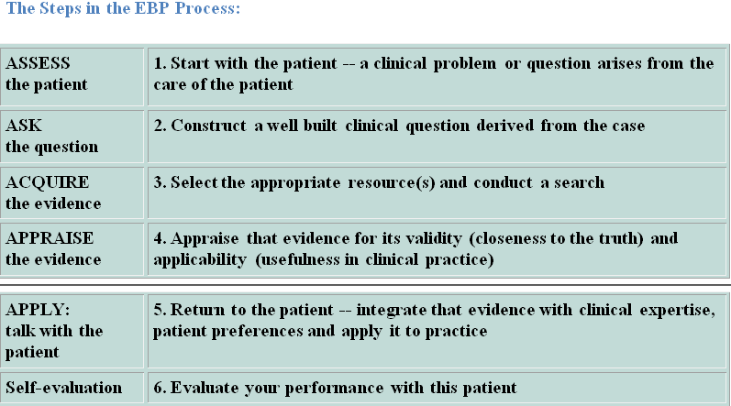

Slide 50
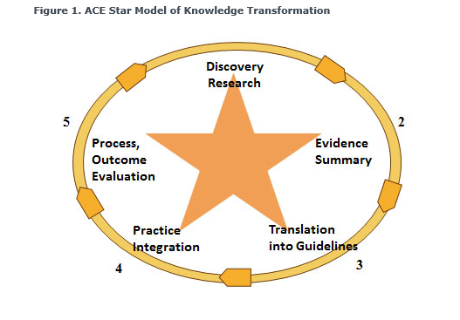

Slide 51
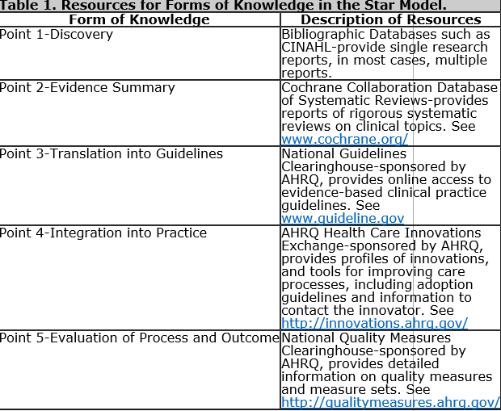

Slide 52

To contact the library, e-mail CONlibrary@osfhealthcare.org or call 309-655-2180

