Slide 1
CAPNOgraphy
Measuring the Human Machine
2020 December REMERT Training
Patrick Kell, EMT-P

Slide 2
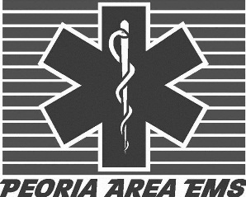
Capnography Agenda
History of Capnography
Phase 1
How does it Work
Phase 2
Basic Waveform
Phase 3
Phase 4
Diagnostic Waveforms
Phase 5
Use in Resuscitation
Phase 6
Capnography and Law

Slide 3

History of Capnography

Slide 4
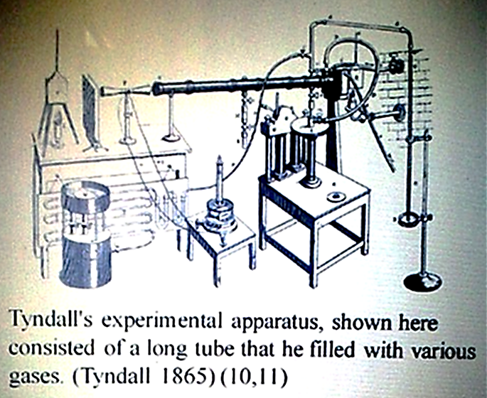

History of Capnography
The current frequently used infrared measurement of CO2 owes thanks to William Herschel (1738–1822)
        Known primarily as the astronomer who discovered Uranus (1781)
  Also discovered infrared radiation (1800)
Measuring the CO2 in human breath by measuring its infrared absorptive power was established as a reliable technique by John Tyndall.
Capnography was first introduced by
Karl Luft, a German bioengineer, in 1943
with an infrared CO2 measuring device.
It was big, heavy, and very impractical to
use.
Over the years capnography evolved
many times, as did the technology used
to measure it.
Used by anesthesiologists since the 1970s
Standard of care in the OR since 1991
New standards and technologies now expanding utilization

Slide 5
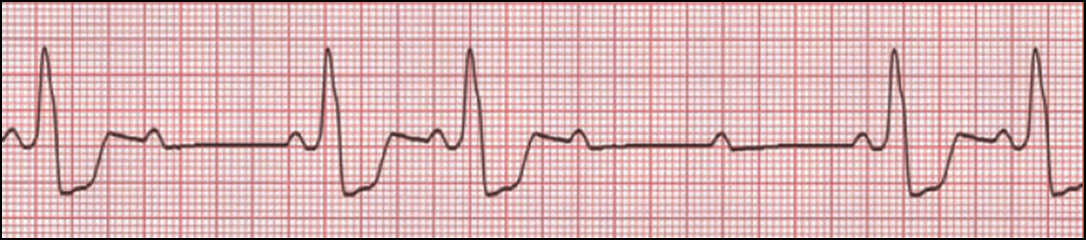
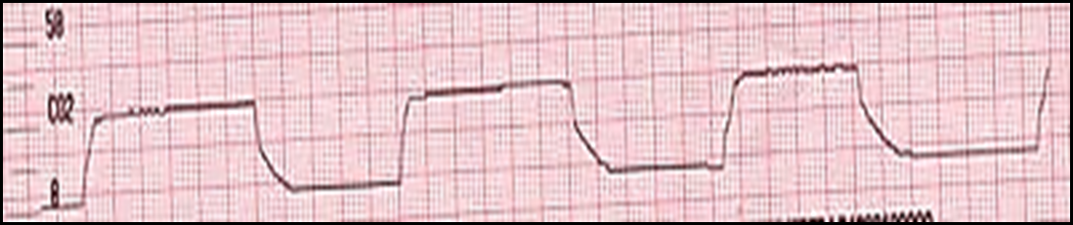
Why Capnography
Pulse Oximetry
Capnography is considered by many experts to be a diagnostic test.
Remember, diagnostic tests, regardless of their ability and value, must be interpreted in the context of the patient’s clinical picture.

Slide 6
Why Capnography?

Slide 7
Why Capnography I Have my Pulse Ox?
Pulse Oximetry
Capnography
Oxygen Saturation
Reflects Oxygenation
Pulse-oximetry can take 3 – 4 minutes to show a change in respiratory status.
Should be used with Capnography
Carbon Dioxide
Reflects Ventilation
Hypoventilation/Apnea detected immediately
Should be used with pulse Oximetry

Slide 8
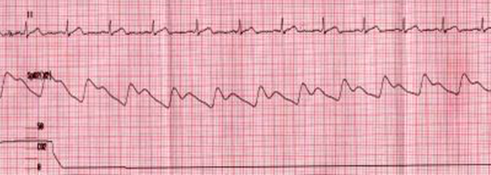
Pulse Ox vs. Capnography
Good pulse….good Spo2….No Capnography!

Slide 9
What can Capnography do for me?
Non-Intubated Applications
Intubated Applications
Bronchospasms: Asthma, COPD, Anaphylaxis
Hypoventilation: Drugs, Stroke, CHF, Postictal
Shock & Circulatory compromise
Hyperventilation Syndrome: Biofeedback
Verification of ETT placement
ETT surveillance during transport
Control ventilations during CHI and increased ICP
CPR: compression efficacy, early signs of ROSC, survival predictor

Slide 10
How do CO2

Slide 11
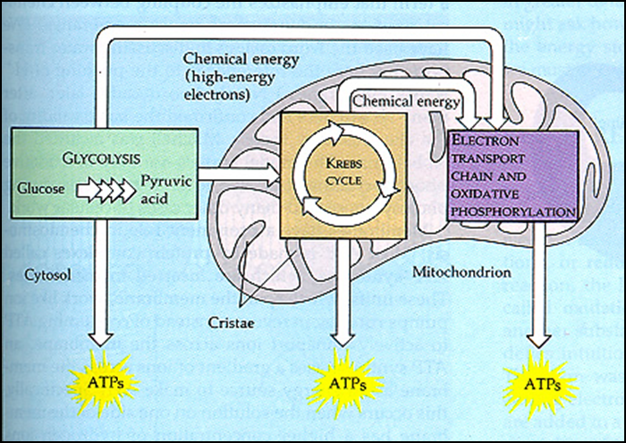
How do CO2
Aerobic Respiration
Multiple step process
Glycolysis – “splitting sugars”
Kreb’s Cycle – Further oxidation of glucose
For every one molecule of glucose the enters the cell 6 molecules of CO2 are produced.
C6H12O6 + 6O2 -------------------> 6CO2 + 6H2O + ~38 ATP

Slide 12
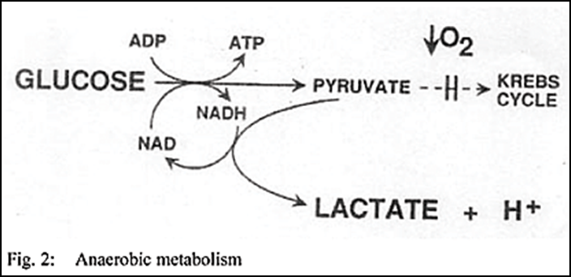
How do CO2
Anaerobic Respiration
Metabolism demand exceeds the supply of oxygen
Partial breakdown of sugar occurs that results in just a bit of energy, enough to keep a cell alive or working for a while, but not as efficiently.
Anaerobic respiration results in the production of lactic acid.
The lactic acid, plus the hydrogen (2H) released, cause the body to become more acidic.

Slide 13
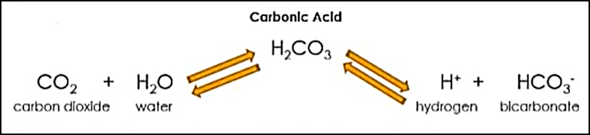
How do CO2
Acid - Base Balance
If the body becomes acidic (shifts toward CO2 & H2O)
If the body becomes alkaline (shifts toward H & HCO3)

Slide 14
Types of Capnography

Slide 15
CO2 Detector Types
Color-metric
Relies on pH change
Paper changes color
• Yellow (Yes) – EtCO2 >2%
• Tan -- EtCO2 0.5-2%
• Purple (pull the tube) - EtCO2 < 0.5%
May turn yellow if exposed to acid
(gastric, epinephrine)
Normal end-tidal CO2 is >4%; hence,
the device should turn yellow when
the endotracheal tube is inserted in
patients with intact circulation.
Not sensitive when exposed to
lower levels, such as during
CPR/low cardiac output
(so may not be able to identify
esophageal intubation)

Slide 16
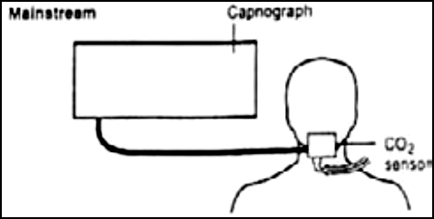
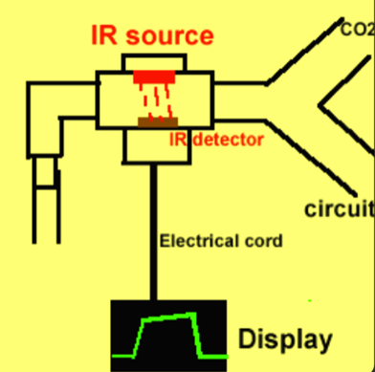
CO2 Detector Types
Mainstream
CO2 sensor is located between the ET tube and the breathing circuit
Gives immediate recording of the patient’s CO2 concentration(<40 msec)
The sensor may be difficult to clean when clogged; is expensive; is more bulky
Only intubated patient populations
Requires routine calibration

Slide 17
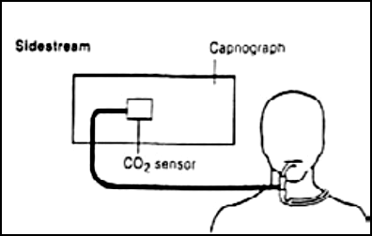
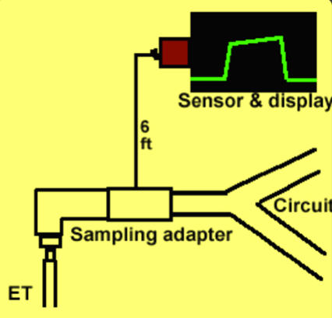
CO2 Detector Types
Sidestream
CO2 travels through a small port/tube to the sensor
Delayed recording of time it takes for gas to travel through the tube
Gives rapid recording of the patient’s CO2 concentration(< 1-2 sec)
Neonatal through adult
Intubated and non-intubated patients
Accurate at small tidal volumes and high
respiratory rates

Slide 18
How Waveform Capnography Works

Slide 19
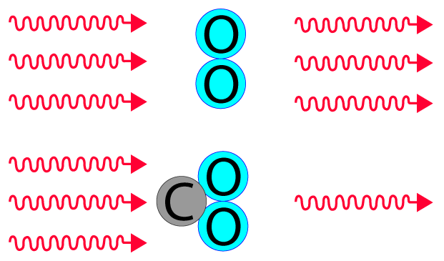
How Waveform Capnography Works
Capnography uses infrared waves to measure CO2.
Infrared is absorbed by gases that have “two or more different atoms”.
  • Oxygen gas has two atoms which are not different.
  • Therefore, oxygen does not absorb infrared waves.
  Carbon dioxide gas, unlike oxygen gas, has atoms that are different
    • Therefore, because carbon dioxide gas has different atoms, it
    absorbs infrared waves.
    • Resting adults produce 2.5 mg/kg/min

Slide 20
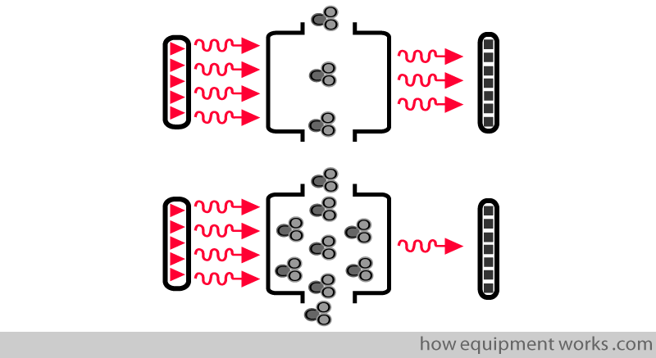
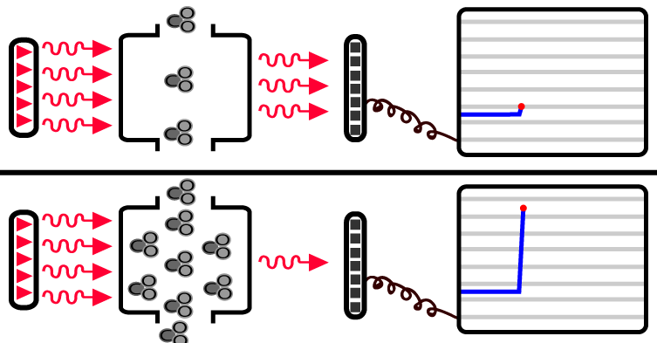
How Waveform Capnography Works
The CO2 being measured goes via a sampling chamber that has a fixed size
The detector outputs a signal that is proportional to the amount of infrared waves falling on it
The computer uses the information from the detector to display the CO2.
• Low CO2 = more infrared reaching detector = low CO2 display
• High CO2 = less infrared reaching detector = high CO2 display

Slide 21
Basic Waveform

Slide 22
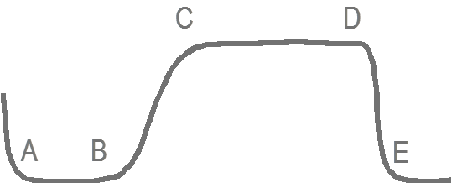

Basic Waveforms
Baseline
Capnograph detects only CO2
from ventilation
No CO2 present during inspiration
Baseline is normally zero
Baseline

Slide 23
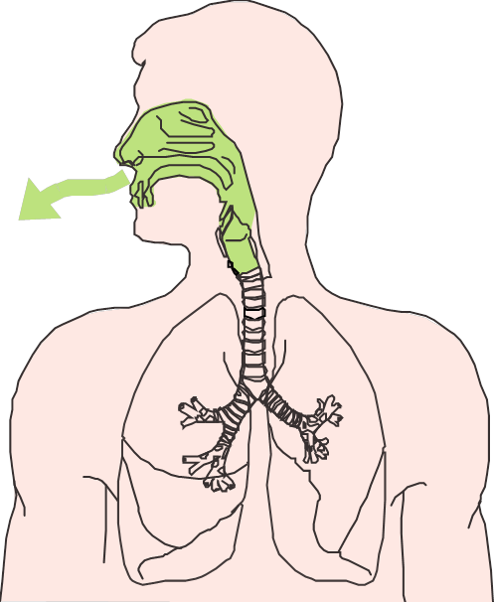




Basic Waveforms
Phase 1
Dead Space Ventilation
Beginning of exhalation
No CO2 present
Air from trachea, posterior pharynx,
mouth and nose
Typically 50 to 150 cc
No gas exchange occurs there
Called “dead space”

Slide 24
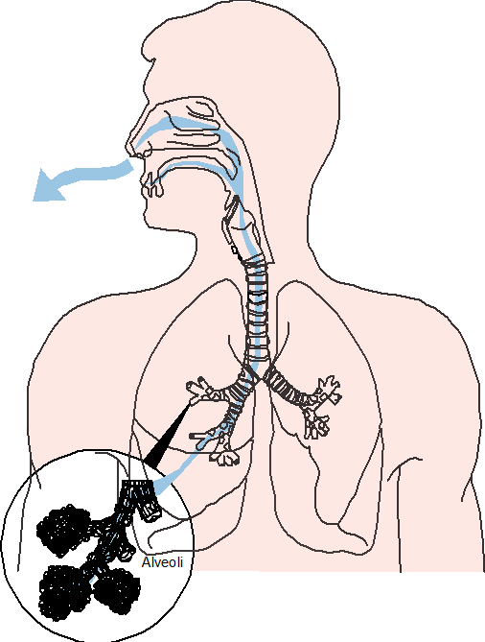



Basic Waveforms
Phase 2
Ascending Phase
CO2 from the alveoli begins to reach
the upper airway and mix with the
dead space air
Causes a rapid rise in the
amount of CO2
CO2 now present and detected
in exhaled air

Slide 25
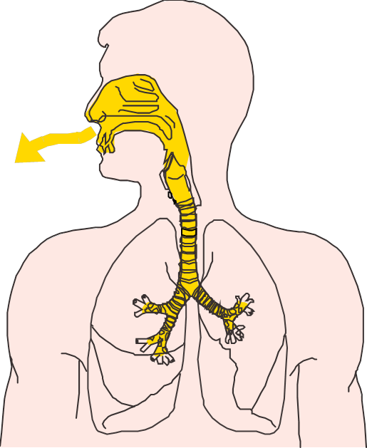
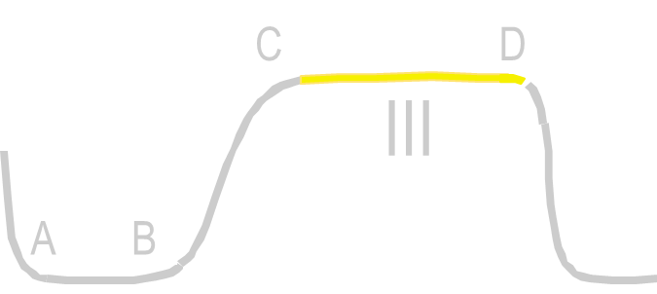

Basic Waveforms
Phase 3
Alveolar Plateau
CO2 rich alveolar gas now constitutes
the majority of the exhaled air
Uniform concentration of CO2 from
alveoli to nose/mouth

Slide 26




Basic Waveforms
Phase 3
End-Tidal
End of exhalation contains the
highest concentration of CO2
- The “end-tidal CO2”
- The number seen on your monitor
Normal EtCO2 is 35-45mmHg

Slide 27
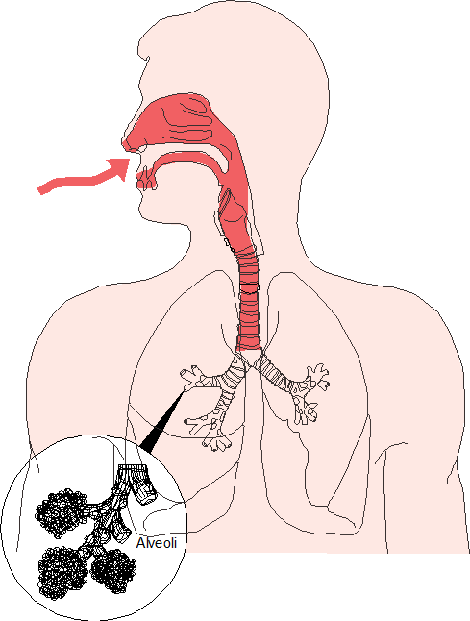


Basic Waveforms
Phase 4
Descending Phase
Inhalation begins
Oxygen fills airway
CO2 level quickly drops to zero

Slide 28
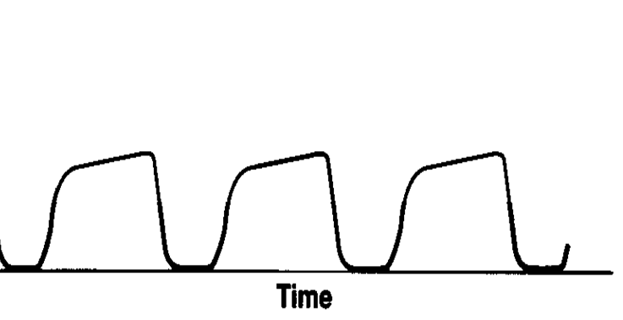
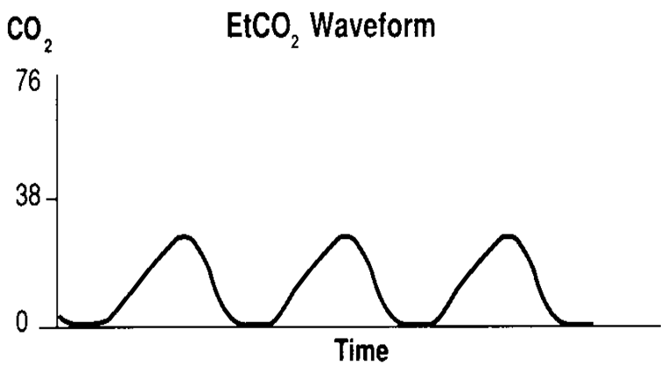
Basic Waveforms
In normal exhalation, the alveolar plateau will range from relatively flat to a slight upward angle.
Normal values are between 35-45 mmHg.
Several pathological conditions reveal themselves in alterations of the normally relatively square-shaped capnogram.
• Square = GOOD
• Hump = BAD

Slide 29
Diagnostic Waveform

Slide 30






Diagnostic Waveforms
ETCO2 between 35 and 45 mmHg is in the “normal” range
ETCO2 Less Than 35 mmHg = "Hyperventilation or Hypocapnia“
ETC02 Greater Than 45 mmHg = "Hypoventilation or Hypercapnia"
mmHg
RR
24
mmHg
35
RR
mmHg
RR

Slide 31
Diagnostic Waveforms
Uses for Capnography
Bronchospasm | Pulmonary Embolism
DKA | Seizure
Sepsis | Increased Intracranial Pressure
COPD | Bicarbonate Administration
CHF
Malignant Hyperthermia / Excited Delirium

Slide 32

Diagnostic Waveforms
Bronchospasm Waveforms
Air trapped due to
irregularities in airways
Uneven emptying of alveolar gas
– Dilutes exhaled CO2
– Slower rise in CO2 concentration
during exhalation

Slide 33
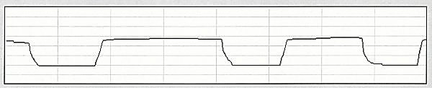
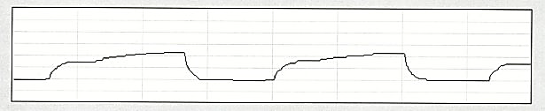
Diagnostic Waveforms
Bronchospasm Waveforms
Uneven emptying of alveolar gas
Produces changes in ascending phase with loss of the sharp upslope
Alters alveolar plateau producing a shark fin appearance
Waveform can allow EMS Providers the judge the severity of the bronchospasm and its response to treatment.

Slide 34
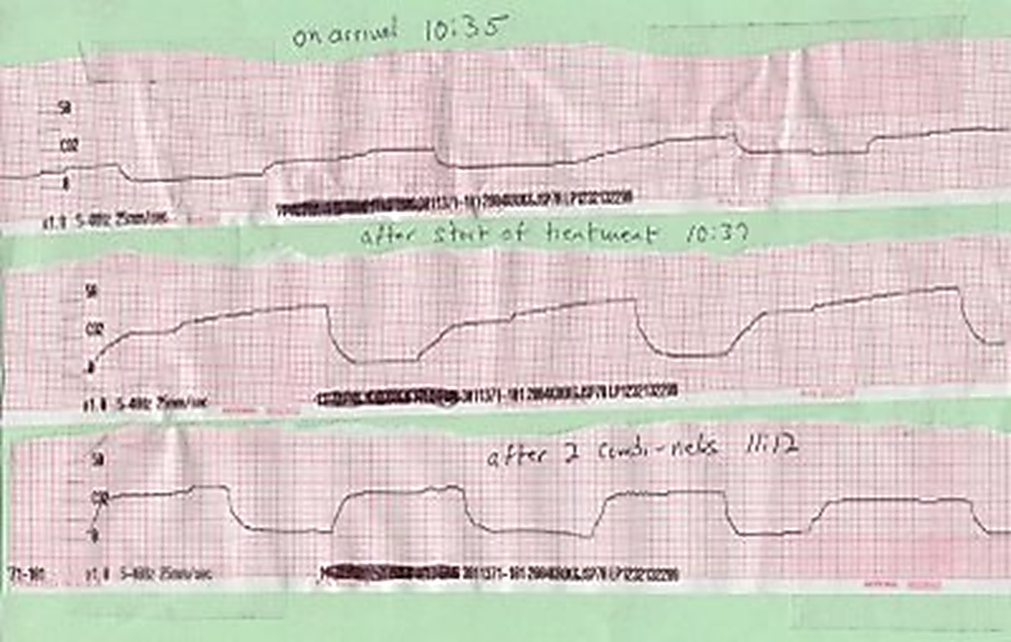
Diagnostic Waveforms
Bronchospasm response to treatment

Slide 35
Diagnostic Waveforms
Sepsis
Accounts for approximately 282,000 ED visits annually, 2% of all hospital admissions, and up to 11% of intensive care unit admissions.
The incidence of severe sepsis and septic shock in the US has been steadily rising.
Estimated cost of sepsis in the US is 16.7 billion dollars annually.
Lactic acidosis is a well accepted marker for disease severity in sepsis and has been shown to predict mortality in ED patients with an infection.
There is a significant association between ETCO2 concentration and mortality in patients with suspected sepsis.

Slide 36
Diagnostic Waveforms
Sepsis
Most of these screening tools rely on the suspicion of infection, systemic inflammatory response syndrome (SIRS) criteria, and point-of-care serum lactate levels
Heart rate > 90 beats per minute;
Temperature < 96.8 degrees F or > 100 degrees F;
Respiratory rate > 20 breaths per minute;
Acute altered mental status; or
Increased serum lactate levels (> 4 mmol/L);
Serum lactate levels provide a reliable insight into the severity of the disease they may not be rapidly or easily obtained.

Slide 37
Diagnostic Waveforms
Sepsis
EtCO2 level is inversely proportional to lactate levels
As lactate levels rise in septic patients, we see EtCO2 levels drop.
Studies show that patients with an ETCO2 of 33 or higher have on average a lactic acid level of 2.6 or lower.
Whereas patients with a ETCO2 level of 26 or lower have a average lactic acid level of 6.1 or higher
Mortality rates have been shown to decrease as much as 16% when early goal-related therapy is initiated.

Slide 38
Diagnostic Waveforms
DKA
Diabetic Ketoacidosis significantly decreases ETCO2 levels by depleting bicarbonate reserves secondary to prolonged metabolic acidosis.
Capnography can be utilized to help the paramedic determine if the patient is progressing to DKA;
Patient’s with an elevated blood sugar with a ETCO2 lower than 30 the patient is most likely in DKA
Patient’s with an elevated blood sugar with a ETCO2 greater than 30 the patient has not yet progressed to DKA as their bicarbonate reserves are still adequate.

Slide 39
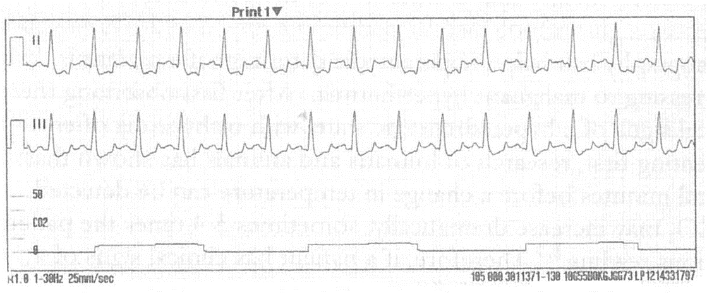
Diagnostic Waveforms
DKA
30 y/o male found unresponsive with Kussmal respirations blood glucose of 495, BP 110/50, RR 42 and ETCO2 of 7

Slide 40
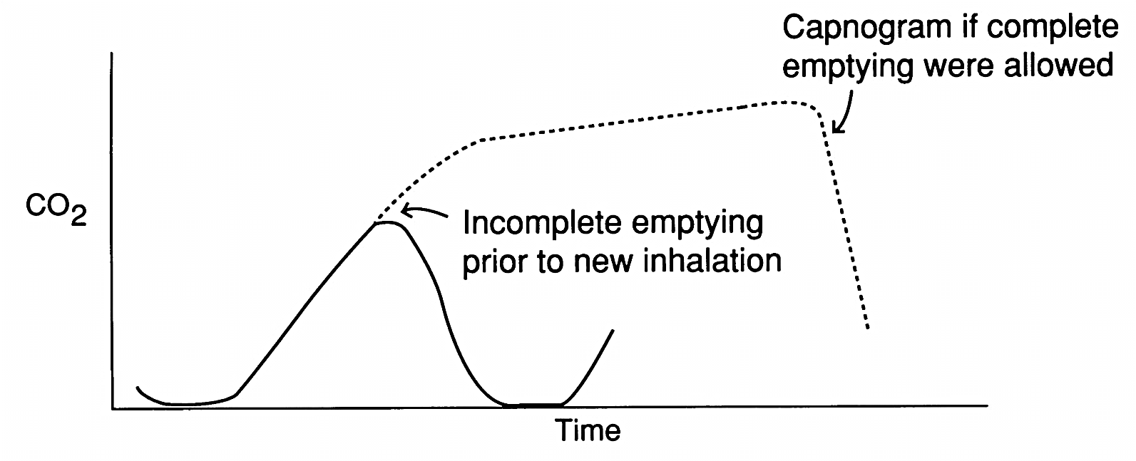
Diagnostic Waveforms
COPD
The capnography of a COPD patient is different than asthma.
Most COPD patients suffer from chronic CO2 retention resulting is higher the normal RR and ETCO2 values and a baseline waveform that may have continual shark fin characteristics. With little to no alveolar plateau.
A CO2 level of 50–60 could be normal for them because their medulla is accustomed to high levels over a long period of time.
All these factors quickly worsen during an exacerbation.

Slide 41
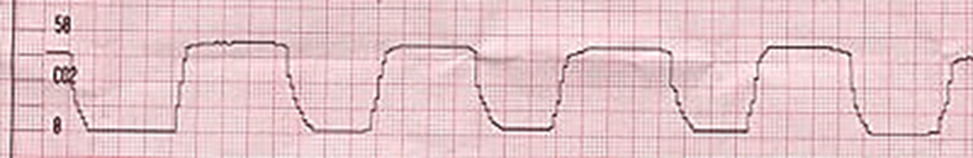
Diagnostic Waveforms
CHF
CHF waveforms are normal in shape because CO2 diffuses through fluid at the same rate it does through air due to CO2’s high solubility.
CHF with excessively low ETCO2, is secondary to cardiogenic shock and tachypnea.

Slide 42
Diagnostic Waveforms
Pulmonary Embolism
The capnography of a PE is low due to decreased pulmonary perfusion and tachypnea.
The capnography of a PE by itself is very ambiguous (low ETCO2 and a normal waveform) as are the signs and symptoms of a PE (shortness of breath with clear lung sounds that may or may not have focal chest pain, etc.). But when used together they create a strong case for PE.

Slide 43
Diagnostic Waveforms
Anxiety
The capnography of anxiety and the patient presentation is nearly identical to PE.
If anxiety is your prime suspect utilize capnography for your advantage.
Coaching Visual Aid – give the patient a numerical goal to help them control breathing.
Distraction Tool – Focusing on the capnography may distract the patient from what is upsetting them.

Slide 44
Diagnostic Waveforms
Seizure
Capnography is useful in providing insight into the ABC’s of a seizure patient as capnography is not confused by motion artifact and can help categorize the patient into one of three groups.
Seizing and Apneic– no waveform, no RR, no ETCO2 values
Seizing with Ineffective Ventilations– normal waveforms, slow RR, elevated ETCO2 levels
Seizing with effective ventilations – normal waveform shap and ETCO2 values.
Allows the paramedic to make decide how aggressively the patient needs to be treated and is the patient’s airway and breathing improving or deteriorating

Slide 45
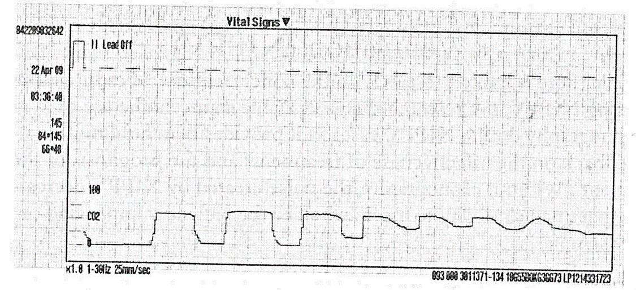
Diagnostic Waveforms
Seizure
Capnogram of a 10 month old female in status seizure.
You can see her cycle in and out of ineffective and effective breathing patterns

Slide 46
Diagnostic Waveforms
Increased Intracranial Pressure
Help gauge whether a patient with ICP is being ventilated at an appropriate rate.
Hyperventilation (ETCO2 ≤ 30 mmHg)– causes cerebral constriction resulting in decreased blood flow to the brain.
Hypoventilation (ETCO2 ≥ 50 mmHg)– causes cerebral dilation resulting to increased blood flow to the brain
By maintaining ETCO2 between 30 – 35mmHg you can achieve the best balance possible between cerebral perfusion and bleeding control.

Slide 47
Diagnostic Waveforms
Malignant Hyperthermia / Excited Delirium
Rare, life threatening emergency usually caused by a patient’s reaction to certain medications/drugs.
Hyperadrenergic state (tachycardia, ↑BP, tachypnea,etc.) which leads to hypermetabolic drive that causes dangerously high body temps.
Prior to the patient having any change in body temp the ETCO2 will usually increase dramatically sometimes 2-3 times the patient’s previous reading.
The rapid increase in ETCO2 in these cases go along with a high mortality rate.

Slide 48
Diagnostic Waveforms
Bicarbonate Administration
Should cause a increase in ETCO2 when given to a patient in acidosis – i.e. prolonged cardiac arrest.
Increase in ETCO2 level are shorter in duration than with ROSC.
Instead of “cookbook” approach and slamming bicarb due to down time; watch for ETCO2 levels that are low or decrease in the presence of CPR.
An alternative to delivering a whole amp of bicarb is to utilize capnography to deliver small doses to titrate the ETCO2 to an appropriate level.

Slide 49
EtCO2 and Cardiac Arrest

Slide 50
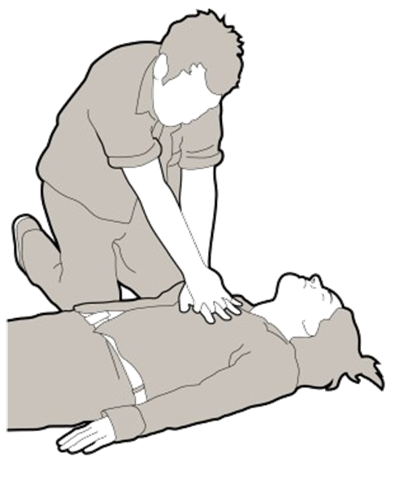
EtCO2 and Cardiac Arrest
Increased emphasis is on the use of capnography to confirm and continually monitor tracheal tube placement, quality of CPR and to provide an early indication of return of spontaneous circulation (ROSC)

Slide 51
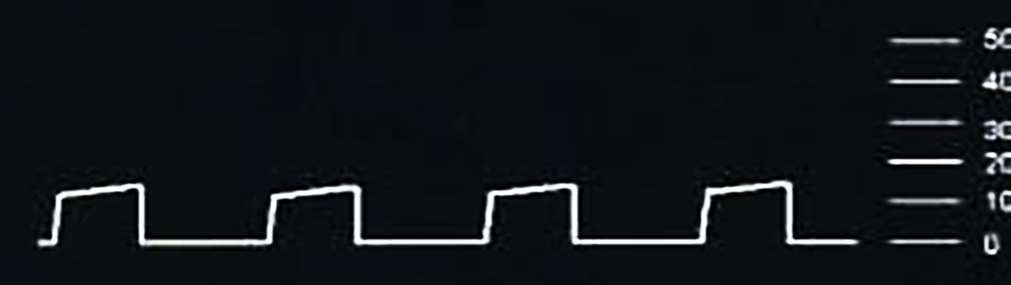
EtCO2 and Cardiac Arrest
CPR
    Square box waveform
    ETCO2 10-15 mm Hg (possibly higher) with adequate CPR
    Management: Change Rescuers if ETCO2 falls below 10 mm Hg

Slide 52


EtCO2 and Cardiac Arrest
Termination of Resuscitation
    EtCO2 measurements during a resuscitation give you an accurate indicator of survivability for patients under CPR

Slide 53
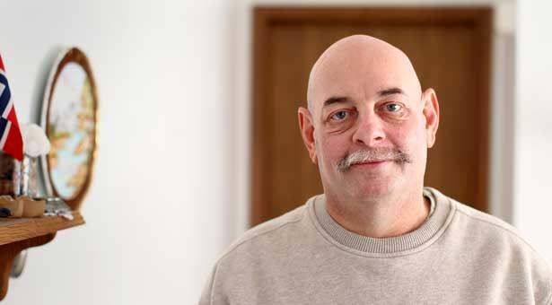
EtCO2 and Cardiac Arrest
96 Minutes Without a Heartbeat
    Howard Snitzer, a 54-year-old chef from
    Goodhue, Minn.
    Collapsed from cardiac arrest outside a
    grocery store in January
    High quality CPR established immediately.
    Mr. Snitzer's rescuers, who rotated every couple of minutes to avoid fatigue, kept pumping his chest.
    What kept them going? Readings displayed on the capnograph indicated the air coming out of Mr. Snitzer's lungs had healthy levels of carbon dioxide (in the mid 30s)—strong evidence that CPR was effectively moving oxygenated blood to his brain and other organs.
    96 minutes and 12 shocks later Mr. Snitzer’s pulse returned.
    Five days later Mr. Snitzer was out of intensive care and has experienced a complete neurologic recovery

Slide 54
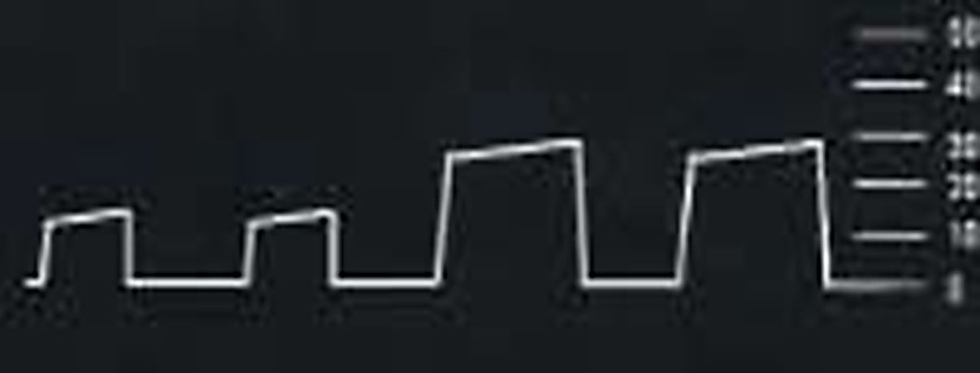
EtCO2 and Cardiac Arrest
ROSC(Return of Spontaneous Circulation)
During CPR sudden increase of ETCO2 above10-15mmHg
ETCO2 may go above baseline as circulation is restored b/c CO2 leaving formerly under-perfused tissues

Slide 55
LUCAS and Capnography
Impact of automated compressions is on ETCO2 waveforms.
The compression-decompression method allows for significant chest recoil during the decompression phase, which allows air will move freely in and out of the lungs in the presents of an open airway.
The air movement is often significant enough to result in detection by capnography and result in observable waveforms.
The waveforms are uniform and consistent in size and will have a short plateau, with the manually delivered ventilations having longer waveforms.
Potential to administer nebulizer via BVM if shark-fin waveform.

Slide 56
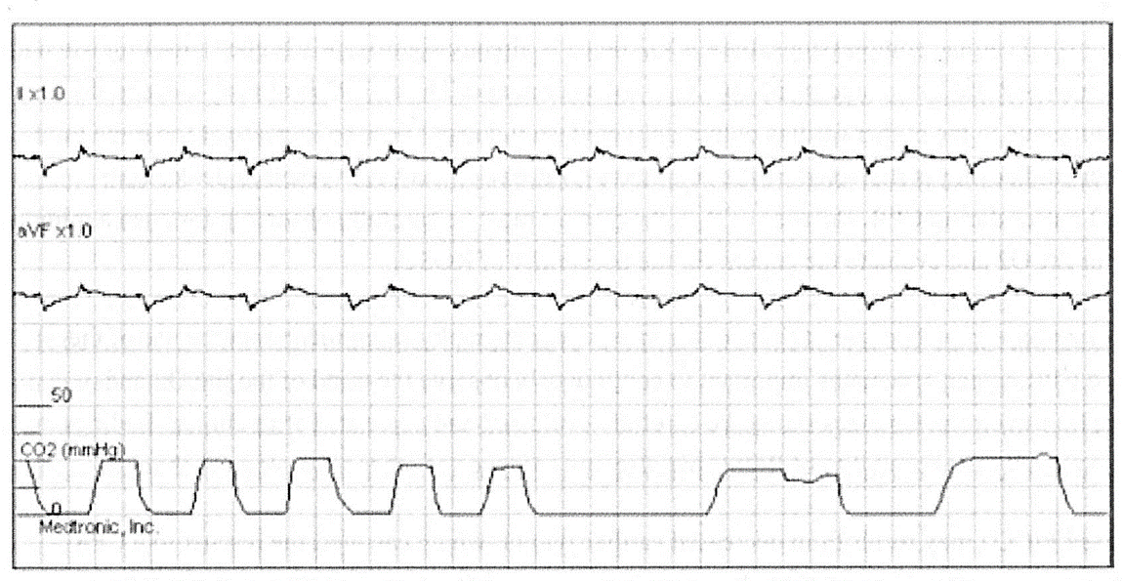
LUCAS and Capnography

Slide 57
EtCO2 and Cardiac Arrest
ET Tube Verification
Verification of proper tube placement
There is simply NO BETTER WAY to confirm proper tube placement
than with waveform capnography…. PERIOD!!!
0
0

Slide 58
EtCO2 and Cardiac Arrest
ET Tube Verification
A study compared field intubations that used capnography to confirm ETT placement vs. intubations that did not use capnography to confirm placement.
The study showed:
• That 0% of intubations went unrecognized if misplaced when ETCO2
monitoring was used
• 23% went unrecognized in the non-EtCO2 monitored group
Always confirm intubations with waveform capnography

Slide 59
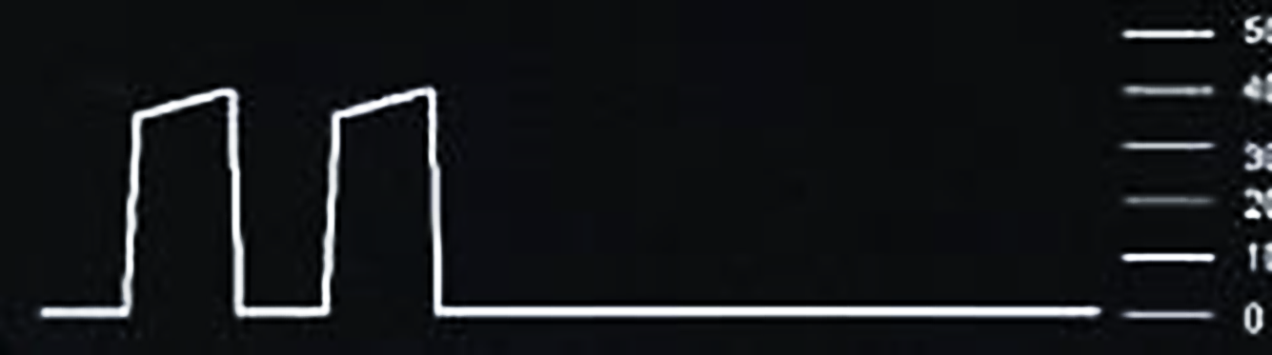
EtCO2 and Cardiac Arrest
ET Tube Troubleshooting
Dislodged ETT
Loss of waveform
Loss of ETCO2 reading
Management: Replace ETT

Slide 60
EtCO2 and Cardiac Arrest
ET Tube Troubleshooting
Obstruction
An obstructed ET tube may have an erratic EtCO2 value with a very irregular waveform
39
16

Slide 61
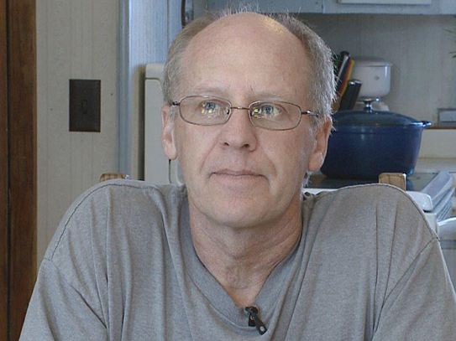
World Record CPR
165 Minutes of CPR
    Tim Franko, a 56-year-old mechanic
    from St.Paul, Minn.
    Collapsed from cardiac arrest
    while at work.
    CPR established immediately.
    Rescuers immediately applied
    a LUCUS device and capnography
    While receiving automated compression Mr. Franko became conscious and would answer yes/no question by blinking.
    Thirty minutes after arriving at the hospital, after numerous unsuccessful shocks his heart briefly began beating but stopped again after a minute.
    After 90 minutes his heartbeat was restored and he was transferred to the Cath Lab.

Slide 62
World Record CPR
2 Hours and 45 Minutes of CPR
    After arriving at the Cath Lab his
    heart stopped again and the LUCAS
    was started again.
    While receiving CPR a catheter was
    inserted and the blockage to the
    LAD “widowmaker” was removed
    Mr. Franko woke the next morning
    with full brain function and was able
    to go home 10 days later.
    Mr. Franko was clinically dead for 2 hours and 45 minutes, during this time he was defibrillated a total of 32 times.
    Mr. Franko’s recovery, by any measure, is stunning. Aside from some anemia and weakness, and sore muscles from the thousands of chest compressions that saved his life, Franko appears fine.

Slide 63
EtCO2 Medical-Legal

Slide 64
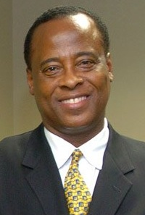

EtCO2 – A New Standard?
Changing Practice Standards, Changing Legal Liability

Slide 65
EtCO2 – A New Standard?
Changing Practice Standards, Changing Legal Liability
Capnography provides an illustration of how advances in technology can affect the standard of care, at least in the juror’s eyes.
The death of Michael Jackson and the criminal prosecution of his physician, Dr. Conrad Murray placed the monitoring of capnography directly into the public eye.
One of the seventeen acts of medical malpractice alleged by the prosecution in the involuntary manslaughter trial of Dr. Murray is that Dr. Murray failed to adequately monitor Michael Jackson with capnography (amongst other monitoring equipment) during the administration of sedation.

Slide 66
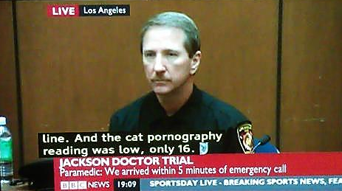
EtCO2 – A New Standard?
Its CAPNOGRAPHY, not Cat Pornography

Slide 67
EtCO2 – A New Standard?
Changing Practice Standards, Changing Legal Liability
Not only is capnography now becoming standard in hospitals, and out-patient care settings, but it is also becoming the standard in emergent care settings.
In October, 2010, the American Heart Association (AHA) and the European Resuscitation Council released updated resuscitation guidelines recommending capnography for intubated patients throughout the peri-arrest period.
Continuous waveform capnography was recommended as a Class 1 Level ,of Evidence procedure, the strongest classification available from the AHA.
Waveform Capnography should be used “to confirm and monitor endotracheal tube placement in the field, in the transport vehicle, on arrival at the hospital, and after any patient transfer to reduce the risk of unrecognized tube misplacement or displacement.”
Furthermore, “it is reasonable to consider using quantitative waveform capnography in intubated patients to monitor CPR quality, optimize chest compressions, and detect ROSC [return of spontaneous resuscitation] during chest compressions or when rhythm check reveals an organized rhythm (Class IIb, LOE C).”

Slide 68
EtCO2 – A New Standard?
Changing Practice Standards, Changing Legal Liability
Fifteen years ago ambulances did not use capnography.
Now, medical professionals predict that, within the next five years, capnography will become the “staple technology” of an emergency responder’s standard of care.
If true, the legal ramifications are apparent.
For example, emergency responders readily arrive on a scene to treat patients suffering cardiac arrest without capnography equipment and initiate CPR.
These same emergency responders cease treatment believing that ROSC is unlikely.
If capnography becomes the “staple technology” of an emergency responder’s standard of care, the emergency responder and the affiliated hospital have just become defendants in medical malpractice action.

Slide 69
EtCO2 – A New Standard?
Standard of Care is Not a Static Concept
New uses of existing technology as well as the advent of new technology will expand the standard of care, regardless of the perceived costs involved.
While capnography was once relegated to the operating room, plaintiffs and their experts will undoubtedly point to the new ASA and AHA guidelines as the standard of care in outside settings.
Again, while some medical professionals may feel that capnography is ill-suited for these outside settings (due to “false alarms” or cost), it is a jury, and not a medical panel, who decides what the applicable standard of care is in a trial.

Slide 70
EtCO2 – A New Standard?
Standard of Care is Not a Static Concept
Dr. Conrad Murray did not keep abreast and/or accept the evolving guidelines, whereas Mr. Snitzer’s first responders followed the AHA guidelines and saved someone’s life.
While Mr. Snitzer’s resuscitation may now be considered miraculous, in the future, with the help of capnography, such outcomes may become more common.
In the end, medical professionals should not be hesitant to embrace the fact that advanced technology leads to changes in the standard of care.

Slide 71
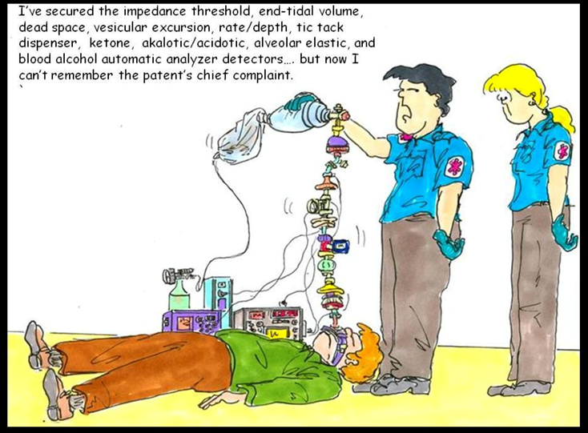
Questions

