Slide 1
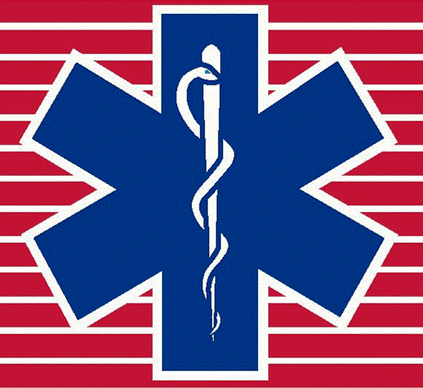
Summer Sucks
Environmental Emergencies of Illinois Summers
Peoria Area EMS System Continuing Education

Slide 2
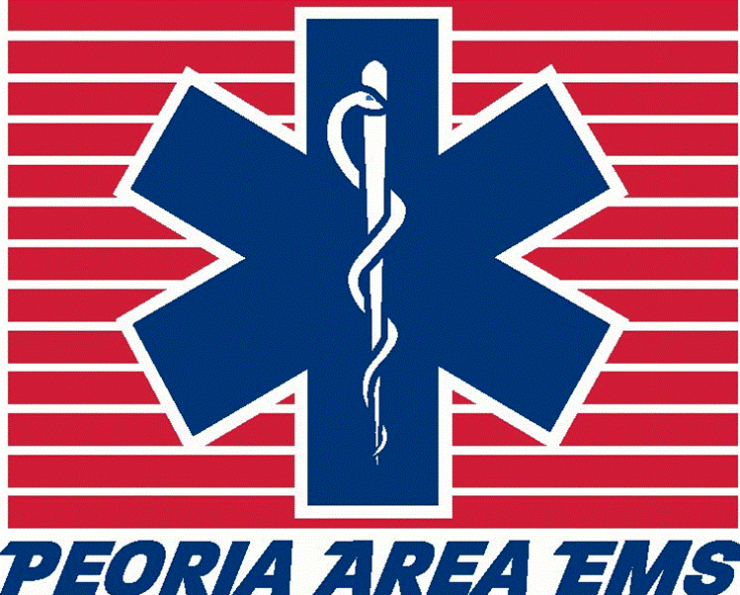
Heat Related Facts

Slide 3
Facts
About 600 to 700 persons die from heat-related disorders (including heat stroke) annually in the US; this number can rise to over 1,500 during heat waves. (Kunihiro)
Called the “silent disaster”. Kills more than tornadoes, hurricanes, lightning, or flooding in the average year
Approximately 68% of heat-related deaths were among males, and is the 2nd leading cause of death among young athletes
The elderly and the very young are at the highest risk for developing life threatening heat related emergencies.

Slide 4
Temperature Regulation

Slide 5
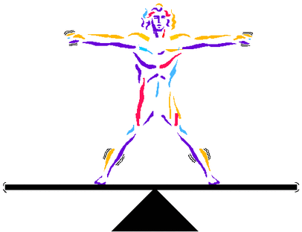
Homeostasis
Homeostasis – The tendency of the body to seek and maintain a condition of balance or equilibrium
within its internal environment, even when faced with external changes.

Slide 6
Homeostasis
Why 98.6° Fahrenheit?
According to a study by researchers at Albert Einstein College of Medicine, the 98-degree range is in perfect balance.
It's warm enough to prevent fungal infections but not so hot that we need to eat nonstop to maintain our metabolism.
Every 1° Celsius rise in body temperature wards off about 6% more fungal species. So tens of thousands of
fungi can infect reptiles and amphibians, but we
can only be invaded by a few hundred fungi.

Slide 7
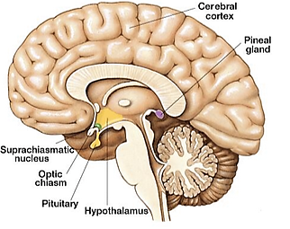
Hypothalamus
The portion of the brain that
maintains the body’s internal
balance (homeostasis).
The hypothalamus is the link
between the endocrine and
nervous systems.
The hypothalamus is located below the thalamus (a part of the brain that relays sensory information) and above the pituitary gland and brain stem.

Slide 8
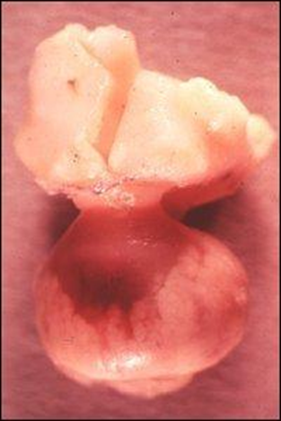
Hypothalamus
About the size of a almond, the hypothalamus directs a multitude of important functions in the body.
It is the control center for many autonomic functions of the peripheral nervous system.

Slide 9
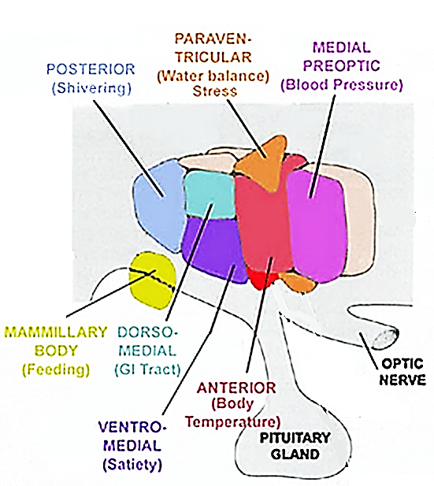
Hypothalamus
Involved in several functions of the body including:
  Body Temperature Control
  Blood Pressure
  Stress
  Food and Water Intake Regulation
  Sleep-Wake Cycle
  Regulation

Slide 10
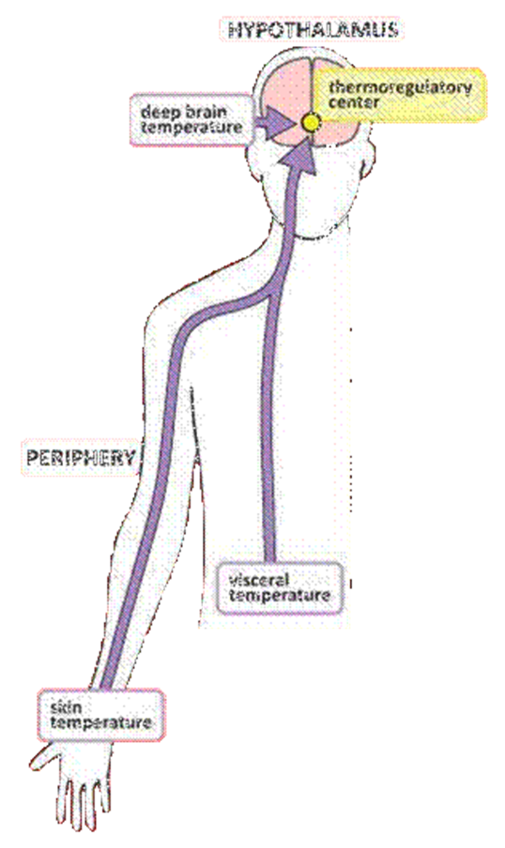
Hypothalamus - Thermoregulation
Although the hypothalamus
plays a key role in body
temperature regulation, thermoreceptors in other
parts of the body help to
moderate temperature.
  Peripheral Thermoreceptors
  (warm surface & cold dermis)
  Central Thermoreceptors
  (warm & cold)

Slide 11
Thermoregulation
Thermoregulation – The maintenance or regulation of temperature
The temperature of the deep tissues (core temperature) usually does not vary more than a degree or so from its normal 98.6°F
The body continuously adjusts it’s metabolic rate (metabolism that occurs when the body is completely at rest) in order to maintain a constant core temperature.

Slide 12
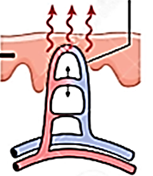
Hypothalamus Response
When the body temperature rises this information is relayed to the hypothalamic thermostat.
The thermostat inhibits the adrenergic
activity of the sympathetic nervous
system, causing cutaneous
vasodilation and reducing basic
metabolic rate.
This causes an increase in heat loss via the skin and a decrease in heat production in the core.

Slide 13
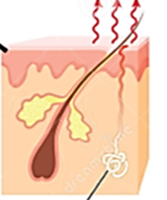
Hypothalamus Response
If the heat is sufficiently intense, the
body’s nervous system stimulates
the sweat glands to release sweat.
Sweating is the most effective
involuntary heat fighting response in man.
Behavioral responses to heat, such as lethargy, resting or lying down with limbs spread out, decreases heat production and increases heat loss.

Slide 14
Diminished Cooling Ability
Evaporation is the principal mechanism of heat loss in a hot environment, but this becomes ineffective above a relative humidity of 75%
Other methods of heat dissipation
- Radiation- emission of infrared electromagnetic energy
- Conduction- direct transfer of heat to an adjacent, cooler object
- Convection-direct transfer of heat to convective air currents
These methods cannot efficiently transfer heat when environmental temperature exceeds skin temperature.

Slide 15
Heat Injury Predisposition
Factors
Increased Internal Heat Production
    - Physical Activity
    - Febrile illness
    - Pharmacologic agents
Increased External Heat Gain
- Exposure to high ambient temperature
Decreased Ability to Disperse Heat
- Decreased Ability to Disperse Heat
Living in an urban environment

Slide 16
Pharmacologic Predisposition
Hypersensitivity
- Antibiotics
- Antiarrhythmics
- Phenytoin (Dilantin)
Pyrogens
- Antibiotics
- Cancer chemo Rx
Hypermetabolism
- Salicylates (NSAID)
- Thyroid
Impaired Heat Dissipation
- Phenothiazine
- Diuretics
- Laxatives
- Beta blockers
Muscle Hyperactivity
- Cocaine
- Amphetamines
- Phencyclidine (PCP)
- MAO inhibitors

Slide 17
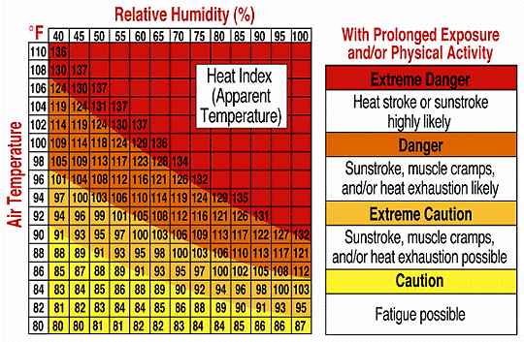
Heat Injury Predisposition

Slide 18
Heat Island Effect
On hot, sunny summer days, roof and pavement surface temperatures can be 50–90°F hotter than the air, while surfaces in more rural surroundings remain close to air temperatures.
Air temperatures in cities, particularly after sunset, can be as much as 22°F warmer than the air in neighboring, less developed regions.
Increased daytime temperatures, reduced nighttime cooling, and higher air pollution levels associated with urban heat islands can affect human health by contributing to respiratory difficulties, heat cramps and exhaustion, non-fatal heat stroke, and heat-related mortality.

Slide 19
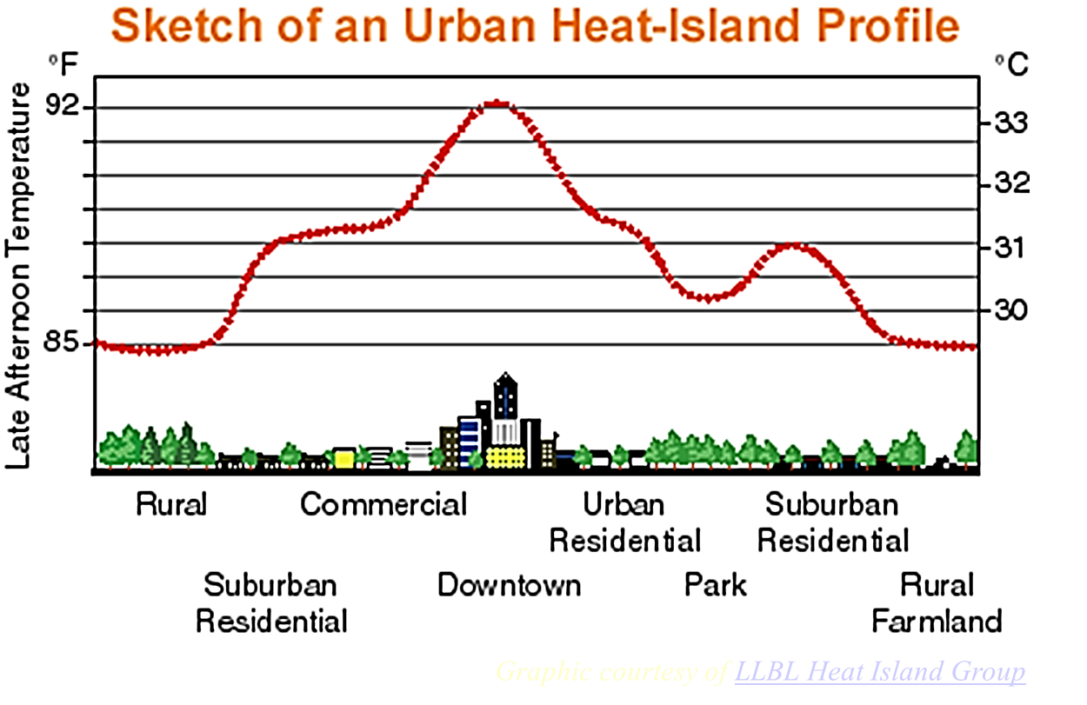
Heat Island Effect

Slide 20
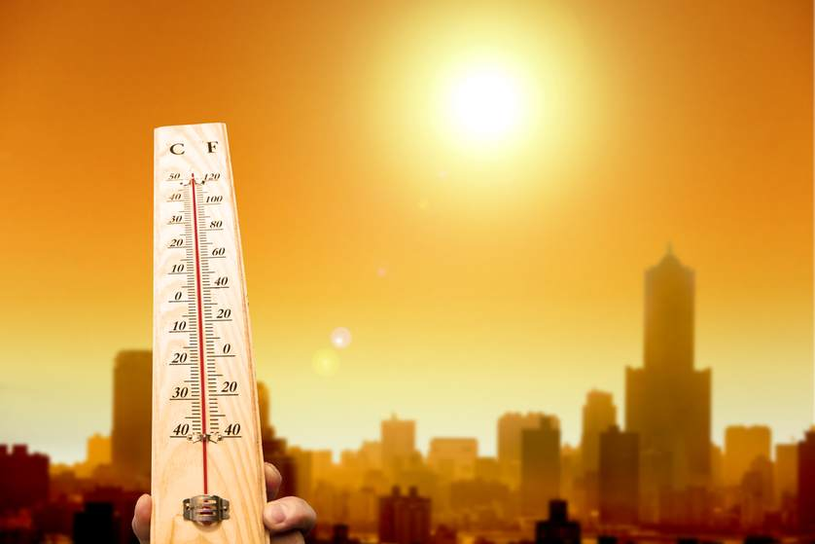
Heat Island Effect
Heat islands can also
exacerbate the impact of
heat waves, which are
periods of abnormally
hot, and often humid,
weather.
Excessive heat events, or abrupt and dramatic temperature increases, are particularly dangerous and can result in above-average rates of mortality.

Slide 21
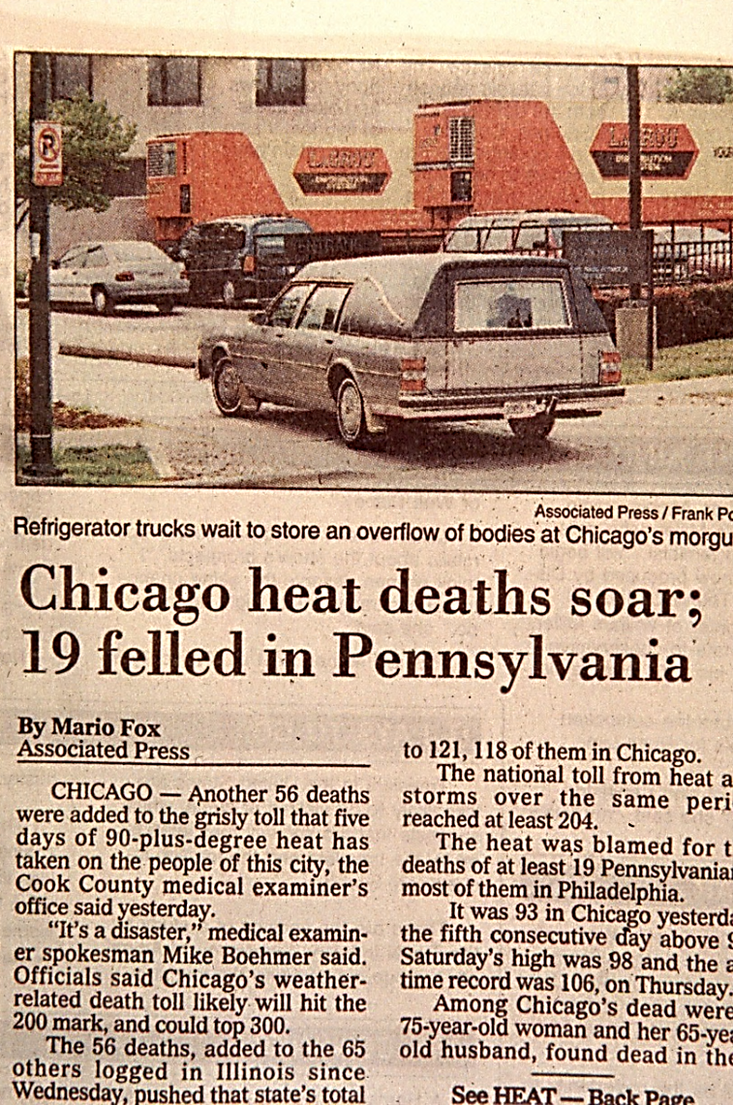
Chicago Heat Wave: July 13-16, 1995
For three horribly sweltering days in the summer of 1995, Chicago endured the deadliest stretch of heat ever recorded in the United States.
The death toll ultimately numbered an estimated 739.
Most victims were elderly and infirm and lived in the city’s poorest neighborhoods

Slide 22
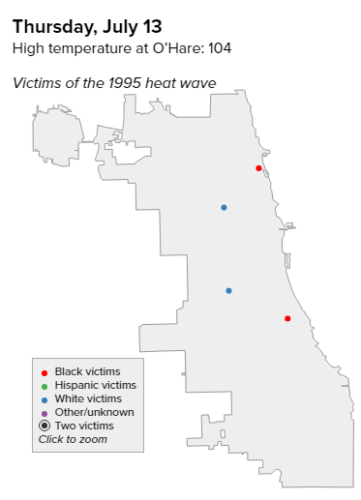
Chicago Heat Wave: July 13, 1995
Thursday, July 13
- High of 106°
- Heat indices of 125°

Slide 23
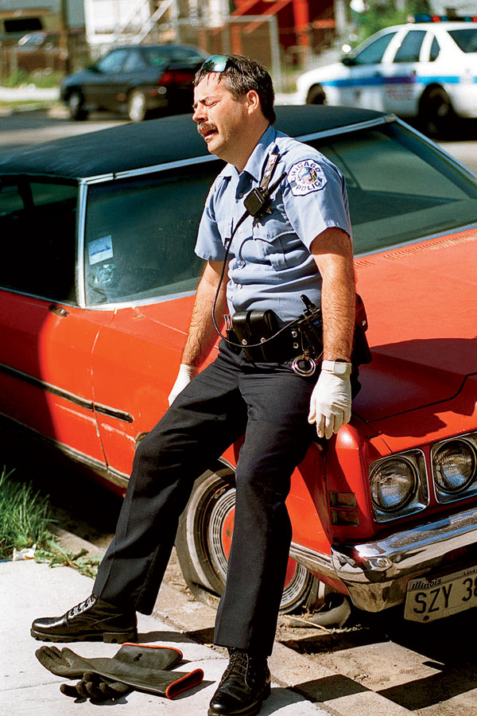
Chicago Heat Wave: July 13, 1995
Fans had little effect, so residents without air conditioning tried to find relief in Lake Michigan and community swimming pools or by splashing in sprinklers and the gushing waters of 3,000 illegally opened fire hydrants.

Slide 24
Chicago Heat Wave: July 13, 1995
As people began to suffer heat-related health problems or grew concerned about loved ones, 911 operators were flooded with calls.
They typically fielded 10,000 to 11,000 a day during summer months but received 16,727 the first day of the heat wave.

Slide 25
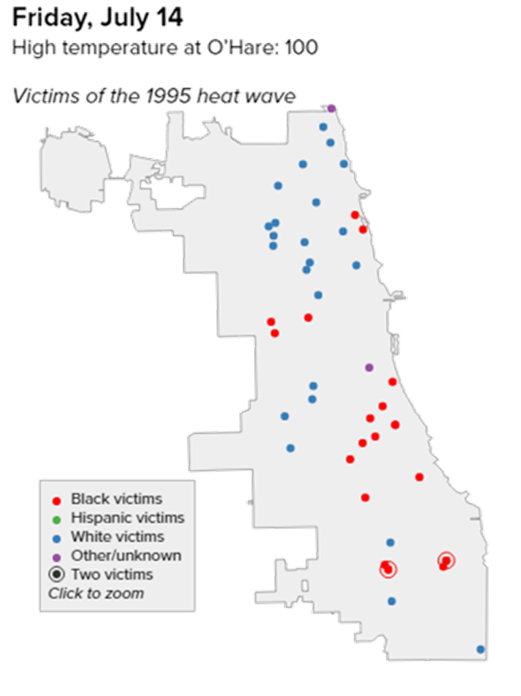
Chicago Heat Wave: July 14, 1995
Friday, July 14
- High of 102°
- Heat indices over 110°

Slide 26
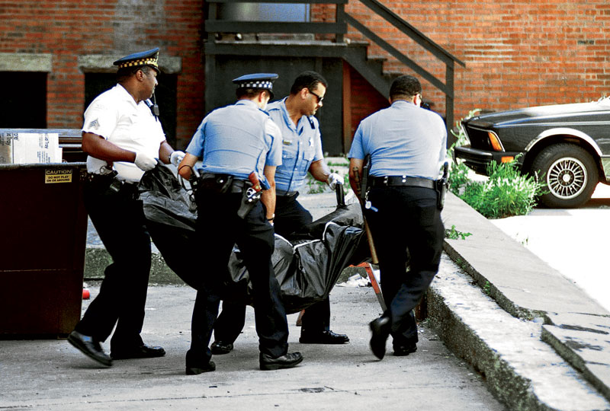
Chicago Heat Wave: July 14, 1995
Even as the heat wave entered a suffocating second day, City Hall officials seemed to be largely unaware of the disaster unfolding around them.
To further complicate matters, about 10 packed-to-capacity emergency rooms went on “bypass” mode, meaning they weren’t accepting new patients.

Slide 27
Chicago Heat Wave: July 14, 1995
On the North Side, as many as 49,000 residents lost power for much of the weekend after multiple Commonwealth Edison transformers blew, rendering air conditioners useless.

Slide 28
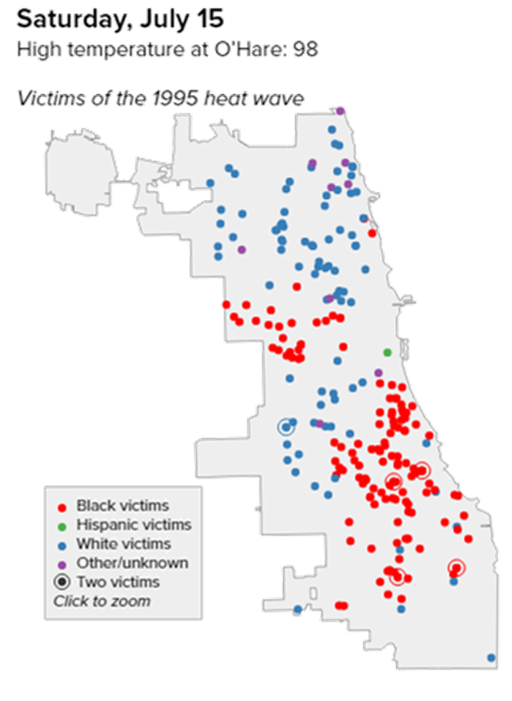
Chicago Heat Wave: July 15, 1995
Saturday, July 15
- High of 98°
- Heat indices over 100°

Slide 29
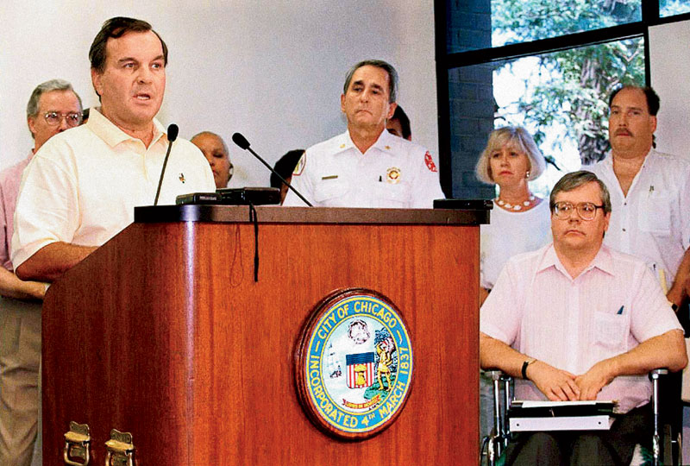
Chicago Heat Wave: July 15, 1995
Late Saturday morning, health department officials declared a citywide heat emergency.
Before long, all of the city’s 56 ambulances and 600 paramedics were pressed into service.
The number of emergency rooms that were no longer admitting people jumped to at least 16.

Slide 30
Chicago Heat Wave: July 15, 1995
At the Cook County morgue, four blocks from the old Cook County Hospital building on West Harrison Street, a cavalcade of police vehicles and ambulances delivered one corpse after another.
Not since American Airlines Flight 191 crashed at O’Hare in May 1979 had the morgue been so busy.

Slide 31
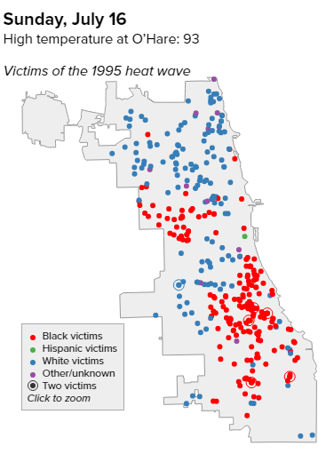
Chicago Heat Wave: July 16, 1995
Sunday, July 16
- Heat wave broke
- High of 93°
Most fatalities were between the ages of 70 and 89.

Slide 32
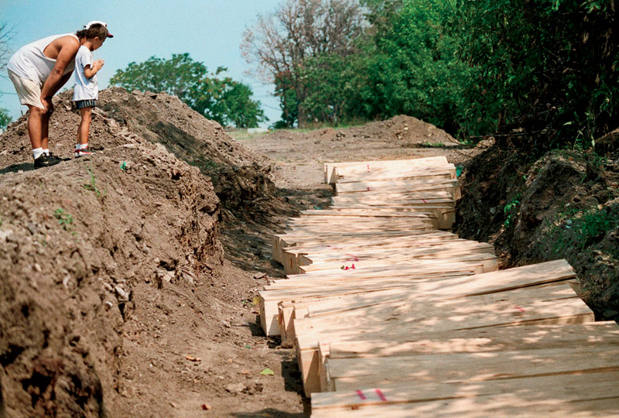
Chicago Heat Wave: July 16, 1995
Although the heat wave broke on Sunday, the situation remained dire as 911 calls continued to pour in and more bodies were discovered.
The county morgue was overwhelmed; 15 pathologists had to perform autopsies wherever space was available, including in its hallways.
More than 40 unclaimed heat victims await burial in a mass grave.

Slide 33
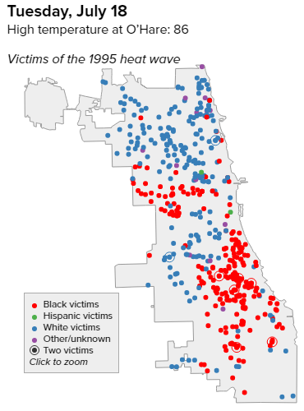
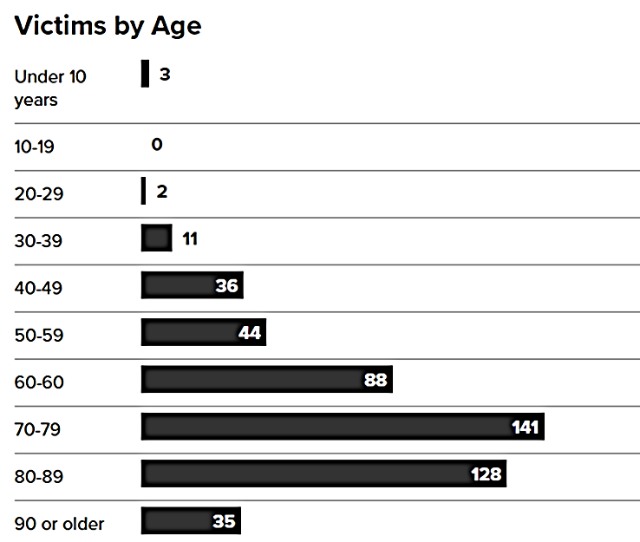
Chicago Heat Wave

Slide 34
Excessive Heat
Defined by National Weather Service as:
Heat index ≥ 110° for 3 hrs or more, with overnight temps > 80° through ~ 2 am
Heat index ≥ 115° for any length of time
Problem: heat can be dangerous below these criteria for at-risk groups – especially for the first event of the year

Slide 35
At Risk Groups

Slide 36
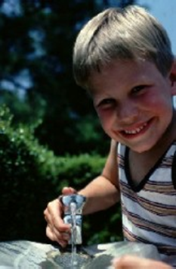
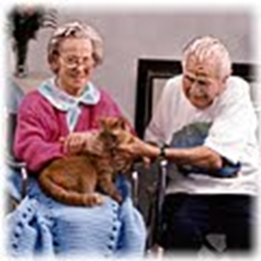
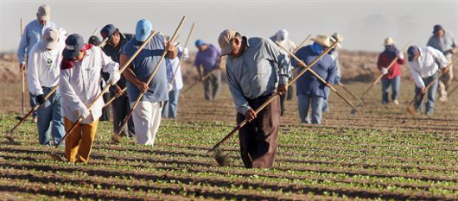
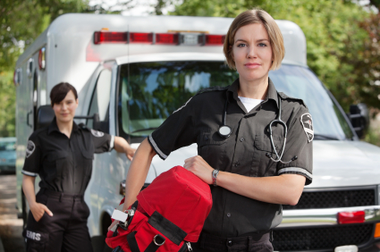
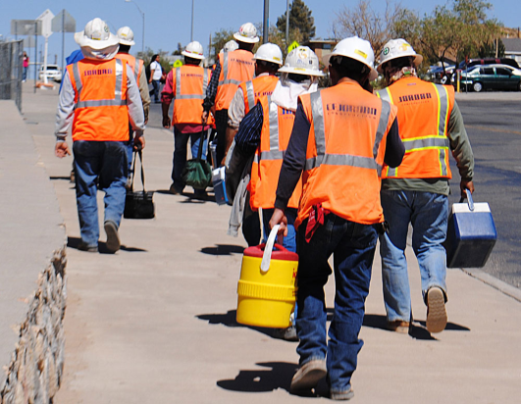
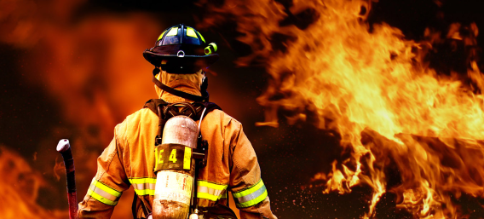
Who’s most at risk?
Elderly
(especially urban)
Children
Outdoor workers

Slide 37
The Elderly
From 1999-2009, roughly 40 percent of all heat-related deaths in the U.S. were adults over 65 years old.
Often isolated & difficult to reach
May not have air conditioning, or turn it off to reduce bills
May not dress properly for the heat
May not open windows due to safety concerns
Immobile… unable to get to cooling centers
Medication can make them vulnerable

Slide 38
Children
Over 637 children have died from heat stroke in vehicles in the U.S. since 1998
- One third: trapped while playing
- When temp=83°, car temp can rise to109° in 15 minutes
Children have fewer and immature sweating mechanisms and also sweat less than adults, so they have less ability to get rid of heat by evaporation of sweat.
Children have more body surface area than body weight, so when the outside temperature is higher than body temperature, children tend to gain heat 3-5 times faster than that of adult
Might not know they’re dehydrated
May not be able to convey thirst

Slide 39
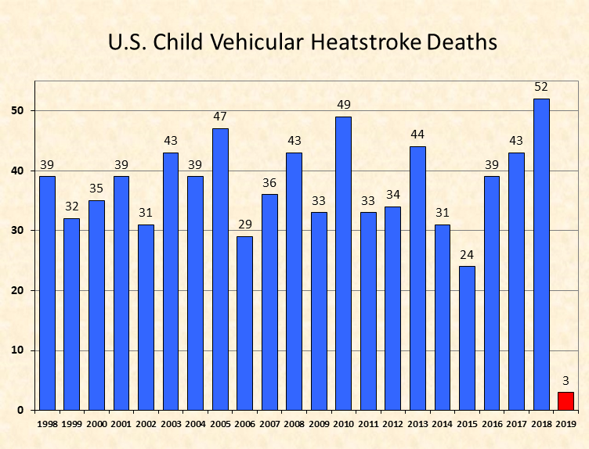
Notes:
Since 1998, more than 700 U.S. children died due to vehicular heatstroke
1985 the first child passenger safety laws were passed.
39% - child "forgotten" by caregiver
27% - child playing in unattended vehicle
20% - child intentionally left in vehicle by adult
14% - circumstances unclear

Slide 40
Outdoor Workers
25% of heat-related deaths
Documented deaths and injuries include:
- Migrant workers
- Roofers
- Firefighters
Often work long hours in direct sunlight
May not have adequate shade or air conditioning
Abundant water alone won’t prevent illness

Slide 41
Heat Related Illnesses

Slide 42
Heat Related Illnesses
Heat rash
Heat cramps
Heat syncope
Heat Exhaustion
Heat stroke
Severity

Slide 43
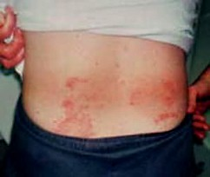
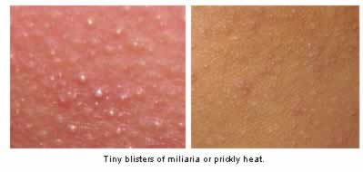
Heat Rash
Known as prickly heat.
It is a red, itchy, raised rash normally seen on the skin an area of restrictive clothing and heaving sweating.
It caused by inflammation of sweat glands that blocks the sweat duct
Will usually resolve itself in as little time as
24-48 hours.

Slide 44
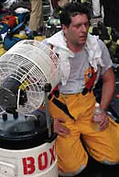
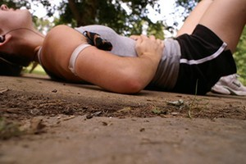
Heat Cramps
Hot environment causes profuse sweating
Sodium lost in sweat
Lack of sodium causes painful spasmodic contractions of skeletal muscle.

Slide 45
Heat Cramps
Signs/Symptoms
Patient usually in good condition; working in hot, humid environment
Cramps of fingers, arms, legs, abdominal muscles
Nausea
Normotensive, mild hypotension; tachycardia
Cool, pale skin
Awake, alert, normal body temperature.

Slide 46
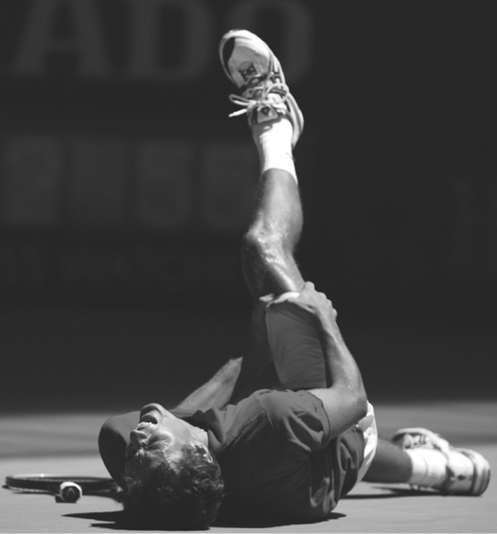
Heat Cramps
Management:
Rest in cool environment
Stretching the affected muscle
Rehydration (Do not give liquids
with caffeine or alcohol.)
Discontinue liquids, if victim is
nauseated.

Slide 47
Heat Exhaustion
More serious than heat cramps
Most common heat-related illness a prehospital provider will encounter.
Caused by:
- Increased vascular space due to vasodilation
- Decreased blood volume due to sweating
- Decreased CNS perfusion
Although heat exhaustion isn't as serious as heat stroke, it isn't something to be taken lightly.

Slide 48
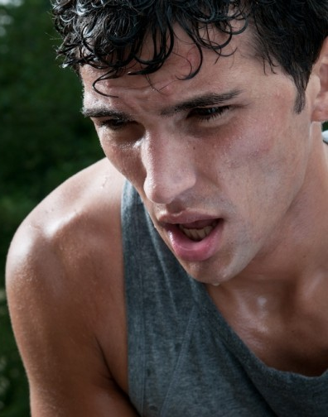
Heat Exhaustion
Signs/Symptoms
Headache, dizziness, fatigue,
nausea, confusion
Weakness, syncope
Profuse perspiration, pallor
Tachycardia, hypotension,
tachypnea
Orthostatic changes
Normal core temperature

Slide 49
Heat Exhaustion
Management
Move to cool place, stop activity, lie down
Remove clothing as necessary to make the patient comfortable.
Cold packs may be utilized for the neck (posterior), armpits, groin and along the thorax.
Oxygen
IV Fluid Therapy: 20mL/kg fluid bolus if the patient is hypotensive to achieve a systolic BP of at least 100mmHg.

Slide 50
Heat Stroke
It the most emergent and life threatening form of heat illness.
Body heat accumulation leads to increased temperature above 104F
Increased temperature damages hypothalamus:
- Heat regulating mechanism failure occurs
- Sweating mechanism fails
- Organ damage across all body systems (liver, kidney, brain, etc.)
Two types :
- Classic
- Exertional

Slide 51
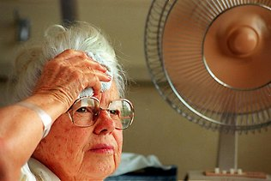
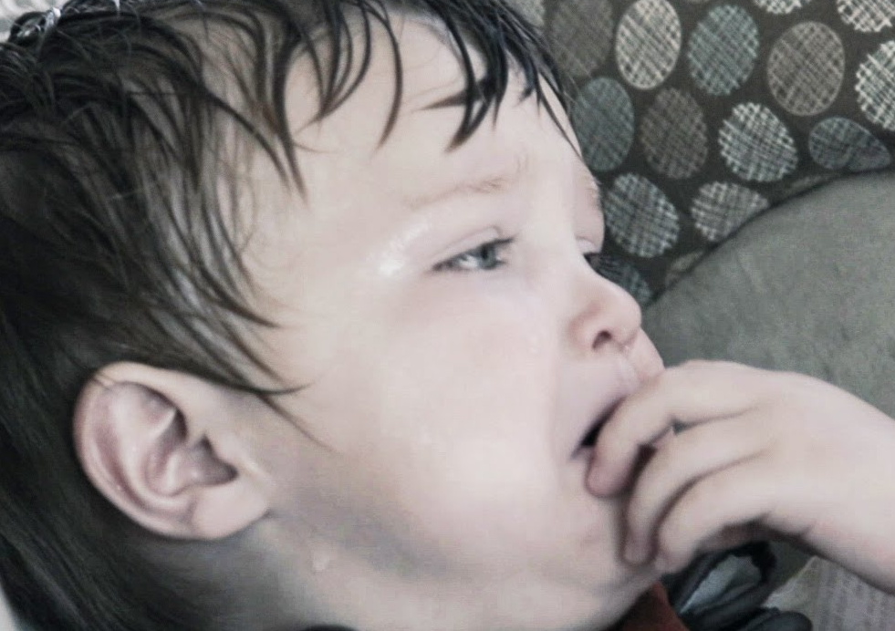
Heat Stroke
Classic Heat Stroke
Slow evolution, onset insidious
Increased external heat gain with
decreased heat dispersal
Elderly, poor, infants, and chronically ill at greatest risk.
Increased risk with
- Lack of AC
- Cardiovascular disease
- Older age
- Cardiovascular/anticholinergic drugs
Dry skin, absence of sweating

Slide 52
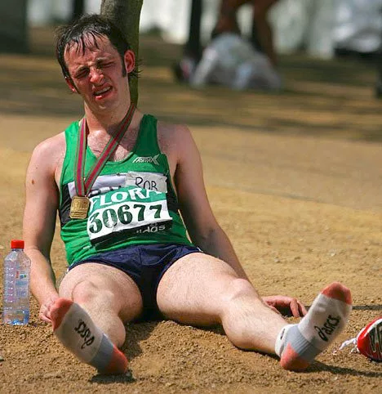
Heat Stroke
Exertional Heat Stroke
Occurs in healthy, young people in hot environments
Heat builds up faster than it is removed
Damage to hypothalamus occurs
Patient sweats heavily prior

Slide 53
Heat Stroke
Signs/Symptoms
Cessation of sweating
Very high body temperature
Hot, flushed skin
Dizziness, nausea, vomiting
Deep, rapid, shallow respirations (which later slow)
Bounding pulse progressing to rapid, weak pulse
Hypotension
Confusion– altered mental state
Possible seizures.

Slide 54
Heat Stroke
Complications
Heart failure, pulmonary edema, cardiovascular collapse
Hepatic injury (thermal)
Renal injury
- rhabdomyolysis, myoglobinuria, and renal failure
Hematological insult
- Micro-hemorrhages
- Thrombocytopenia
- Increased platelet aggregation (thermal)
Fluid/Electrolyte disturbances

Slide 55
Heat Stroke
Management
Secure airway
High concentration oxygen
Cold packs may be utilized for the neck (posterior), armpits, groin and along the thorax.
IV Fluid Therapy: 20mL/kg fluid bolus if the patient is hypotensive to achieve a systolic BP of at least 100mmHg.
Monitor EKG
Do not let cooling in the field delay your transport. Cool patient if possible while en-route

Slide 56
Toxic Illinois

Slide 57
Illinois‘ Venomous Creatures
There's a vast array of venomous varmints in Illinois, from snakes that can kill to spiders whose bites render skin necrotic.

Slide 58
Venomous Snakes
While there are numerous venomous creatures in Illinois, snakes are the best known and least likely to bite you.
Most are currently found in the southern parts of Illinois, but with climate change have been noted to the central areas of the state.
To gauge a better understanding of snakebite rarity, you should know that nationwide only 2,000 people are bitten per year by venomous snakes, and less than 14 actually die.

Slide 59
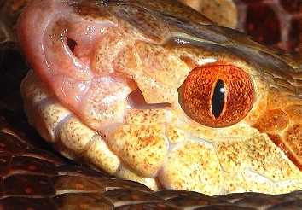
Venomous Snakes
There are only four venomous snakes in Illinois: the timber rattlesnake, eastern massasauga rattle-snake, copperhead and cottonmouth.
All four are pit vipers and have a heat-sensing pit between the eye and nostril on each side of the face for detection of prey.
Opposed to non-venomous
snakes, who have round pupils,
these all have elliptical,
cat-shaped pupils.

Slide 60
Venomous Snakes
There are only four venomous snakes in Illinois: the timber rattlesnake, eastern massasauga rattle-snake, copperhead and cottonmouth.
All four are pit vipers and have a heat-sensing pit between the eye and nostril on each side of the face for detection of prey.
Opposed to non-venomous
snakes, who have round pupils,
these all have elliptical,
cat-shaped pupils.

Slide 61
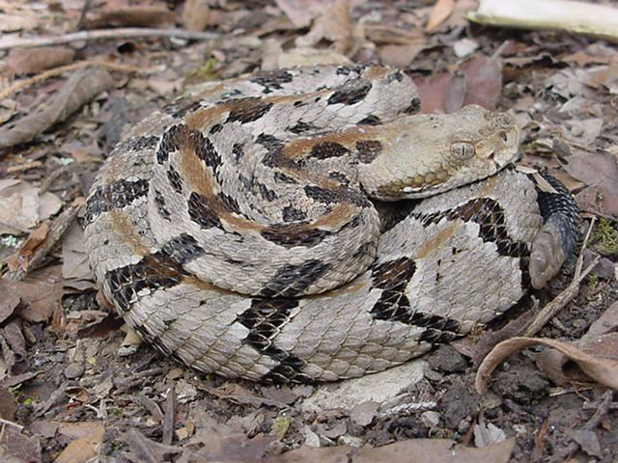
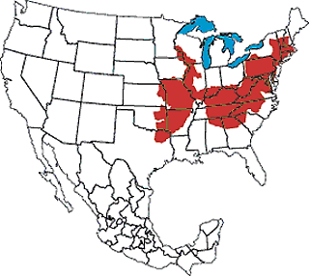
Timber Rattlesnake

Slide 62
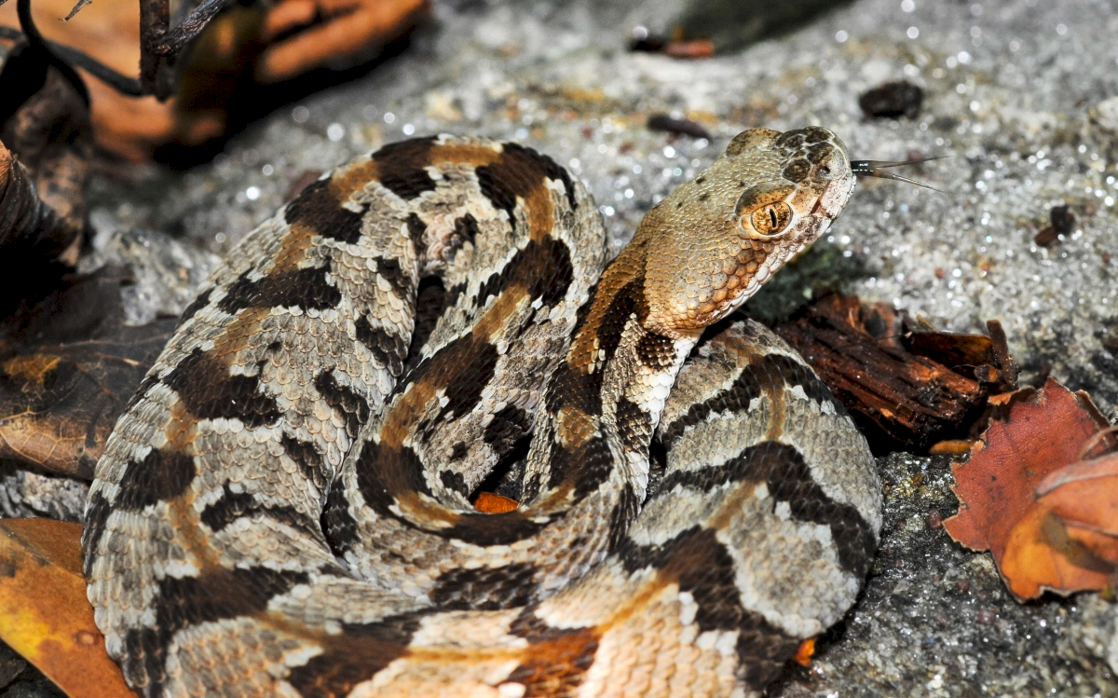
Timber Rattlesnake
Large, stout-bodied venomous snake.
Back gray, light yellow, or greenish white with 20-25 black, jagged crossbars or blotches.
Sometimes an orange or rust stripe down midback.
Head clearly larger than
slender neck.
Dark stripe behind
each eye.

Slide 63
Timber Rattlesnake
The timber rattlesnake is the 3rd largest venomous snake in the US and is one of North America's most dangerous snakes, due to its impressive size, long fangs and high venom yield.
However, the species relatively mild disposition and a long hibernation period mean there aren't that many bites.

Slide 64
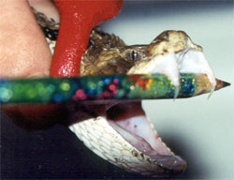
Timber Rattlesnake
Timber rattlesnake venom is a complex mix of naturally occurring toxins.
This neurotoxin is a mixture of enzymes, metal-ions, and various polypeptides.
As systemic toxicity occurs and the venom spreads in the circulatory systems, the
victims can often taste a metallic
taste in the mouth due to the
metal-ions.

Slide 65
Timber Rattlesnake
Signs and Symptoms
Burning sensation and swelling at the site of the bite
Breathing and swallowing can become difficult
The venom causes myotoxicity and the interaction with calcium binding sites causes improper muscle contractions; these spread throughout the body, this is muscular neurotoxicity.
Finally, hematotoxicity occurs, thrombin is unable to form and coagulation is prevented, causing hemorrhaging.
Hemorrhaging is usually located gastrointestinally and intracranially.

Slide 66
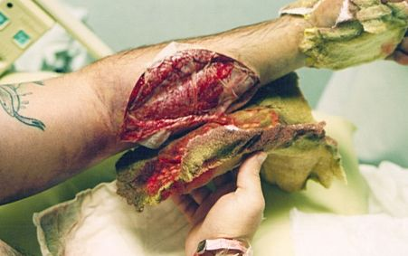
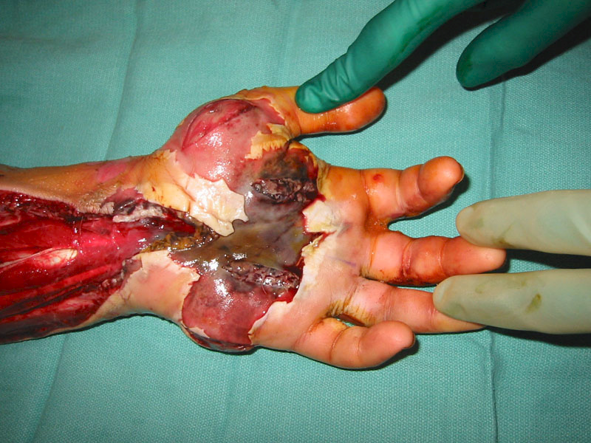
Timber Rattlesnake

Slide 67
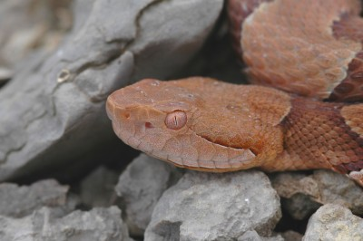
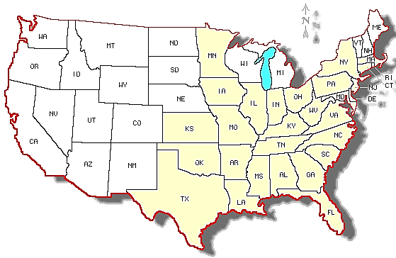
Copperhead

Slide 68
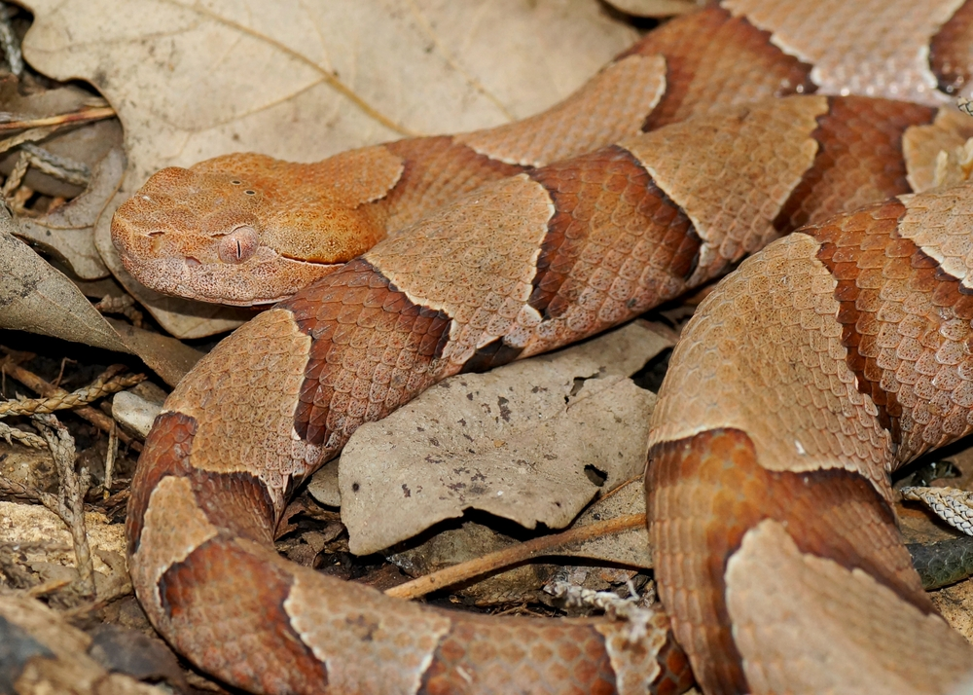
Copperhead
Copperhead snakes are some of the more commonly seen North American snakes.
Copperheads bite more people in most years than any other U.S. species of snake
Their venom is relatively mild,
and their bites are rarely fatal
for humans.
These snakes get their name,
fittingly, from their copper-red
heads

Slide 69
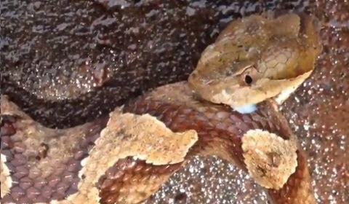
Copperhead
Copperheads have hemotoxic venom
Bite often results in temporary tissue damage in the immediate area of bite.
Their bite may be painful but is "very rarely (almost never) fatal to humans."

Slide 70

Copperhead
Children, the elderly and people with compromised immune systems may have strong reactions to the venom.
Anyone who is bitten by a copperhead should seek medical attention.

Slide 71


Copperhead

Slide 72
Brown Recluse Spider

Slide 73


Brown Recluse

Slide 74

Brown Recluse
They often live in dark sheltered areas, such as piles of wood, leaves, or rocks.
They may also live inside people’s homes or under their porches.
Sometimes a brown recluse will
even hide in shoes or under
clothes that have been lying on
the floor for a long time.

Slide 75

Brown Recluse
Brown recluse spider or violin spider, is a small-sized arachnid of approximately 1/4" - 1/2" long.
Its body shows a peculiar cephalothorax with a dark brown violin-shaped spot; the legs are
light brown and the oval-shaped
abdomen is dark brown, yellow, or
greenish yellow.
The most important characteristic is
the presence of 3 pairs of eyes in the
cephalothorax.

Slide 76
Brown Recluse
Brown recluse spiders don’t generally bite people.
They’re not aggressive spiders and will typically only bite if they feel trapped or threatened.
You usually don’t feel a brown recluse spider’s bite.
    In fact, you might not even realize that you’ve been bitten if you don’t actually see the spider biting you.
Symptoms usually don’t develop for several hours.

Slide 77
Brown Recluse
Brown recluse spider bites are characterized by a unique pattern of discoloration that often develops around the bite.
The site of the bite may turn a deep purple or blue color and be surrounded by a whitish ring and a larger red area.
There may also be a dark blister or ulcer by the bite. In some cases, the ulcer caused by the bite can persist and grow for weeks.

Slide 78
Brown Recluse
Additional symptoms you may develop include:
fever
nausea
intense itching at site of the bite
rash
chills
general discomfort
sweating

Slide 79



Brown Recluse

Slide 80
Anaphylaxis Awareness
Bees, Peanuts, and Pollen…….Oh My!

Slide 81

Skin Contact
Poison Plant
Latex
Injection
Bee Stings
Ingestion
Nuts & Shellfish
Medication
Inhalation
Pollen
Dust
Mold & Mildew
Animal Dander
Foods
Insect Stings
Medications
Plants
Food allergy is the leading cause of serious allergic reaction (anaphylaxis) outside the hospital setting

Slide 82
Food Allergy Facts
Eight foods account for 90% of all reactions
    Peanuts
    Tree nuts (walnut, cashew, pecan, etc.)
    Shellfish
    Fish
    Milk
    Wheat
    Soy
  Children often outgrow allergies to eggs, milk, and soy
  Allergies to peanuts, tree nuts, fish, and shellfish most
  often continue into adulthood.

Slide 83
Symptoms of Allergic or Anaphylactic Reaction
Common sites for allergic reactions
Mouth - swelling of the lips, tongue, itching lips
Airways - noisy breathing or respiratory distress
Digestive tract - stomach cramps, vomiting, diarrhea
Skin - hives, rashes, or eczema
Skin: Hives, swelling, itchy red rash
Belly: Cramps, nausea, vomiting, diarrhea, gas
Respiratory: Itchy, watery eyes; runny nose; stuffy nose; sneezing; cough; itching or swelling of lips, tongue or throat; changes in voice; difficulty swallowing; tightness in chest; wheezing; shortness of breath; repetitive throat clearing.
Cardiovascular: reduced blood pressure, increased heart rate, shock, pale and sweaty.

Slide 84
Allergic vs. Anaphylactic Reactions
Allergic Reactions
Itchy rash
Runny Nose, sneezing
Itchy, Red, watery eyes
Local reaction to sting
Anaphylactic Reactions
Hives
Swelling - face, lips, tongue, throat,
upper airway
Difficulty breathing
Chest tightness
Vomiting, diarrhea, cramping
Difficulty swallowing (voice changes)
Weakness, paleness, sweating

Slide 85
Epinephrine Auto-Injector
Epinephrine
  A hormone produced by the body.
Auto-Injector
  Spring-loaded needle and syringe with a single dose of epinephrine
  Automatically releases and injects the medication through the skin when the device is pressed firmly against the body

Slide 86

EpiPen®

Slide 87
How does the EpiPen® help?
EpiPen® = Epinephrine Medication
Quickly constricts blood vessels
Relaxes smooth muscles in the lungs to improve breathing.
Works to reverse hives and swelling around the face and lips.
Wears off in 10-20 minutes, sometimes requires a second dose.

Slide 88

How to use the EpiPen®
Assist the patient to a lying position
Remove the EpiPen® Auto-injector from
its carrier tube.
Hold firmly in your hand with the orange
tip pointing downward
Remove the blue safety release on the
top of the auto-injector.

Slide 89
How to use the EpiPen®
Hold the auto-injector at a 90° angle
Press orange tip firmly against patient’s thigh (outside of thigh, midway between waist and knee) until you hear a click.
  Hold the auto-injector in place for 10 seconds.
Remove the auto-injector from the thigh
  When removed the orange needle cover automatically extends to cover to injection needle

Slide 90
How to use the EpiPen®
Rub the injection site to increase the absorption of the epinephrine.
Record the time that the EpiPen® was given, and give EMS the used EpiPen®

Slide 91
Poisonous Plants

Slide 92

Wild Parsnip
The non-native Wild Parsnip is a
common plant that occurs in every
county of Illinois
It is relatively more common in
central and northern Illinois than
southern Illinois.
Habitats include black soil prairies,
savannas, pastures and fields,
weedy meadows, areas along
railroads and roadsides, vacant
lots, and waste areas.

Slide 93
Wild Parsnip
Sap contains photosensitizing
toxins that cause a skin reaction
when it comes into contact with light.
This light sensitive reaction takes
place within 48 hours causing nasty
painful blisters that can result in
scars lasting months to years.
Touching the sap can cause
long-term sunlight sensitivity as well
as blindness if it comes into contact
with ones eyes.

Slide 94

Wild Parsnip

Slide 95

Wild Parsnip
What to do if you accidentally touch it
Immediately wash the area with COLD water, toxic reaction occurs in as little as 15 minutes.
If you're out and you've flushed the area, apply sunscreen to it to prevent further reactions with the sun.
If eyes exposed, flush the eye or eyes with cool water and put on sunglasses, seek emergency treatment.

Slide 96
Water and Poison Hemlock
The invasive Poison Hemlock is a common plant that occurs in many areas of Illinois, except for scattered counties in north and south. This plant is undoubtedly more common than official records indicate and it is still spreading to new areas of the state.
The native Water Hemlock has been observed in nearly all counties of Illinois.

Slide 97
Water and Poison Hemlock
Hemlock poisoning may refer to poisoning by either poison hemlock or plants in the water hemlock family
Hemlocks are among the few plants that can cause life-threatening toxicity.
In both species, the root contains the greatest concentration of toxin: just a small piece can be fatal.

Slide 98
Water and Poison Hemlock
These wildflowers have been dubbed "the most violently toxic plant that grows in North America" by the USDA.
True to its killer reputation, hemlock can strike you dead within 30 minutes of ingestion.
The poison cicutoxin wastes no time in attacking the central nervous system, causing severe seizures and convulsions that turn deadly as a result of asphyxia and cardiovascular collapse.

Slide 99

Water and Poison Hemlock

Slide 100


Water and Poison Hemlock

Slide 101
Poisonous Garden Plants

Slide 102


Poisonous Plants
Common Toxic Garden Plants
Daffodils
Can cause high blood pressure, tremors, and irregular heartbeat. In some cases, ingestion of the bulbs can even be fatal.
Rhododendron
Swallow this plant, and you're drooling from the
mouth and teary-eyed, you'll begin vomiting
violently, just as your pulse slows down and
low blood pressure sets in.
Death can occur shortly after falling into a coma or during a violent seizure.

Slide 103

Poisonous Plants
Common Toxic Garden Plants
Lily-of-the-Valley
They make for an attractive flower
arrangement, but even the water you
place cut lily-of-the-valley flowers in contains deadly traces of convallatoxin, which intensifies the heart's contractions.
Just a bite causes headaches, hot flashes, hallucinations, and irritability, not to mention red blotches on cold, clammy skin.
The heart will also slow down, potentially leading to coma and death.

Slide 104

Poisonous Plants
Common Toxic Garden Plants
Hydrangea
Swallowing hydrangea is like popping a cyanide pill.
The present poison, hydragin, is a
cyanogenic glycoside, meaning it will cause shortness of breath, dizziness, fainting, and a rapid pulse, along with a drop in blood pressure that can cause convulsions and death.

Slide 105

Poisonous Plants
Common Toxic Garden Plants
Poet's Narcissus
If the scent of a narcissus bouquet in a closed room is strong enough to cause a headache, just imagine what eating an entire bulb might do.
Think severe nausea, convulsions, fainting, paralysis and eventual death.
Watch any open wounds you may have while tending to them—coming into contact with their bulb secretions has produced staggering, numbness, and heart paralysis.

Slide 106

Poisonous Plants
Common Toxic Garden Plants
Foxglove
The same thing that makes these lookers toxic to deer won't sit well with your digestive tract.
Twenty minutes after a little nibbling, nausea, vomiting, and diarrhea set in.
Depending on the amount ingested, untreated poisoning leads to death by bradycardia (lowered heart rate) or ventricular fibrillation (a rapid, irregular rhythm in the lower heart chambers).
Keep in mind, however, that children have died just from sucking on a part of the plant.
Notes:
is the major source of digoxin in the US. Foxglove is most commonly used for heart failure and fluid build up in the body (congestive heart failure or CHF) and irregular heartbeat (atrial fibrillation).

Slide 107

Poisonous Plants
Common Toxic Garden Plants
Oleander
A single leaf contains enough toxins to be
lethal to an infant or small child.
All parts — leaves, flowers, stems, twigs, roots — are toxic, and oleander poisoning can affect the heart, nervous system, stomach and intestines,
Symptoms of poisoning include serious heart rhythm disorders along with nausea and vomiting, cramping and bloody diarrhea. It also causes confusion, dizziness, weakness, drowsiness and visual disturbances,
Notes:
Its poisonous ingredients are two potent cardiac glycosides, oleandrin and nerine
Cut stems exude a sticky latex that can irritate the skin, so wear gloves when you handle it. Don't burn oleander prunings, as the smoke can cause severe irritation. Don't use branches for fires, or as skewers for food. If oleander is ingested, seek treatment immediately.

Slide 108

Questions?
Patrick Kell
Patrick.d.kell@osfhealthcare.org

