Slide 1
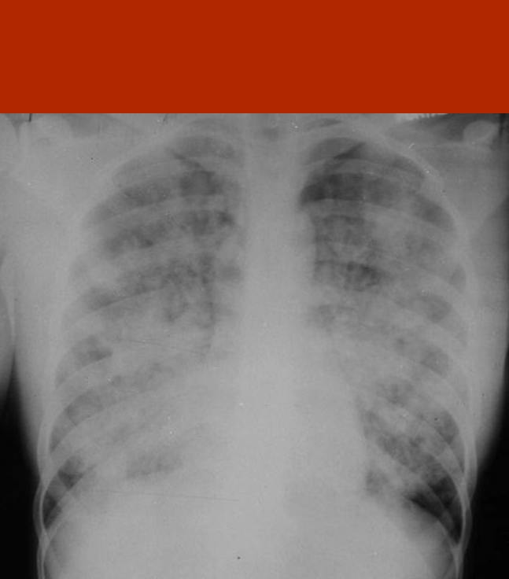
CARE OF THE VENTILATED PATIENT IN A CRITICAL ACCESS HOSPITAL
BRANDON B. BLEESS, MD, EMT-T, FACEP, FAAEM, FAEMS
ROBERT M. JONES, RN, CFRN
@BBBleess

Slide 2
PLEASE SHARE!
#FOAMed
#FOAMems
#FOANed
#FOAMpara

Slide 3
DISCLOSURES
Nothing to disclosure
Opinions expressed are my own
Follow local protocols

Slide 4
OBJECTIVES
Discuss Basic Airway Management and Ventilator Settings
Discuss Common Ventilator Alarms
Understand Basic ABG Interpretation and Interventions
Discuss Proning and Patient Care
Discuss Basic Sedation Pharmacology and Dosage

Slide 5
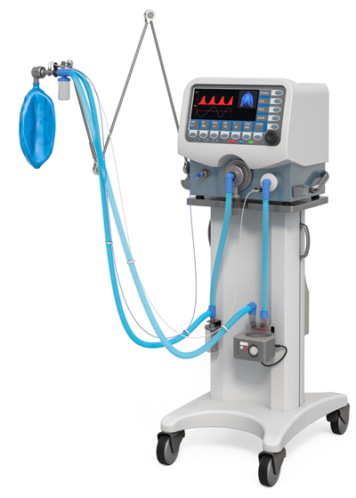
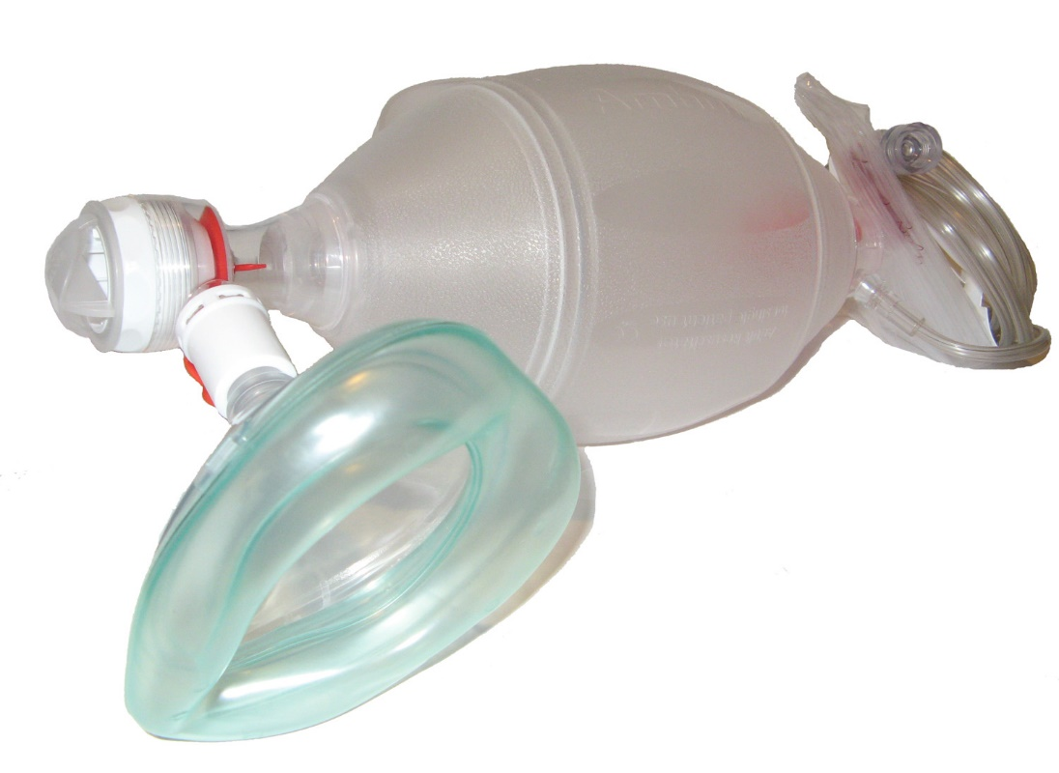
AIRWAY MANAGEMENT AND VENTILATOR SETTINGS

Slide 6
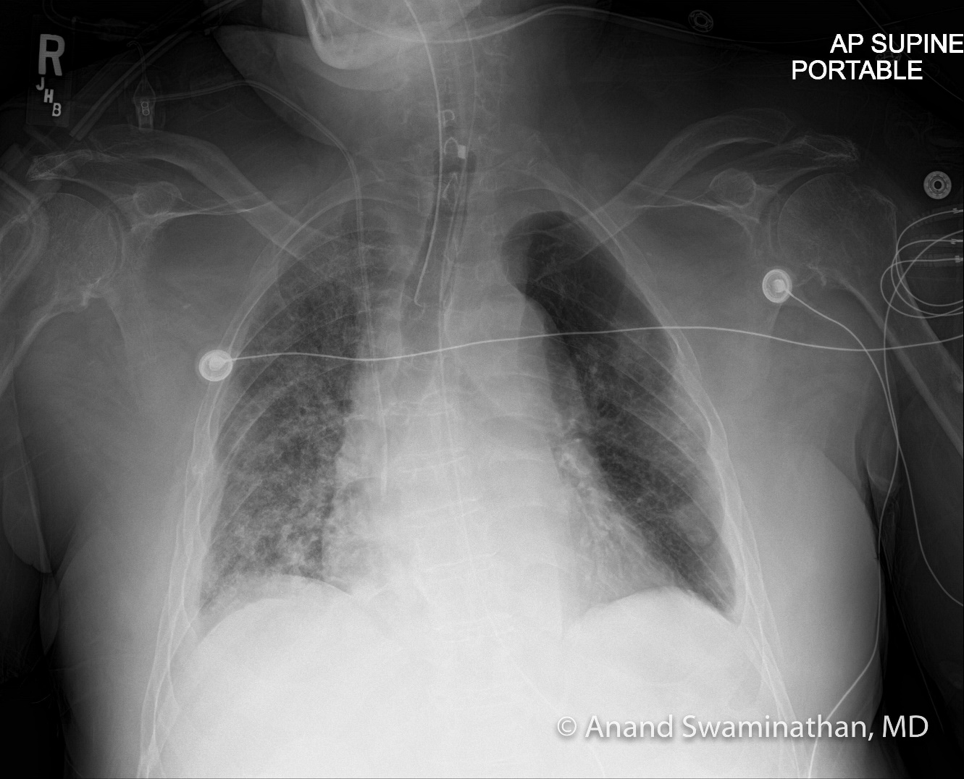
CASE PRESENTATION
58 year-old male presented to the ED with acute respiratory failure requiring intubation
Thoughts?

Slide 7
BVM ISSUES
Recent study looking at the use of adult and pediatric BVM with mask ventilation, supraglottic airway, and ETT tidal volumes with bagging.
Bagging with an OPA and mask ventilation, median tidal volumes of 796 mL (705–871) and 570.5 mL (542–637) for adult and pediatric BVM.
Supraglottic airway demonstrated median tidal volumes of 994.5 mL (880–1148) and 664 mL(647–714) for adult and pediatric BVM.
ETT, 981.5 (901–1085) and 663 (615–696).

Slide 8
BVM ISSUES
Majority of the ventilations recorded were excessive volume for the weight (70 kg of predicted body weight).
A statistically greater percentage of breaths fell in the appropriate volume range when the Peds BVM was used.

Slide 9
BVM ISSUES
Repeat investigation with six different scenarios: three different grips (using the thumb and either three fingers, two fingers, or one finger) with two different sized BVMs (adult and pediatric).
Median volumes of 836.0mL, 834.5mL, 794mL for the adult BMV (p = 0.003).
Median volumes of 576.0mL, 571.5mL, 547.0mL for the pediatric BVM (p < 0.001).
Across all three grips, the pediatric BVM provided more breaths within the recommended volume range for a 70kg patient (46.4% vs 0.4%; p < 0.001) with only a 1.1% of breaths below the recommended tidal volume.
Possible to alter the volume provided by BVM by altering grip on the BVM and the pediatric BVM is more consistent with lung-protective ventilation volumes.

Slide 10
BVM TECHNIQUE

Slide 11
DEFINITIONS
Tidal Volume (Vt): The amount of volume delivered with each breath (mL).
Respiratory Rate (RR): Number of breaths per minute (artificial or naturally occurring).
Inspiratory : Expiratory Ratio (I:E Ratio): The ratio of the inspiratory time (I-Time) to expiratory time (E-Time).
Fraction of Inspired Oxygen (FiO₂): Percentage of oxygen delivered through the ventilator (21%-100%).
Pressure Support (PS): The pressure used to augment a spontaneous breath of the patient to assist the work of breathing.

Slide 12
DEFINITIONS
Ventilator Associated Lung Injury (VALI): How a ventilator can propagate injury in already damaged lungs, or initiate injury in at-risk lungs.
Lung-Protective Ventilation: Ventilator Settings used to reduce the mechanical power applied to the lungs.
Acute Respiratory Distress Syndrome (ARDS): Wide spread inflammation causing diffuse injury to cells which form the alveolar barrier, surfactant dysfunction, activation of the innate immune response, and abnormal coagulation resulting in impaired gas exchange.
Positive End Expiratory Pressure (PEEP): Amount of pressure in the lungs (alveolar pressure) above atmospheric pressure at the end of expiration.
Predicted Ideal Body Weight (PBW): The ideal weight for a given sex based on height.

Slide 13
VENTILATOR SETTINGS
OXYGENATION
FiO₂
PEEP
VENTILATION
Respiratory Rate
Tidal Volume (Vt)
FiO₂
PEEP
RR
Vt

Slide 14
VOLUME CONTROL
Set tidal volume
With set tidal volume and respiratory rate, there is a known minute ventilation
Since the tidal volume is fixed, if lung compliance is decreased, could result in high peak pressures

Slide 15
PRESSURE CONTROL
Set pressure in order to achieve a desired tidal volume
Pressure-Controlled tidal volume and set rate can determine minute ventilation
Tidal volume can change with lung compliance or airway resistance

Slide 16
ASSIST/CONTROL (A/C)
Minimum number of mandatory breaths are delivered by the ventilator but the patient also triggers assisted breaths
If the patient makes an effort to breathe, the ventilator assists in delivering the breath with full volume/pressure
Does not allow the patient to take spontaneous breaths
Sensitivity can be adjusted to make it easier or harder for the patient to initiate a breath

Slide 17
ASSIST/CONTROL (A/C)
Most often used when mechanical ventilation is first initiated because this mode provides full support
Advantage of Assist/Control is to keep patient’s work of breathing requirement low
Complication of Assist/Control is possible hyperventilation, resulting in respiratory alkalosis--too many breaths given, whether patient or machine-triggered

Slide 18
SYNCHORNOUS INTERMITENT MANDORY VENTILATION (SIMV)
Ventilator delivers a preset minimum number of mandatory breaths but allows patient to initiate spontaneous breaths in between the mandatory breaths
Allows the operator to set either a controlled pressure or a controlled volume
SIMV is ideal when a patient needs partial ventilatory support since the patient can takes spontaneous breaths--contributing to their minute ventilation

Slide 19
SYNCHORNOUS INTERMITENT MANDORY VENTILATION (SIMV)
Patient is able to take spontaneous breaths, helping to maintain their respiratory muscle strength and avoid muscular atrophy
Distributes tidal volumes evenly throughout the lung fields, which reduces V/Q mismatching
Helps to decrease the mean airway pressure

Slide 20
PRESSURE REGULATED VOLUME CONTROL (PRVC)
Ventilator adjusts the pressure based on airway resistance and lung compliance for a targeted tidal volume
Monitors each breath for Vt and adjusts the next breath based on feedback

Slide 21
PRESSURE REGULATED VOLUME CONTROL (PRVC)

Slide 22
LUNG PROTECTIVE VENTILATION
Lung-Protective Ventilation aims to mitigate VALI by reducing the mechanical power applied to the lungs.
Lung-protective ventilation with low tidal volume and effective PEEP has become standard of care in ARDS patients.

Slide 23
LUNG PROTECTIVE VENTILATION
Now evidence from critically ill patients in the ICU and operating room demonstrates that low tidal volume ventilation [6-8 mL/kg PBW] is associated with improved outcomes in mechanically ventilated patients without ARDS.
Although the data are not definitive, the current body of evidence suggests that using lung-protective ventilation strategies can mitigate VALI and prevent progression to ARDS.

Slide 24
LUNG PROTECTIVE VENTILATION
Low tidal volume ventilation initiated in the ED is more likely to be continued in the ICU.
It has also been demonstrated that the mechanical ventilation strategy started in the pre-hospital setting is often continued in the ED and in the ICU.
This “ventilator inertia” reinforces the importance of initiating lung protective ventilator strategies from the outset.
Low Compliance with lung protective ventilation strategies in the pre-hospital setting (13%) and ED (range 27.1%-55.7%).

Slide 25
LUNG PROTECTIVE VENTILATION
Other ventilator parameters are positive end-expiratory pressure (PEEP) and plateau pressure.
PEEP can be used to keep diseased alveoli open and limit physiologic shunting thus reducing hypoxemia.
Setting the PEEP to 5 cm H₂O and titrating PEEP and fraction of inspired oxygen (FiO2) combinations using a PEEP table is a simple way to maintain alveolar recruitment and limit derecruitment injury (i.e. atelectrauma).
Targeting oxygen saturations of 88% or greater can limit the dangers of hyperoxia as well.
Maintaining plateau pressures less than 30 cm H2O helps to limit alveolar stretch.

Slide 26
PREDICTED IDEAL BODY WEIGHT
Male PBW (kg) = 50 + 2.3 (height (in) – 60)
Ex: 6’0”Male
50+2.3 (72-60)=50+2.3(12)
50+27.6=77.6
Female PBW (kg) = 45.5 + 2.3 (height (in) – 60)
Ex: 5’5” Female
45.5+2.3 (65-60)=45.5+2.3(5)
45.5+11.5=57

Slide 27
MALE PBW and Vt

Slide 28
FEMALE PBW and Vt

Slide 29
VENTILATOR SETTINGS
Set ventilator settings to achieve initial Vt = 8 ml/kg PBW
Reduce Vt by 1 ml/kg at intervals ≤ 2 hours until VT = 6ml/kg PBW.
Set initial rate to approximate baseline minute ventilation (not > 35 bpm).
Adjust VT and RR to achieve pH and plateau pressure goals

Slide 30
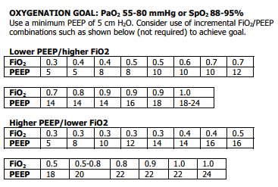
PEEP TABLE

Slide 31
PLATEAU PRESSURES
Goal: ≤ 30 cm H2O Check Pplat (0.5 second inspiratory pause)
If Pplat > 30 cm H2O: decrease Vt by 1ml/kg steps (minimum = 4 ml/kg).
If Pplat < 25 cm H2O and Vt< 6 ml/kg, increase Vt by 1 ml/kg until Pplat > 25 cm H2O or Vt = 6 ml/kg.
If Pplat < 30 and breath stacking or dys-synchrony occurs: may increase Vt in 1ml/kg increments to 7 or 8 ml/kg if Pplat remains < 30 cm H2O.

Slide 32
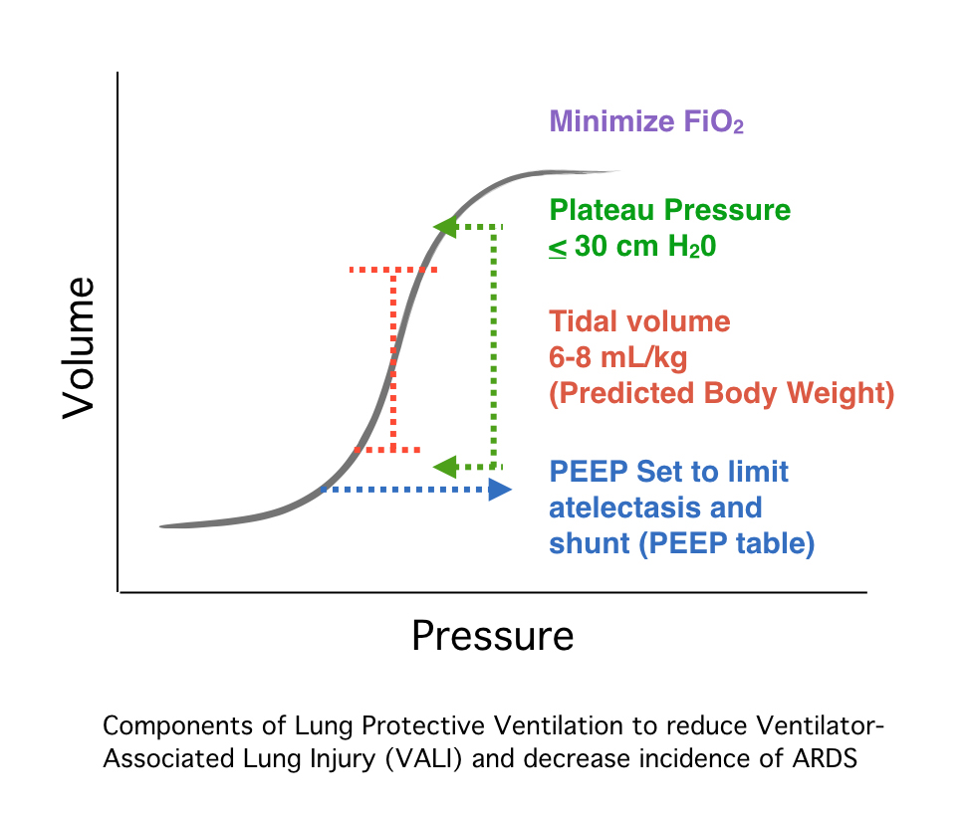
OVERALL PICTURE

Slide 33
VENTILATOR ALARMS

Slide 34
HIGH PRESSURE ALARM
Peak Inspiratory Pressure is greater than set point (40 cmH₂O)
Be mindful of going above 40 cmH₂O, but may be necessary in certain patients with obstructive pathology (COPD/Asthma)

Slide 35
LOW PRESSURE ALARM
Inform of any disconnections in the circuit
Informs of disruption of oxygen source
DOPE pneumonic (Disconnections/Displacements, Obstructions, Pneumothorax, Equipment Failure)

Slide 36
LOW MINUTE VENTILATION ALARM
Informs when the minute ventilation is below the set point of the alarm
In pressure control, Vt will change and thus possibly change your minute ventilation
Minute ventilation should be between approximately 4-8 L/min

Slide 37
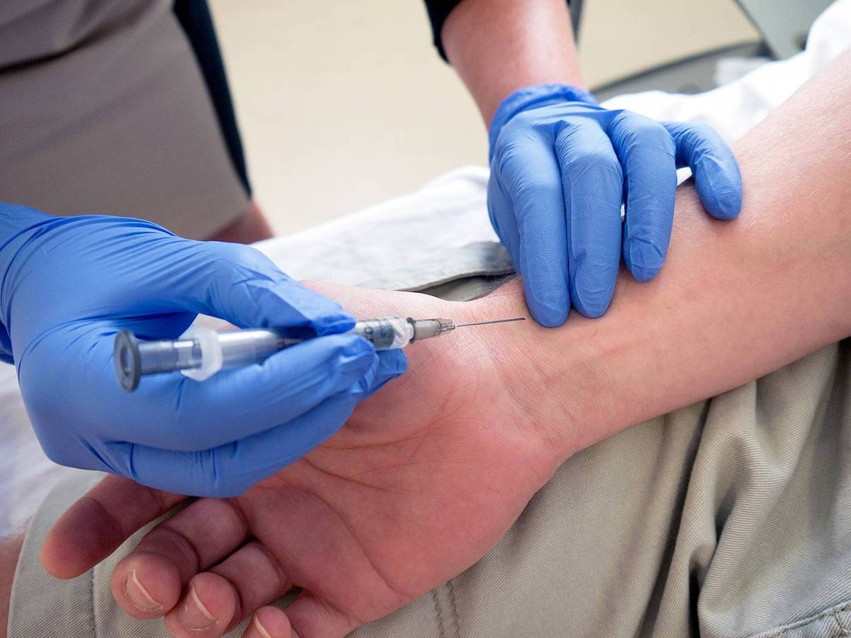
BLOOD GAS INTERPRETATION AND INTERVENTIONS

Slide 38
BLOOD GAS BASICS
Common providers are taught common facts/parameters:
EtCO₂ 35-45
pH 7.35-7.45
K₊ 3.5-5.5
Advanced providers recognize these parameters exist in normal human beings with undisturbed homeostasis.
We look to you to provide advanced care to complicated patients.

Slide 39
BLOOD GAS BASICS
Topics of study related to vent management:
Vent setting that effect Oxygenation are:
FIO₂ and PEEP
Vent setting that effect Ventilation are:
Respiratory Rate and Tidal Volume (minute volume)
PIP and Pplat pressures also need to be monitored, charted, and assessed.
We follow ARDS Net and other resources to help guide appropriate volumes
and PEEP/FIO₂ settings
This is not a rate of 12, Volume 500, PEEP of 5, FIO₂ 100% for all

Slide 40
BLOOD GAS BASICS
∆ CO₂ of 10 = ∆ pH of 0.08
(Opposite ↑↓)
Refer to Ventilator Management page 11
∆ pH of 0.1 = ∆ K⁺ of 0.6
(Opposite ↑↓)
EtCO₂ of 35-45 is normal for a normal patient only
PaCO₂ ≠ EtCO₂
Normal is 3-5 mm Hg ∆
VQ mismatch may vary greatly

Slide 41
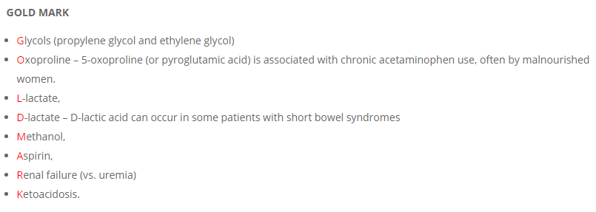
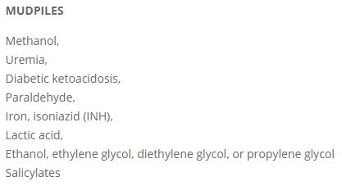
MUDPILES/GOLD MARK

Slide 42
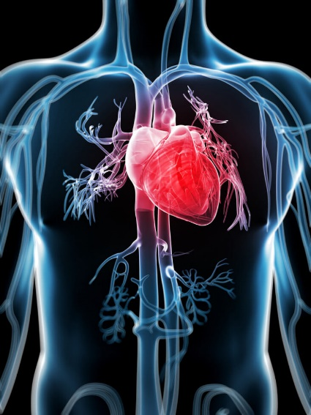
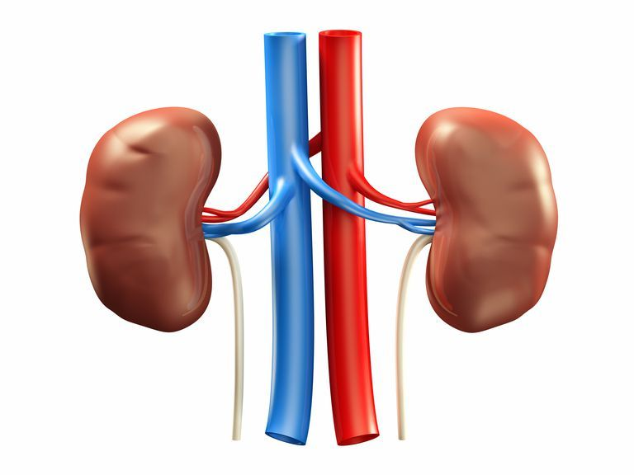
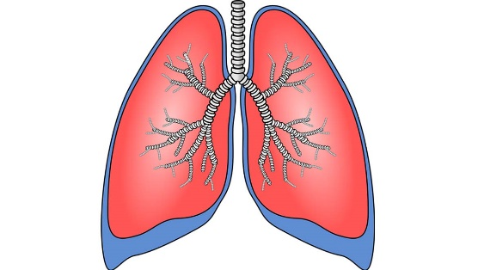
As blood flows through the pulmonary
vasculature, remaining CO₂ dissolves into H₂O,
which → H₂CO₃ (Acid)
Lungs breath off: H₂O, CO₂ (Acid)
GOAL is to have a pH of 7.4
40 mm Hg happens to be the number
that normally generates the Goal
But….it is NOT the GOAL
When H₂CO₃ reaches the renal system,
it dissociates into H⁺ and HCO₃ (Base)
GOAL is to have a pH of 7.4
Bicarb of 24 happens to be the number
that normally generates the Goal
But….it is NOT the GOAL

Slide 43
pH is out of balance…
CO₂
If another acid, other than CO₂, is creating the imbalance,
the lungs cannot breath off any other acid…
Gold Mark
Mudpiles

Slide 44
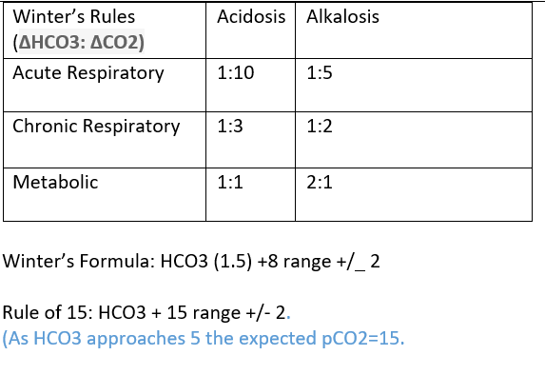
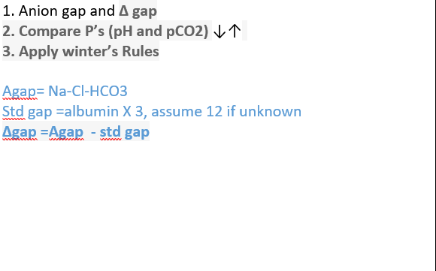
WINTER’S FORMULA

Slide 45
CASE STUDY
35 y/o female breathing 40 times a minute. Intubated in ED. She is breathing over the vent. When you apply EtCO₂ and it reads 18. You ask about labs and are provided with this set just prior to intubation.

Slide 46
CASE STUDY
Na 141-Cl 105-CO2 13= 23
Assume albumin is 4 and std gap is 3X the albumin = 12
23 – 12= 11

Slide 47
CASE STUDY
pH is 7.0 ↓ EtCO₂ is 18 ↓

Slide 48
CASE STUDY
Perfect HCO3 24, we have 13. We are short by 11
Perfect CO₂ 40, Metabolic acidosis for Winters says Change the CO₂ the same as the HCO3 changed. 1:1
So what CO₂ do we target ?

Slide 49
CASE STUDY
HCO3 24 – 13= 11 EtCO₂ 40 – 11= 29
HCO3 13(1.5) + 8 = 27.5
HCO3 + 15 = 28

Slide 50
Your partner who is hell bent on leaving in 5 minutes has the vent set to:
RR10
Tidal volume 500
PEEP 5
FIO₂ 100 %
He/she slaps it on the tube and says let’s go!
He/she set it en route, and put the vent on standby to get out quickly.
Been doing it for years, what is 20 minutes going to hurt?
Well Dr. Bleess has shown us studies that show that at least 2 other people most often follow the initial settings. In some hospitals it could be several days before someone recognizes the less than optimal settings.
What happens if we just titrate EtCO₂ to 40. Isn’t that the normal?
Our initial EtCO₂ was 18. If we raise it to 40 what will that do to our patient?
∆ EtCO₂ of 10 ↑ = ∆ pH by 0.08 ↓. We started at 7.0. ?

Slide 51
We just added 22 points of CO₂ (acid) to our pH of 7.0. Our new pH is 6.8
How does this effect vasodilation?
How does this effect the pressors we are using to maintain pressure?
How does this effect the oxyhemoglobin disassociation curve?
Does it effect our electrolytes?
Does our patient still have a pulse?

Slide 52
COMMUNICATION GAP
Doctors and Nurses aren’t speaking the same language
Respiratory compensation Vs Homeostasis
CO₂ vs HCO₃ (or molecules vs pressures)

Slide 53
PUTTING IT TOGETHER
Let’s say we understand enough that we did manage to correct our pH to 7.4
Did anyone catch that K⁺ ? We stated that for ∆ pH of 0.1 ↑ = ∆ K⁺ 0.6 ↓
We started at pH 7.0 ∆ to pH 7.4 our new K⁺ is 0.6.
Your patient now shows a wide complex tachycardia on the monitor. You grab for amiodarone per ACLS protocol when you suddenly lose consciousness because Pete slapped you in the head. But that is a whole other lecture, we can talk.

Slide 54
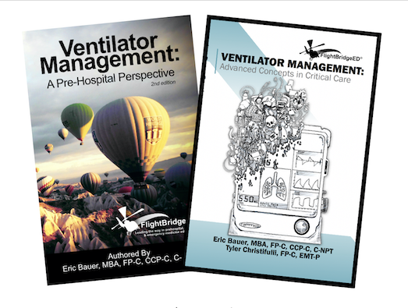

Slide 55
FlightBridgeED: https://flightbridgeed.com/index.php/fbe-bookstore MedCram: https://www.youtube.com/c/Medcram/search?query=acid%20base The Ventilator Book: https://www.amazon.com/Ventilator-Book-William-Owens-MD/dp/0985296542

Slide 56
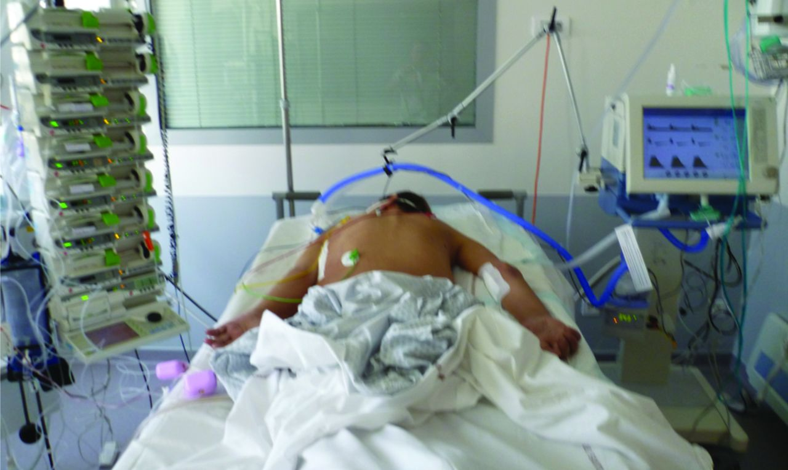
PRONING

Slide 57
PRONING
Supine compresses the lungs by gravity and other forces
Causes hyperinflation of alveoli in the ventral (upward) lung while causing alveolar collapse (atelectasis) in the dorsal lung (closest the bed)
Gravity pushes blood down toward the poorly oxygenated alveoli in the posterior lung—creates a ventilation/perfusion mismatch

Slide 58
PRONING
Better ventilation of the dorsal lung threatened by alveolar collapse
Improvement in ventilation/perfusion matching and potentially an improvement in mortality.
This result in a more even distribution of ventilator volumes and pressures throughout the lung--thought to reduce the incidence and severity of ventilator-induced lung injury

Slide 59
CARDIAC ARREST IN PRONED PATIENT

Slide 60
CARDIAC ARREST IN PRONED PATIENT

Slide 61
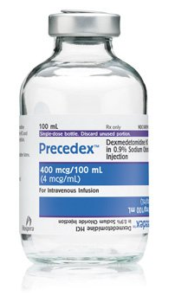
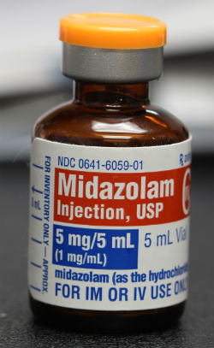
SEDATION MEDICATIONS

Slide 62
ETOMIDATE
Non-Barbiturate Hypnotic
Dose: 0.2-0.3 (max 0.6) mg/kg
Route: IV/IO
Onset: 1-2 minutes
Duration: Variable (100 seconds per 0.1 mg/kg)
Indications: Sedation for intubation or procedures and ongoing sedation in mechanically ventilated patients
Contraindications: Allergy to drug components, history of adrenal issues

Slide 63
FENTANYL
Narcotic Analgesic
Dose: 1-2 mcg/kg
Route: IV/IO
Onset: 1-3 minutes
Duration: 15-20 minutes
Indications: Blunting of circulatory response to intubation or suspected known increased ICP or cardiovascular disease. Continuous pain management for intubated patients
Contraindications: Allergy to drug components; caution with documented history of rigid chest syndrome

Slide 64
MIDAZOLAM (VERSED)
Benzodiazepine
Dose: 1-5 mg/kg
Route: IV/IO
Onset: 3-5 minutes
Duration: Variable (short acting)
Indications: Sedation for anxiety and ongoing sedation in mechanically ventilated patients
Contraindications: Allergy to drug components and hypotension

Slide 65
KETAMINE
Non-Barbituate Anesthetic
Dose: 1-2 mg/kg IV—RSI Induction
4 mg/kg IV or IM—Excited Delirium
0.1-0.25 mg/kg IV—Pain Management
05.-1 mg/kg IV—Sedation
Route: IV/IO
Onset: Variable
Duration: Variable
Indications: Sedation for Induction with Severe Bronchospasm, analgesia, ongoing sedation, excited delirium
Contraindications: Allergy to drug components, hypertension

Slide 66
PROPOFOL
Non-Barbiturate Anesthetic
Dose: 1-2.5 mg/kg bolus for induction and 5-75 mcg/kg infusion
Route: IV/IO
Onset: 1-2 minutes
Duration: Variable (Approximately 10 minutes for bolus)
Indications: Sedation for intubation or procedures and ongoing sedation in mechanically ventilated patients (Several off label usages)
Contraindications: Allergy to drug components, hypotension (Possibly Egg or Soy)

Slide 67
DEXMEDETOMIDINE (PRECEDEX)
Alpha₂-Adrenergic Agonist
Dose: 0.2-1.5 mcg/kg/hour (Typical 0.2-0.7 mcg/kg/hour
Route: IV/IO
Onset: 5 minutes
Duration: Variable (Approximately 15minutes)
Indications: Sedation for intubation or procedures and ongoing sedation in mechanically ventilated patients
Contraindications: Allergy to drug components, hypotension/bradycardia

Slide 68
QUESTIONS?
Brandon.B.Bleess@osfhealthcare.org
Robert.M.Jones@osfhealthcare.org
@BBBleess

Slide 69
REFERENCES
Gervais HW, Eberle B, Konietzke D, Hennes HJ, Dick W, “Comparison of blood gases of ventilated patients during transport”. Critical Care Medicine 1987;15:761-763.
Weiss, Steven J., et al. "Automatic Transport Ventilator Versus Bag Valve In The EMS Setting: A Prospective, Randomized Trial." Southern Medical Journal 98.10 (2005): 970-976.
Slutsky AS, Ranieri VM. Ventilator-induced lung injury. N Engl J Med. 2013 Nov 28;369(22):2126-36.
Gattinoni L, Tonetti T, Cressoni M, Cadringher P, Herrmann P, Moerer O, Protti A, Gotti M, Chiurazzi C, Carlesso E, Chiumello D, Quintel M. Ventilator-related causes of lung injury: the mechanical power. Intensive Care Med. 2016 Oct;42(10):1567-75.
The Acute Respiratory Distress Syndrome Network: Ventilation with lower tidal volumes as compared with traditional tidal volumes for acute lung injury and the acute respiratory distress syndrome. N Engl J Med 2000, 342:1301-1308.
Putensen C, Theuerkauf N, Zinserling J, Wrigge H, Pelosi P. Meta-analysis: ventilation strategies and outcomes of the acute respiratory distress syndrome and acute lung injury. Ann Intern Med. 2009;151:566–76.

Slide 70
REFERENCES
Determann RM, Royakkers A, Wolthuis EK, Vlaar AP, Choi G, Paulus F, et al. Ventilation with lower tidal volumes as compared with conventional tidal volumes for patients without acute lung injury: a preventive randomized controlled trial. Crit Care 2010;14:R1.
Mascia L, Pasero D, Slutsky AS, Arguis MJ, Berardino M, Grasso S, Munari M, Boifava S, Cornara G, Della Corte F, Vivaldi N, Malacarne P, Del Gaudio P, Livigni S, Zavala E, Filippini C, Martin EL, Donadio PP, Mastromauro I, Ranieri VM. Effect of a lung protective strategy for organ donors on eligibility and availability of lungs for transplantation: a randomized controlled trial. JAMA. 2010 Dec 15;304(23):2620-7.
Futier E, Constantin JM, Paugam-Burtz C, Pascal J, Eurin M, Neuschwander A, et al. A trial of intraoperative low-tidal-volume ventilation in abdominal surgery. N Engl J Med 2013;369:428–37.
Serpa Neto A, Cardoso SO, Manetta JA, et al. Association between use of lung- protective ventilation with lower tidal volumes and clinical outcomes among patients without acute respiratory dis- tress syndrome: a meta-analysis. JAMA. 2012;308(16):1651-1659.

Slide 71
REFERENCES
Serpa Neto A, Simonis FD, Barbas CS,et al. Association between tidal volume size, duration of ventilation, and sedation needs in patients without acute respi- ratory distress syndrome: an individual patient data meta-analysis. Intensive Care Med. 2014;40(7):950-970.
Siegler J, Kroll M, Wojcik S, Moy HP. Can EMS Providers Provide Appropriate Tidal Volumes in a Simulated Adult-sized Patient with a Pediatric-sized Bag-Valve-Mask? Prehosp Emerg Care. 2017 Jan-Feb;21(1):74-78.
Kroll M, Das J, Siegler J. “Can grip technique and bag size improve volume delivered with a bag-valve-mask by EMS providers?” in Abstracts for the 2018 NAEMSP Scientific Assembly. Prehosp Emerg Care. 2017 Oct 5:1-50.
Ives-Tallman Crystal, Guest Britt. Novel Coronavirus 2019 (COVID-19). In: Mattu A and Swadron S, ed. CorePendium. Burbank, CA: CorePendium, LLC. https://www.emrap.org/corependium/chapter/rec906m1mD6SRH9np/Novel-Coronavirus-2019-COVID-19. Updated January 29, 2021. Accessed February 9, 2021.

Slide 72
REFERENCES
Caputo N, Strayer R, Levitan R. Early Self-Proning in Awake, Non-intubated Patients in the Emergency Department: A Single ED’s Experience during the COVID-19 Pandemic. Acad Emerg Med. April 2020. [doi:10.1111/acem.13994]
Elharrar X, Trigui Y, Dols A-M, et al. Use of Prone Positioning in Nonintubated Patients With COVID-19 and Hypoxemic Acute Respiratory Failure. JAMA Published online May 15, 2020. [doi:10.1001/jama.2020.8255]
Sartini C, Tresoldi M, Scarpellini P, et al. Respiratory Parameters in Patients With COVID-19 After Using Noninvasive Ventilation in the Prone Position Outside the Intensive Care Unit. JAMA. Published online May 15, 2020. [doi:10.1001/jama.2020.7861]
Caputo N, Strayer R, Levitan R. Early Self-Proning in Awake, Non-intubated Patients in the Emergency Department: A Single ED’s Experience during the COVID-19 Pandemic. Acad Emerg Med. April 2020. [doi:10.1111/acem.13994]

Slide 73
REFERENCES

